Slide 1

Quoting - Vendavo | Docusign
January 2022

Slide 2

Quote to Order
Quote is configured in CPQ
Download the proposal to a word doc. selecting the correct proposal template (see slide 3 for template descriptions)
Save to your desktop and rename the file using the correct file naming convention
  Perennial – Customer Name – Quote ID – Date
Sales rep to login to their specific instance of Docusign, send new envelope and upload the file
Add the recipients for execution (Stage 1: Customer; Stage 2 Alison; Stage 3 Legal signedcontracts@evercommerce.com; Stage 4 Aaron Sandager
Once executed save the document to our desktop
Upload the doc to the opportunity record.
Close out the opportunity
Step by Step Process Outlined in this Document
2
Confidential | Internal Use Only

Slide 3
Proposal Templates
Bold CPQ Template Financial Add-on Modules.docx | Use for all expansion revenue opps for existing SedonaOffice and AlarmBiller customers
Bold CPQ Template SedonaOffice.docx | Use for only Net New SedonaOffice On-Prem Contracts
Bold CPQ Template SedonaOffice Cloud.docx | Use for only Net New SedonaOffice Cloud Services (SedonaOffice Hosted) Contracts
Bold CPQ Template AlarmBiller.docx | Use for only Net New AlarmBiller Contracts
3
Confidential | Internal Use Only

Slide 4
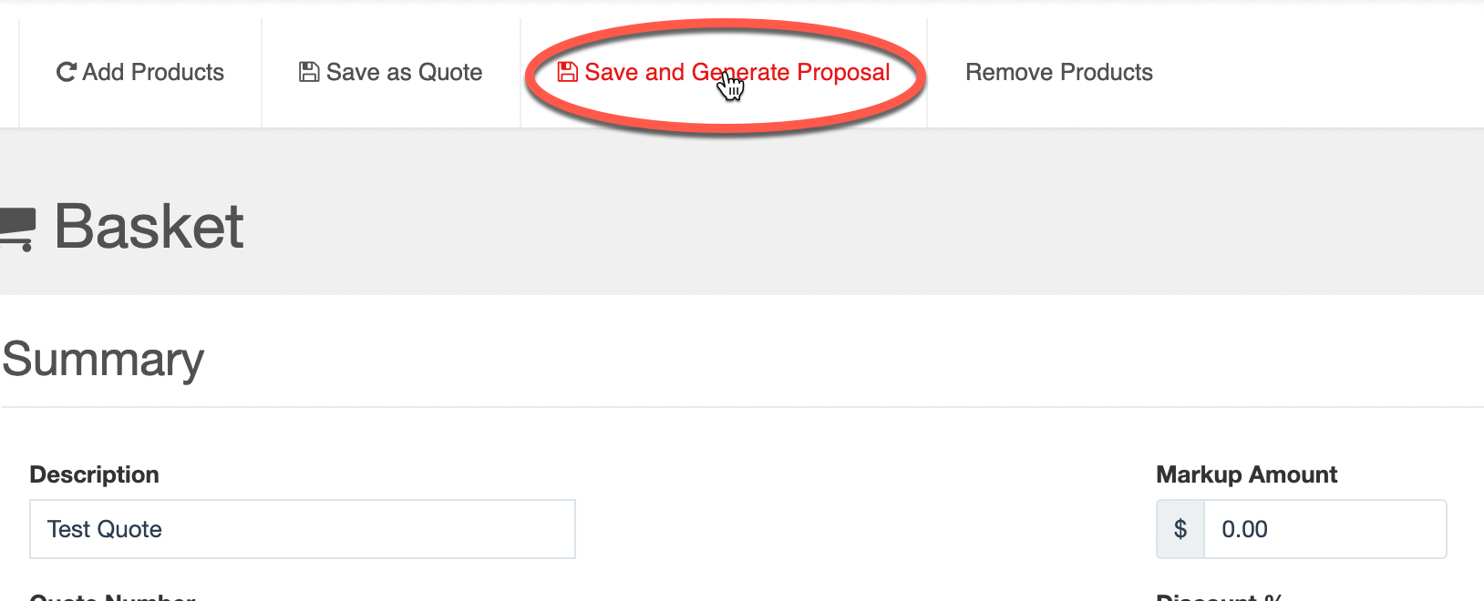
Quote Configured in CPQ
1. Configure the quote in CPQ and select Save and Generate Proposal
4
Confidential | Internal Use Only

Slide 5
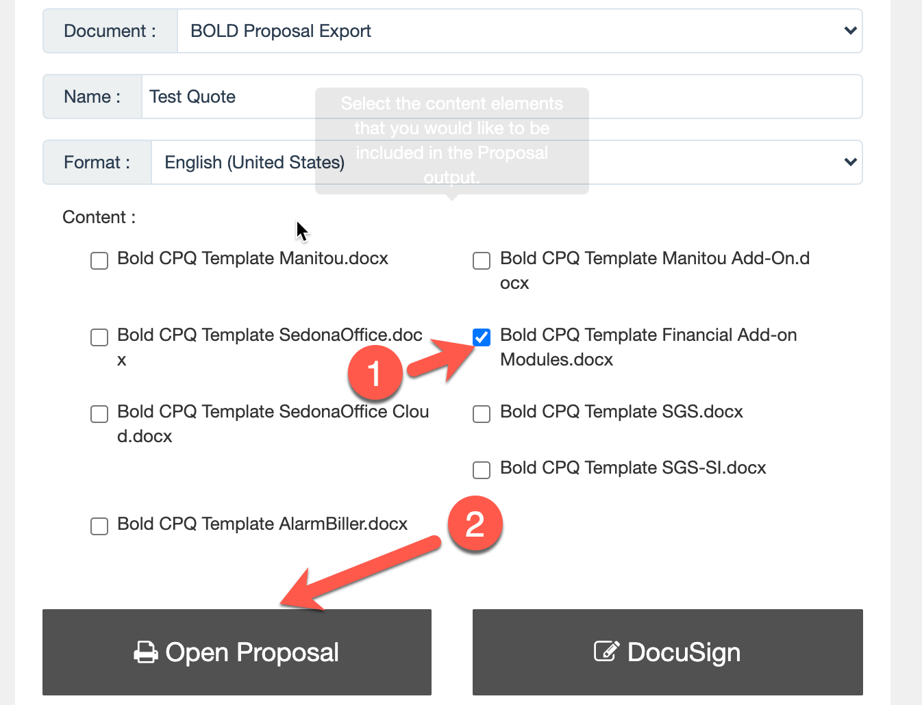
Quote Configured in CPQ
Select the correct proposal template and select Open Proposal
5
Confidential | Internal Use Only

Slide 6
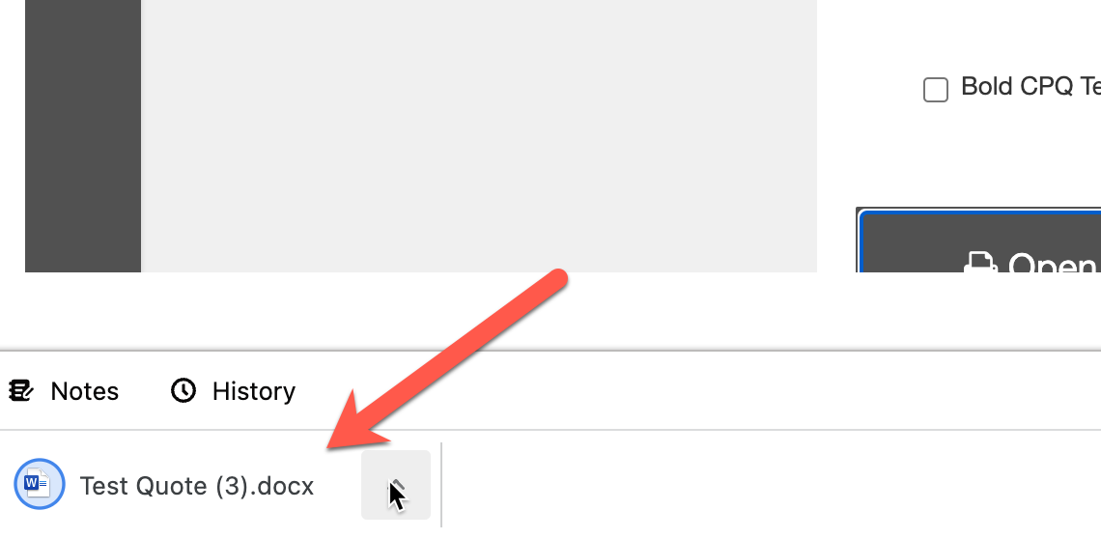
Quote Configured in CPQ
A word document of the configured quote is created; save to your desktop and rename the document using the naming convention on the new page
6
Confidential | Internal Use Only

Slide 7
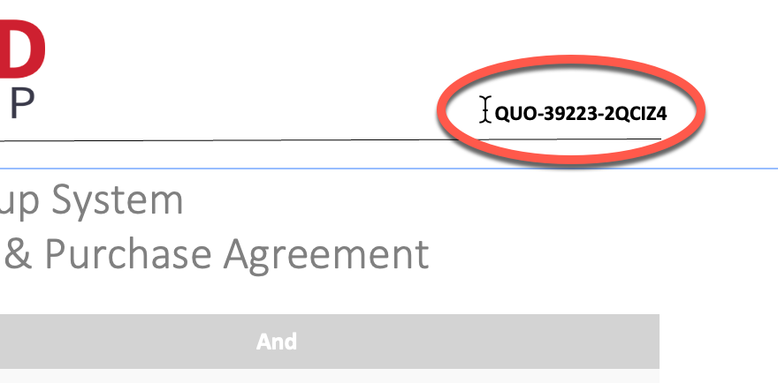
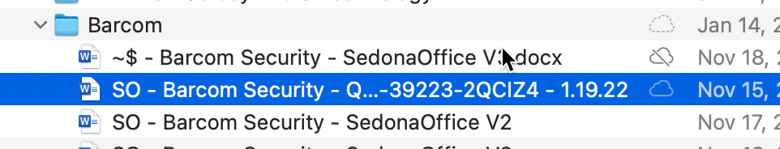
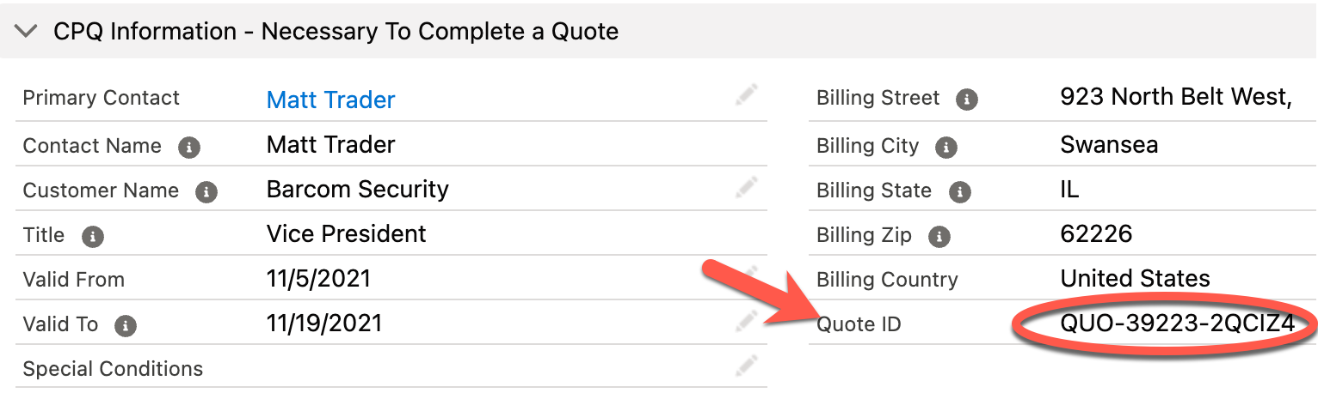
Contract Naming Convention
Naming Convention: Perennial – Customer Name – Quote ID – Date
Key Note: Quote ID can be found on the top right corner of the contract and in the Opportunity record
7
Confidential | Internal Use Only

Slide 8
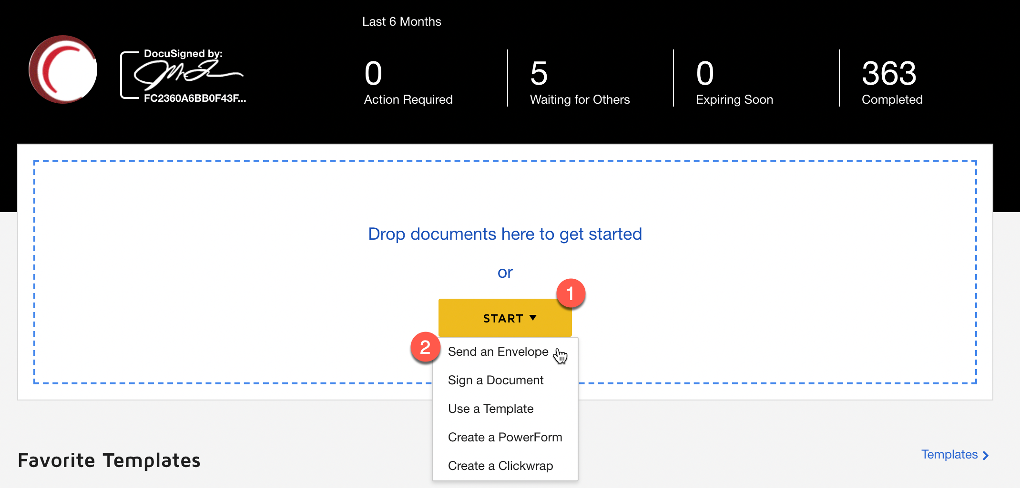
DocuSign
Login to your personal DocuSign account and select Send and Envelope or drag and drop the document from your desktop
8
Confidential | Internal Use Only

Slide 9
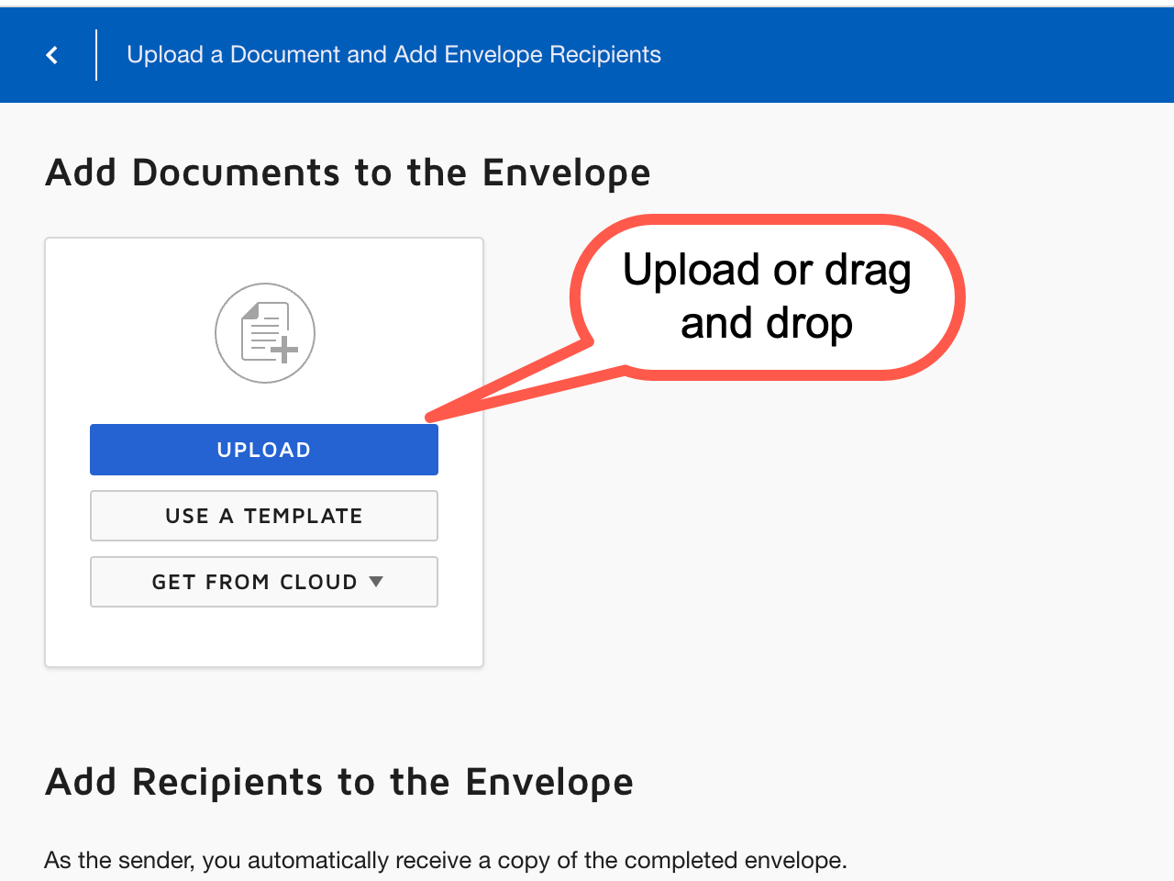
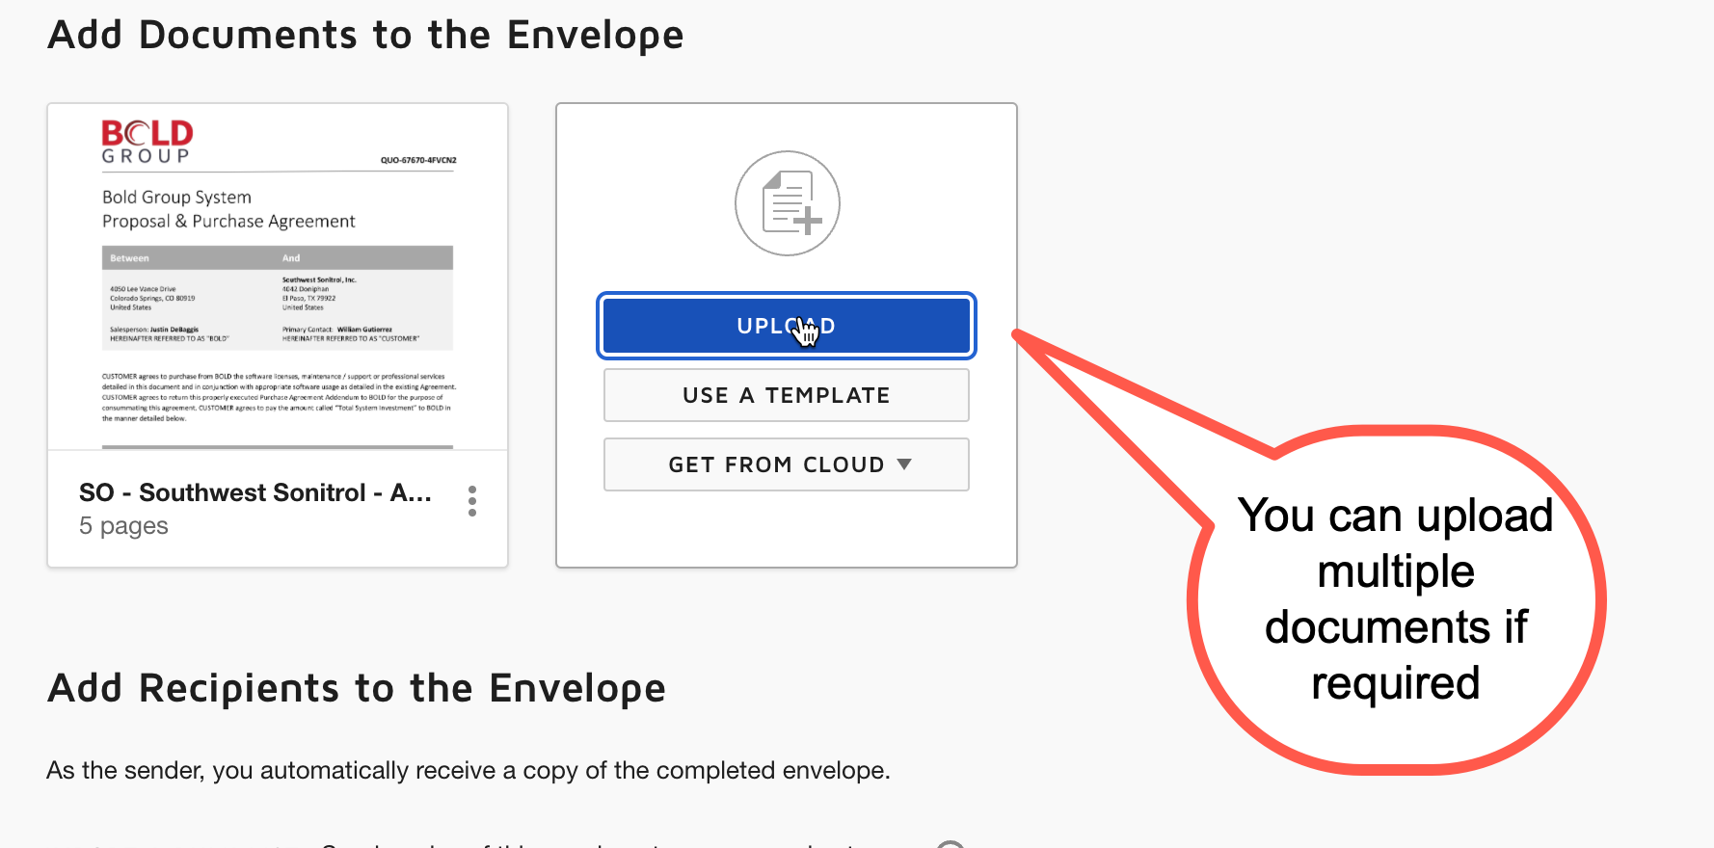
DocuSign | Upload Document
Select upload and select the contract or drag and drop from your desktop
9
Confidential | Internal Use Only

Slide 10
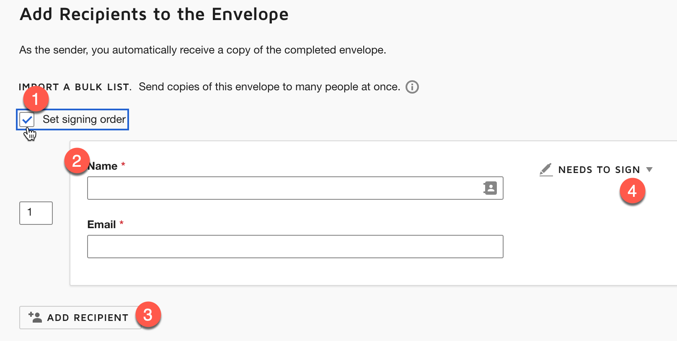
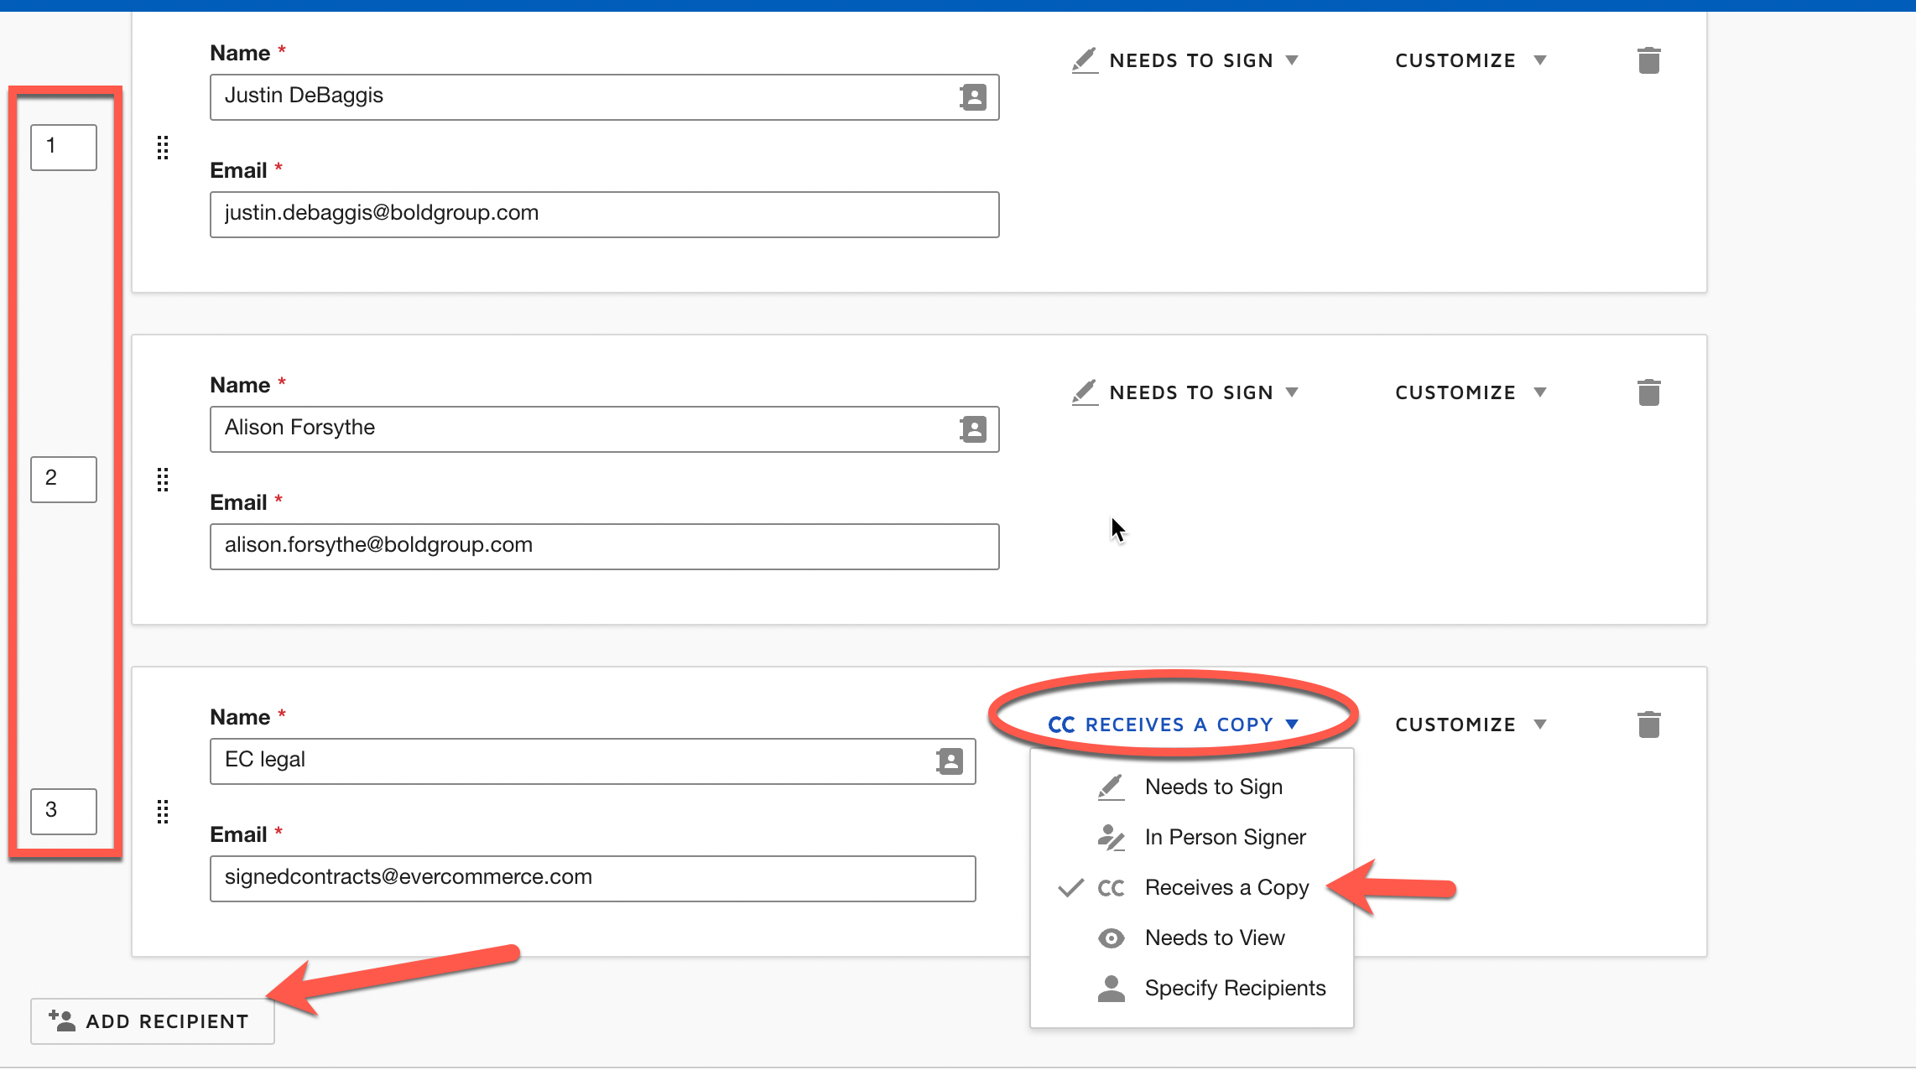
Signing Order
Set the signing order > Add the name of the customer signing > Select Add Recipient > Set Recipient Role (see next page DocuSign Stages and Recipient Roles)
10
Confidential | Internal Use Only

Slide 11
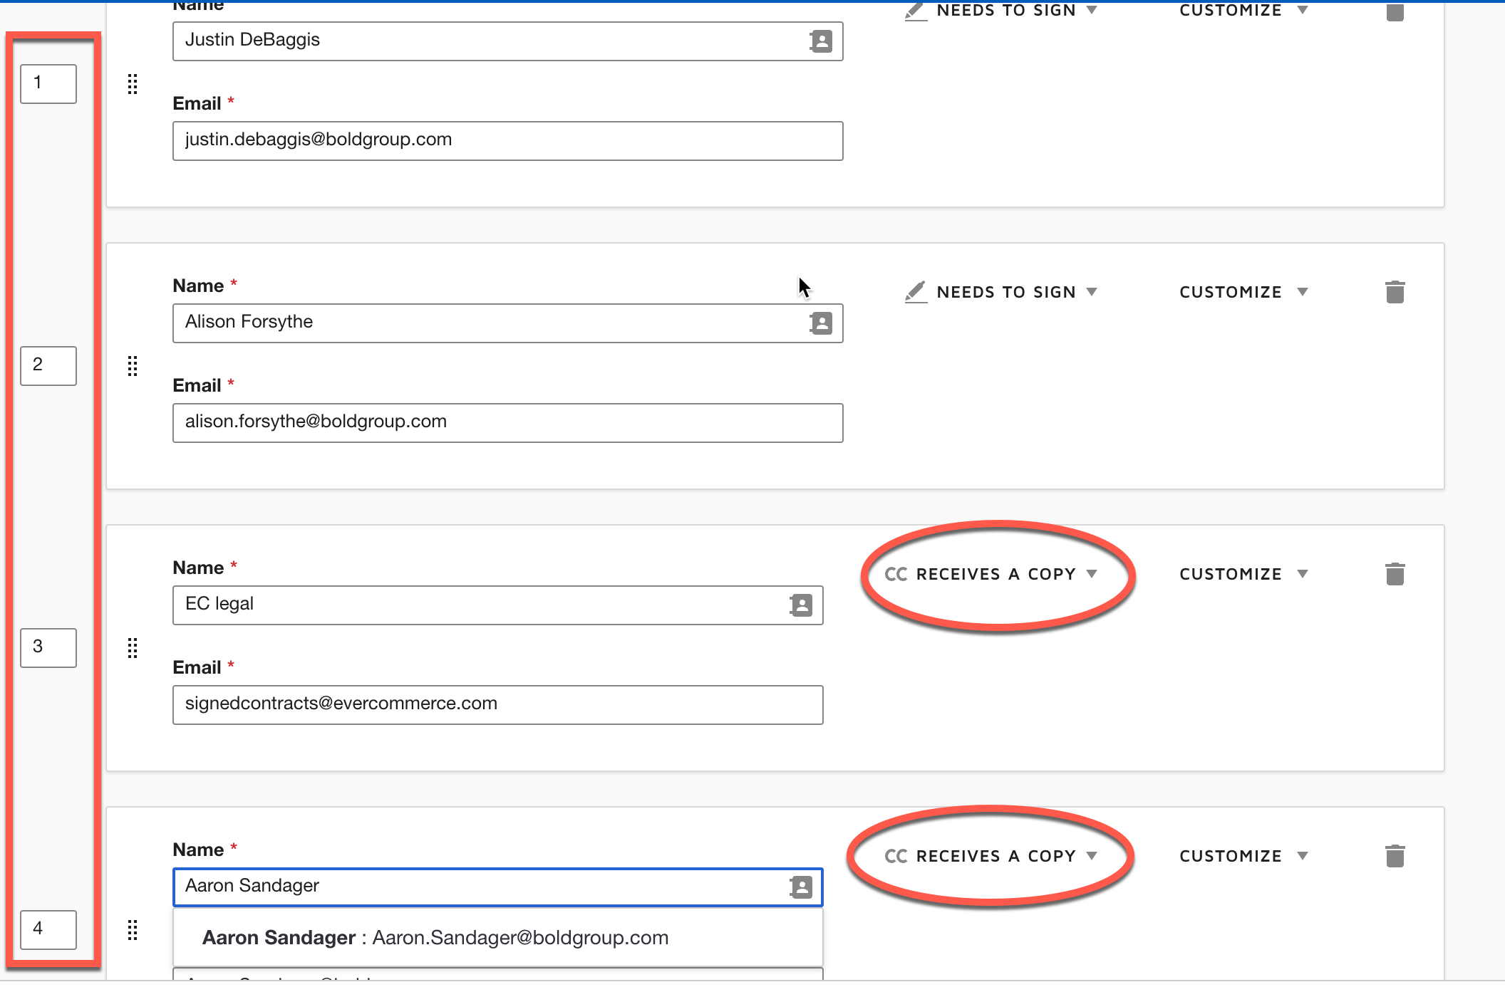
Docusign Stages & Recipient Roles
Stage 1: Customer Name and Email
Role: Needs to Sign
Stage 2: Alison Forsythe
Alison.forsythe@boldgroup.com
Role: Needs to Sign
Stage 3: EC Legal
Signedcontracts@evercommerce.com
Role: CC Receives a Copy
Stage 4: Aaron Sandager
Aaron.sandager@boldgroup.com
Role: CC Receives a Copy
11
Confidential | Internal Use Only

Slide 12
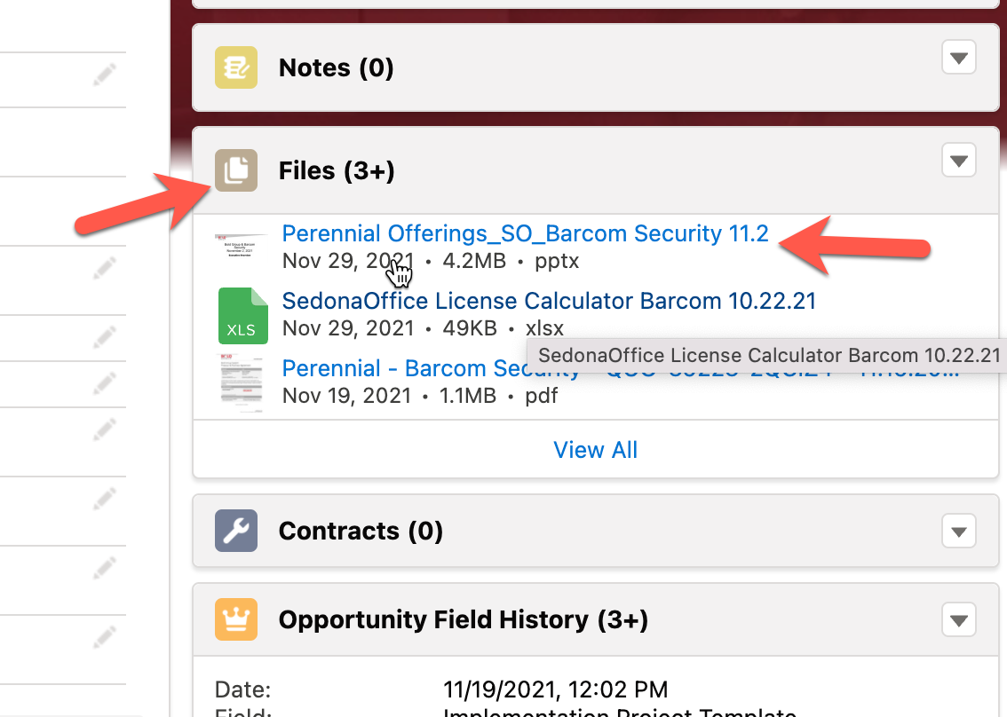
Upload Fully Executed Contracts
After the contract is fully executed, navigate to the opportunity and upload under files
12
Confidential | Internal Use Only

