Slide 1
Q3 2021 QBR’s
Financial Management Division

Slide 2
Agenda
Topic | Presenter | Time
State of the Business | Aaron Sandager | 15 minutes
John Performance & Review | John Doyle | 30 minutes
Jimmy Performance & Review | Jimmy Maxwell | 30 minutes
Sam Performance & Review | Sam Gambatese | 30 minutes
Justin Performance & Review | Justin DeBaggis | 30 minutes
Q&A | Team | 15-20 minutes

Slide 3
FM Q1 Performance & Highlights
Q1 Commit: $840,000
Q1 Division FINISH: $719, 219
New Pipeline Created: 1.15mm*
2 Net New SO deals > 70k per deal
Net New Bookings: 13
New Pipe Created This QTR - Close Date = Current QTR and Next QTR

Slide 4
Product Updates & Initiatives
AlarmBiller & Stages Integration - Completed
Sedona-X Mobile App & T&A Integration – In Progress
SedonaOffice and Stages Integration – In Progress
SalesAutomation & eForms Enhancements – Completed
Grouping
Dependency Notes
SedonaSync Event Library – 30+ Events Created
Dashboards & KPI Enhancements – In Progress

Slide 5
Forecasting
Pipeline – Typically very early-stage deals
Upside (Best Case) – The AE is feeling good about the deal; however, they haven’t ironed out pricing, contract terms, etc.
Commit – the AE is confident in the deal or received a verbal agreement saying the deal will come in by the close date they’ve set

Slide 6
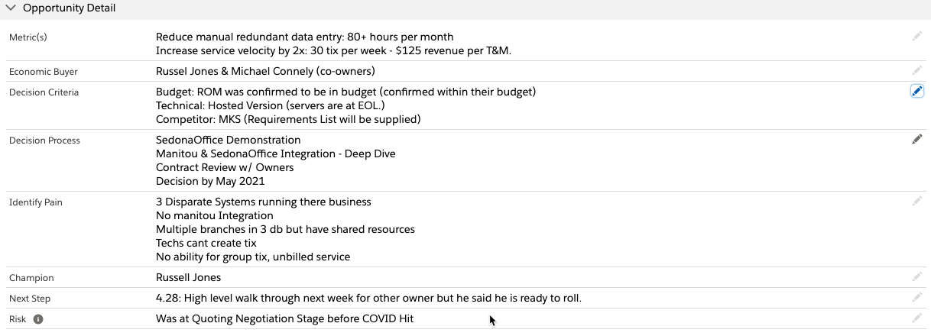
MEDDIC Qualification

Slide 7
Justin Debaggis

Slide 8
Q2 performance review
Q2 Quota = $330,000
Q2 Finish = $493,456
Q2 % over/under goal = +50%

Slide 9
Q3 goals
Q3 Goal = $450,000
Q3 IN = $20,270
Q3 Expected Finish = $385,000
Q3 Expected % over/under goal = -14%
Q3 Stretch Goal = $650,000
Q3 Stretch % over goal = +55%

Slide 10
Q3 SFDC Pipeline review
We will pull this up directly in SFDC. Nothing to do on this slide

Slide 11
2021goals and large pursuits
BHAG (Big Hairy Audacious Goals)
  Revenue
    $2.4 mm in bookings
    $1mm in Net New Bookings
  Non-revenue
    Build out new Salesloft cadences for Closed Lost Deals, New Leads and Stalled Opps
    Continuous Education
Top Larger Pursuits
  Vector Security = $500k+*
    Employees: 1,717
  CPI Security = 350k+*
    Employees: 219
  Manoa Plumbing = 150k+
    200 Employees
  Dynafire = 150k+*
    Employees: 271
  CML Security = 140k
    Employees 140
  Presidio = 130k
  EMC Security = 120k
  Habitec Security = 130k

Slide 12
Needs/issues/concerns/ideas
Needs/Issues/Concerns
Need
  New Contracts
  ROI Calculator
Concern
  Campaigns – Need more built out in Marketo and auto-notifications
Idea
  Marketing Campaign
    Targeting AB to SO
    Stalled Opps AB / SO
    SO Hosted Offering

Slide 13
Q2 2021 QBR’s
-John Doyle
-April 21^{st, 2021}

Slide 14
Q1 performance review
Q1 Quota = $200,000.00
Q1 Finish = $175,000.00
Q1 % over/under goal = $25,000.00

Slide 15
Q2 goals
Q2 Goal = $300,000.00
Q2 Expected Finish = $200,000.00
Q2 Expected 33% under goal = $100,000.00
Q2 Stretch Goal = $300,000.00
Q2 Stretch 0% over/under goal = $0.00

Slide 16
Q2 SFDC Pipeline review
We will pull this up directly in SFDC. Nothing to do on this slide

Slide 17
2021goals and large pursuits
Top 10 Pursuits​
PVT = $117,000.00​ Next Step: Discuss internally​
ASAP Security = $73,130.00​ Next Step: Review Pricing​
Forest = $54,000.00​ Next Step: Sign agreement​
Apex =$53,000.00​ Next Step: Review Pricing, discussion with Justin​
Hukill's =$42,000​ Next Step = Demo for President​
Vyanet Security = $33,000​ Next Step: App doesn’t have offline capabilities​
King Alarm = $32,000​ Next Step: More Demos showing Manitou Integration​
Sacramento Valley = $24,000​ Next Step: See if there ready to move forward death in the family​
Valley Security = $17,000​ Next Step: 1st Demo​
Safety Signal = $14,000​ Next Step: 2nd Demo

Slide 18
Needs/issues/concerns/ideas
Resources toward bigger deals
AB Churn - Does Billing handle cancellations
What modules work with specific platforms ie checkscanner, barcode scanner,
BoldU
Internal Communication on Processes
Marketing Campaigns - Content
Next Generation Product

