Slide 1
Q2 2021 QBR’s
Financial Management Division

Slide 2
Agenda
Topic | Presenter | Time
Justin State of the Business | Justin DeBaggis | 15 minutes
Justin Performance & Review | Justin DeBaggis | 15 minutes
John Performance & Review | John Doyle | 20 minutes
Sam Performance & Review | Sam Gambatese | 20 minutes
Q&A | Team | 15-20 minutes

Slide 3
FM Q1 Performance & Highlights
Q1 Commit: $840,000
Q1 Division FINISH: $719, 219
New Pipeline Created: 1.15mm*
2 Net New SO deals > 70k per deal
Net New Bookings: 13
New Pipe Created This QTR - Close Date = Current QTR and Next QTR

Slide 4
Product Updates & Initiatives
AlarmBiller & Stages Integration - Completed
Sedona-X Mobile App & T&A Integration – In Progress
SedonaOffice and Stages Integration – In Progress
SalesAutomation & eForms Enhancements – Completed
Grouping
Dependency Notes
SedonaSync Event Library – 15+ Events
Dashboards & KPI Enhancements – In Progress

Slide 5
Forecasting
Pipeline – Typically very early-stage deals
Upside (Best Case) – The AE is feeling good about the deal; however, they haven’t ironed out pricing, contract terms, etc.
Commit – the AE is confident in the deal or received a verbal agreement saying the deal will come in by the close date they’ve set

Slide 6
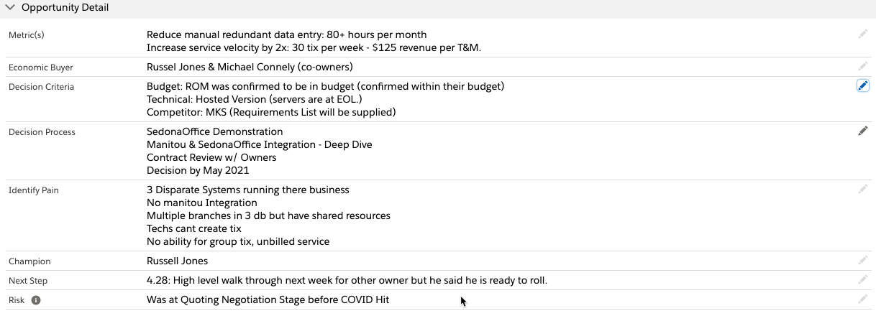
MEDDIC Qualification

Slide 7
Q2 2021 QBR’s
Justin Debaggis

Slide 8
Q1 performance review
Q1 Quota = $300,000
Q1 Finish = $489,762
Q1 % over/under goal = +63%

Slide 9
Q2 goals
Q2 Goal = $350,000
Q2 IN = $153,000
Q2 Expected Finish = $583,000
Q2 Expected % over/under goal = +67%
Q2 Stretch Goal = $600,000
Q2 Stretch % over goal = +71%

Slide 10
Q2 SFDC Pipeline review
We will pull this up directly in SFDC. Nothing to do on this slide

Slide 11
2021goals and large pursuits
BHAG (Big Hairy Audacious Goals)
  Revenue
    $2mm in bookings
    $1mm in Net New Bookings
  Non-revenue
    Finalize Sales Playbook & Battle Card
    Solidify 10-20 New Partner Channels
Top Larger Pursuits
  Vector Security = $500k+*
    Employees: 1,717
  CPI Security = 350k+*
    Employees: 219
  Safe Touch (FL) = 100k+*
    Employees: 219
  Kastle Systems = 150k+*
    Employees: 300+
  Dynafire = 150k+*
    Employees: 271
  Safe Home Security = 150k+*
    Employees: 297
  CML Security = 140k
    Employees 140

Slide 12
Needs/issues/concerns/ideas
Needs/Issues/Concerns
Need: New Contracts
Concern: Custom Dev
SalesAutomation Features to be Launched

Slide 13
Q2 2021 QBR’s
-John Doyle
-April 21^{st, 2021}

Slide 14
Q1 performance review
Q1 Quota = $200,000.00
Q1 Finish = $175,000.00
Q1 % over/under goal = $25,000.00

Slide 15
Q2 goals
Q2 Goal = $300,000.00
Q2 Expected Finish = $200,000.00
Q2 Expected 33% under goal = $100,000.00
Q2 Stretch Goal = $300,000.00
Q2 Stretch 0% over/under goal = $0.00

Slide 16
Q2 SFDC Pipeline review
We will pull this up directly in SFDC. Nothing to do on this slide

Slide 17
2021goals and large pursuits
Top 10 Pursuits​
PVT = $117,000.00​ Next Step: Discuss internally​
ASAP Security = $73,130.00​ Next Step: Review Pricing​
Forest = $54,000.00​ Next Step: Sign agreement​
Apex =$53,000.00​ Next Step: Review Pricing, discussion with Justin​
Hukill's =$42,000​ Next Step = Demo for President​
Vyanet Security = $33,000​ Next Step: App doesn’t have offline capabilities​
King Alarm = $32,000​ Next Step: More Demos showing Manitou Integration​
Sacramento Valley = $24,000​ Next Step: See if there ready to move forward death in the family​
Valley Security = $17,000​ Next Step: 1st Demo​
Safety Signal = $14,000​ Next Step: 2nd Demo

Slide 18
Needs/issues/concerns/ideas
Resources toward bigger deals
AB Churn - Does Billing handle cancellations
What modules work with specific platforms ie checkscanner, barcode scanner,
BoldU
Internal Communication on Processes
Marketing Campaigns - Content
Next Generation Product

