Slide 1


INTELLIGENT BUSINESS AUTOMATION
Presented by: Brad Swindell

Slide 2
BPM
OxyGen
“Driving Value Through Innovation and Automation.”

Slide 3

What is OxyGen?
BPM
IPaaS
OxyGen is a user-friendly Business Process Management (BPM) tool that facilitates the automation of time consuming and repetitive processes.
OxyGen also serves as an Integration Platform as a Service (IPaaS) allowing for powerful workflow management between many products and services.

Slide 4
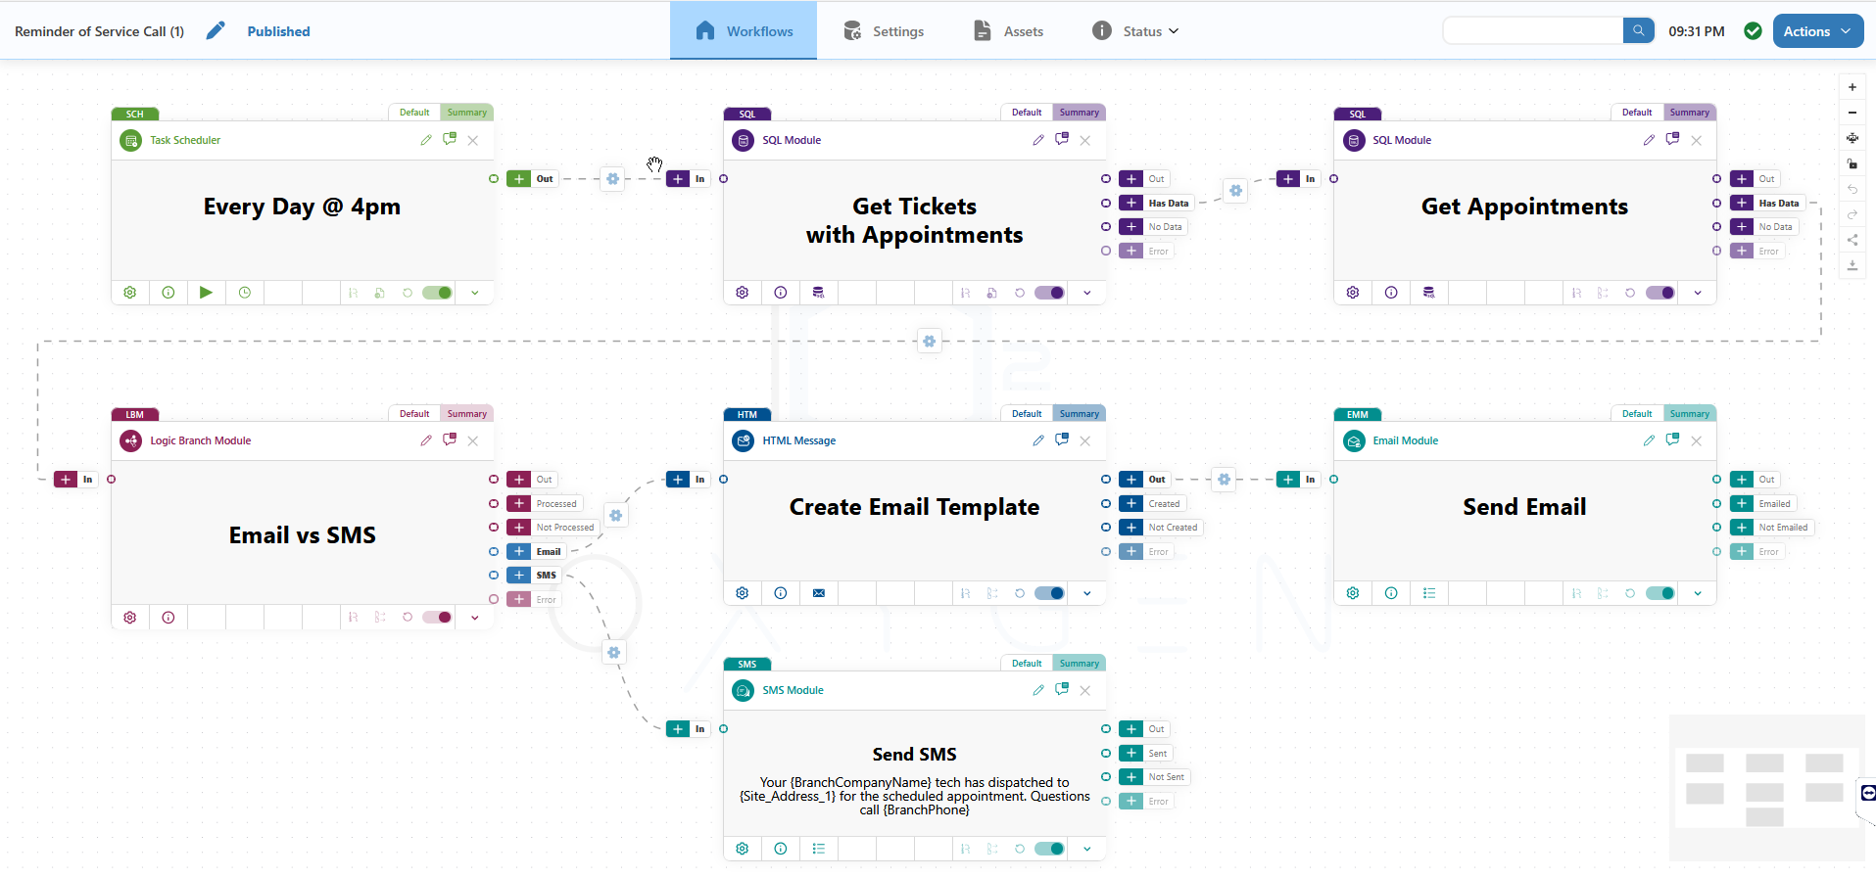

Modern Workflow Designer

Slide 5




OxyGen Module Types
TRIGGER
DATA I/O
LOGIC
Starts a workflow from a automated or user input.
Process data to/from a connected data source.
Preform logical workflow routing & transformations.
QUEUE
COMPOSITION
OUTPUT
Queue & process import/update change requests to connected data sources.
Create & process content such as reports, images, files & email templates.
Send & deliver data and other content created via Email, SMS, FTP, etc.

Slide 6
Workflow Triggering
Schedule
File Processing
Web Hook
Workflows can be started on a recurring basis by configuring a schedule such as “Every Day M-F @ 4pm” or “Every 15 Minutes”.
Files can be manually uploaded or added to a directory for processing. When available, its validated & a workflow starts based on its data.
Used for integration between systems, Web Hooks allow other systems to send us data and start processing a workflow in our system.

Slide 7
Data Access
SQL Query
Stored Procedure
API
OxyGen supported ODBC data sources and allows you to create SELECT, INSERT, UPDATE and DELETE from your data source.
In available, stored procedures allow data processing and a uniform way by providing standard mappable parameters.
Connect to a REST based API to access data on cloud-based systems. OxyGen supports GET, POST, PUT, and PATCH.

Slide 8
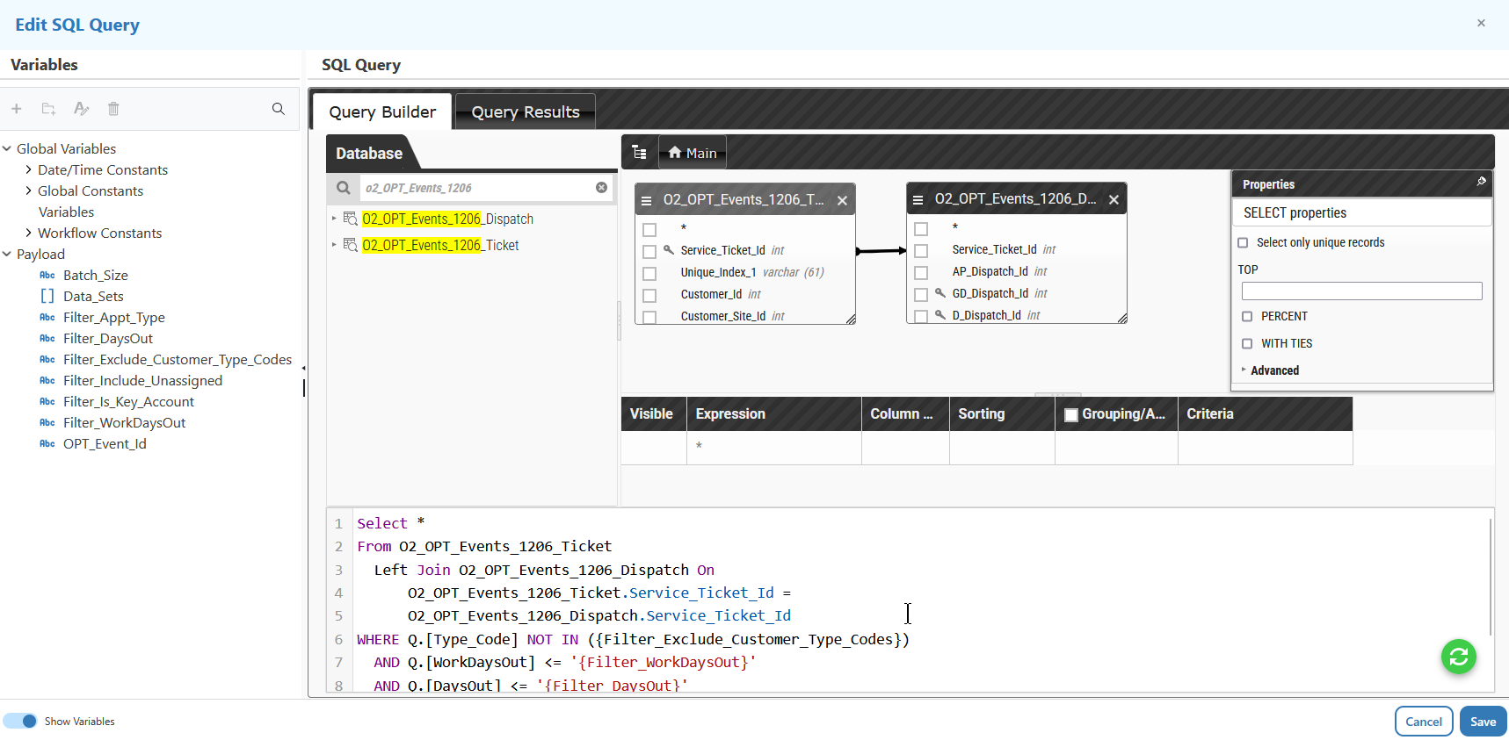
Query Builder
OBJECT BROWSER
Search or Browser for database objects such as tables, views and columns.
QUERY BUILDER
Easy create select columns, relationships, sorting, filtering and grouping.
AUTO GENERATED
Auto generates SQL code from the query builder which can be manually.

Slide 9
Logic and Transformation
Logic Branching
Data Transformation
Workflows processing can be routed based on a given module processes its data such Data Found or SMS Failed, or path can be created based on data filters such as Customer is Residential.
Using familiar tools, the data extracted can be transformed before its is loaded back (ETL). This allows for data cleanup and mapping between systems such as changing “NY” to “New York”.

Slide 10
Composition
Reports
Word Merge
Email Templates
OxyGen currently supports an integration with Crystal Reports which allows for print ready, feature rich reporting.
Quickly and easily merge data into document templates and out to PDF.
Using our No-Code email template editor you can create beautiful and robust emails that will be consistent across every email client.

Slide 11
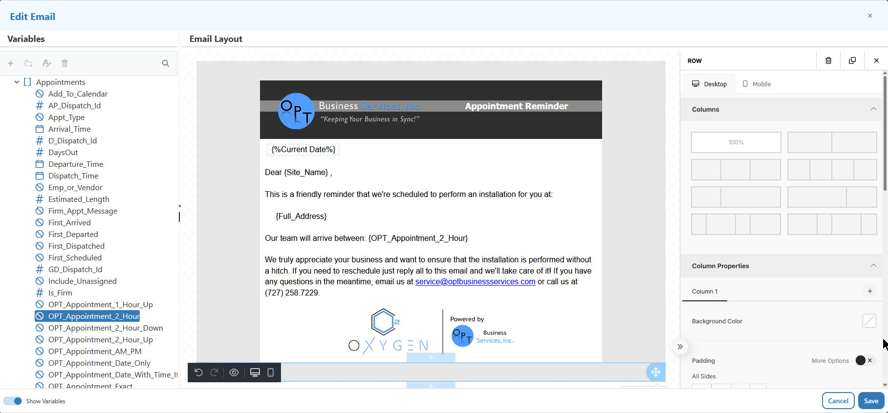
HTML Template Editor
VARIABLE LIBRARY
Quickly search or browser for dynamic data to be included in your email template.
WYSIWYG EDITOR
Easily create beautiful dynamic and responsive email templates using simple but familiar controls.
DRAG & DROP LAYOUT
Customize template layout and features using flexible layout object settings.

Slide 12
Output
Email
SMS
FTP
Connect to your preferred email service provider and send an email template or a simple message.
OxyGen currently has a native integration with Twilio supporting SMS texting capability.
Upload and Download data securely using sFTP to a 3rd party provider.

Slide 13
Partner Ecosystem
IPaaS
“Empower Growth Through Connected Solutions”

Slide 14

Welcome to the Future: Intelligent Automation in AP & Finance.
Optimize your financial operations with cutting-edge automation and technology.
Benefits include:
Powerful & flexible workflow automation.
Average cost savings of $12.64 per invoice.
Process AP invoices 30+ days faster.
Capture 75% more early-pay discounts.
Integrated with SedonaOffice via OxyGen.
Transform your AP processes today.
AI

Slide 16
OxyGen Roadmap
2021 Q1
OxyGen Pilot Launched
Bill.com & Stampli AP Integrations Launched
2022 Q2
OxyGen v1 Workflow Editor Launched
Drag & Drop, Draft Management, Logic
2022 Q4
OxyGen Workflow Management and Diagnostics Released
2023 Q3
OxyGen v2 Workflow Editor Launched
Asset Management, Workflow Library, Improved Editors
2024 Q1
Yooz Integration Expanded in PO Matching and Reconciliation
2024 Q3
Release of Advanced IPaaS Transformation Modules and Features
2025 Q1
BOLD Partnership Expanded into Reseller Relationship
2022 Q1
TTechPrint Partnership Established
Print Automation Launched
2022 Q3
Yooz Partnership & AP Integration Launched
2023 Q2
O² Intelligent Automation Solutions Founded & Partner Program Established
2023 Q4
Performance Enhancements & Improvements Processing
Bulk Processing
2024 Q2
OxyGen v3 Workflow Editor Launched
Variable Library & Payload Inspector
2024 Q4
BOLD Partnership Expanded into Professional Services

Slide 17
Technology Overview
Solution | Business Activity Monitoring (BAM) | OxyGen (BPM / IPaaS)
Target Consumer | IT/Developers | Power Users, Data Analysts
Data Source Connections | ODBC Only | ODBC, API, CSV, Excel, WebHook
Query Builder | Text, SQL Required | Visual Drag & Drop Builder
Email Support | Basic, HTML Code Required | Powerful, No Code Visual Editor
Workflow Designer Options | Static | Dynamic / Decision Based
Available Steps | Schedule, Query, Report, Email | Listen, Upload, Search, Schedule, Query, Report, Transform, Manipulate, Logic, Create, Merge, Email, SMS, Send
Automation Roles | Notify, Report | Notify, Report, Integrate, Process
Technology | Client/Server Legacy Application | Modern Web Application

Slide 18
Analysis
 | KnowledgeSync | OxyGen BPM | BPA Platform | Nintex | KissFlow | Tray.io | Workato | MuleSoft
Software Class | BAM | BPM | BPA | BPM | BPM | iPaaS | IpaaS | ESB / iPaaS
Pricing | $ | $-$$ | $$-$$$ | $$-$$$ | $$$ | $$$ | $$$-$$$$ | $$$$
Primary Buyer Personas | IT Consultants Developers | SMB Executives IT Consultants Automation Partners | Mid-size IT Directors ERP consultants | Enterprise process owners Legal/Compliance | Business leaders Operations managers | Marketing Ops Sales Ops SaaS scale-ups | Enterprise IT leaders Digital transformation teams | Enterprise architects CIOs and CTOs
Typical Users | IT managers | Implementation specialists IT managers Business analysts | Integration specialists Technical users | IT teams Process designers SharePoint/Office365 admins | Department heads Non-technical staff | Growth teams orkflow builders RevOps teams | Integration developers RevOps and BizOps professionals | Backend developers Integration architects
Fit for SMEs? | ⚠️ Possible (limited functionality and deployment options) | ✅ Excellent fit (designed for SME flexibility & affordability) | ✅ Moderate fit (flexible, but still technical) | ⚠️ Possible (limited by price for smaller orgs) | ✅ Strong fit (designed for business users, not developers) | ⚠️ Maybe (entry cost is high but appeals to tech-forward SMEs) | ❌ Rarely (overkill and cost-prohibitive for SMEs) | ❌ Enterprise only (complex and expensive)

Slide 19

How to Engage
O² Reseller
OPT Referral
OxyGen BPM
OPT Essentials
OPT Web Services
Workflow/Events
NPS Surveys
CRM & SRM
Partners (Yooz)
Setup & Training

Slide 20
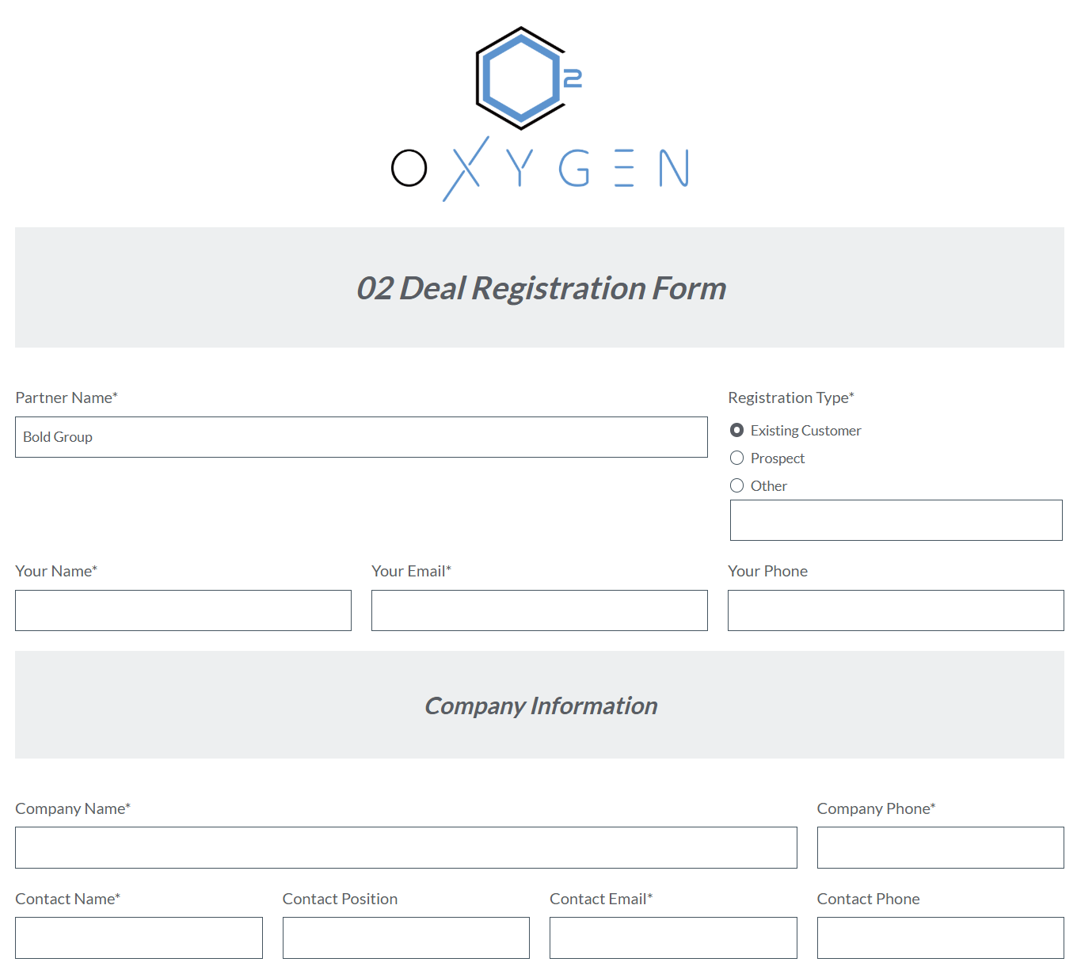
Deal Registration
https://opt.formstack.com/forms/o2_deal_registration?Partner_Code=10002&Partner_Name=Bold+Group

Slide 21
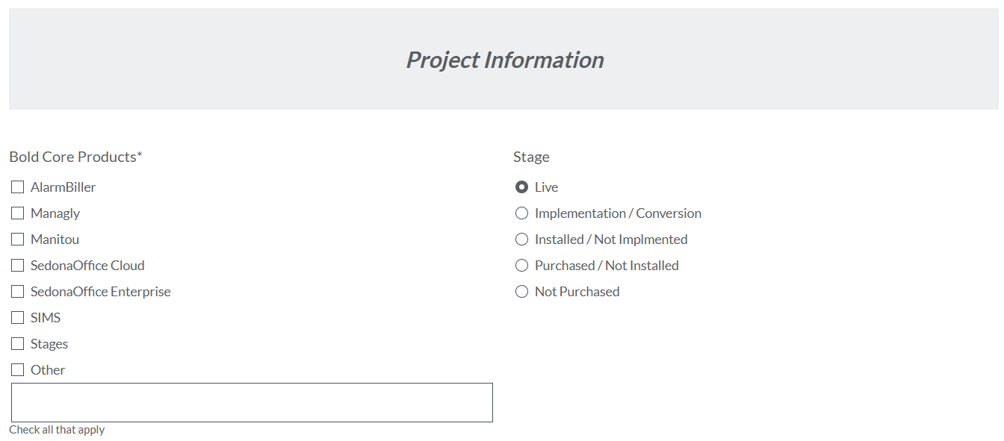
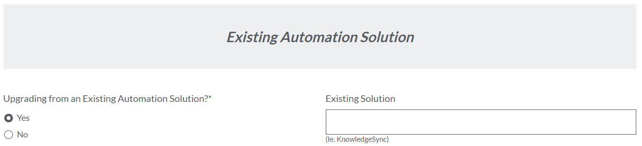
Deal Registration
https://opt.formstack.com/forms/o2_deal_registration?Partner_Code=10002&Partner_Name=Bold+Group

Slide 22
Deal Registration
https://opt.formstack.com/forms/o2_deal_registration?Partner_Code=10002&Partner_Name=Bold+Group

Slide 23
OxyGen Packages
Communication
Integration
Document
Focuses on identification & communication of business-critical events.
Adds advanced report generation, document creation & processing features.
Adds integration capability to connect multiple systems together.
OxyGen Base Platform | Communications Suite | Document Suite | Integration Suite
Triggers
Schedule Module (SCH) | X | X | X
Workflow Monitoring Service (WMS) | X | X | X
WebHook Module (WHE) |  |  | X
File Import Module (FIM) |  |  | X
Directory Monitoring Module (DMM) |  |  | X
Data I/O *
Connections * | 1 * | 1 * | 2 *
API Module (API) | X | X | X
SQL / ODBC (SQL) | X | X | X
Stored Procedure Module (SPM) | X | X | X
Bulk Table Import (BTI) |  |  | X
FTP Module (FTP) |  |  | X
Logic
Logic Branch Module (LBM) | X | X | X
Data Transformation Module (DTM) | X | X | X
Composition
HTML Module (HTM) | X | X | X
Data Repeater Module (DRM) | X | X | X
Automated Report Module (ARM) |  | X | X
Word Merge Module (WMM) |  | X | X
Zip File Module (ZIP) |  | X | X
CSV Module (CSV) |  | X | X
PDF Processing Module (PPM) |  | X | X
Document Handler Export (DHE) |  | X | X
Barcode Generation Module (BGM) |  | X | X
Output
Email Module (EMM) | X | X | X
SMS Module (SMS) | X | X | X

Slide 24
OPT Essentials
BI
“Powerful Insights for Informed Decisions”

Slide 25
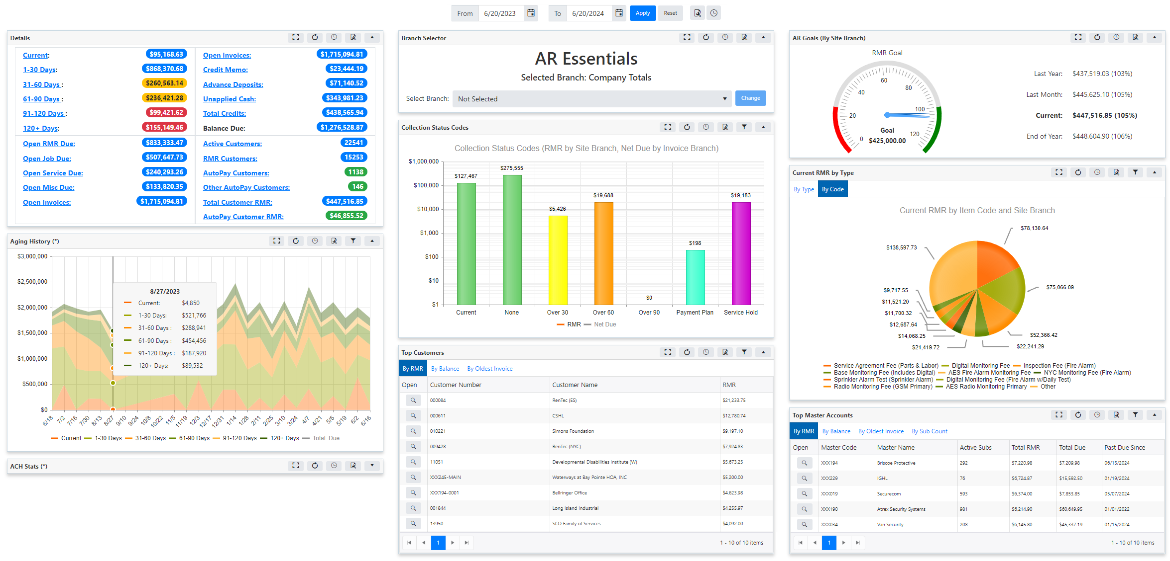
Accounts Receivable

Slide 26
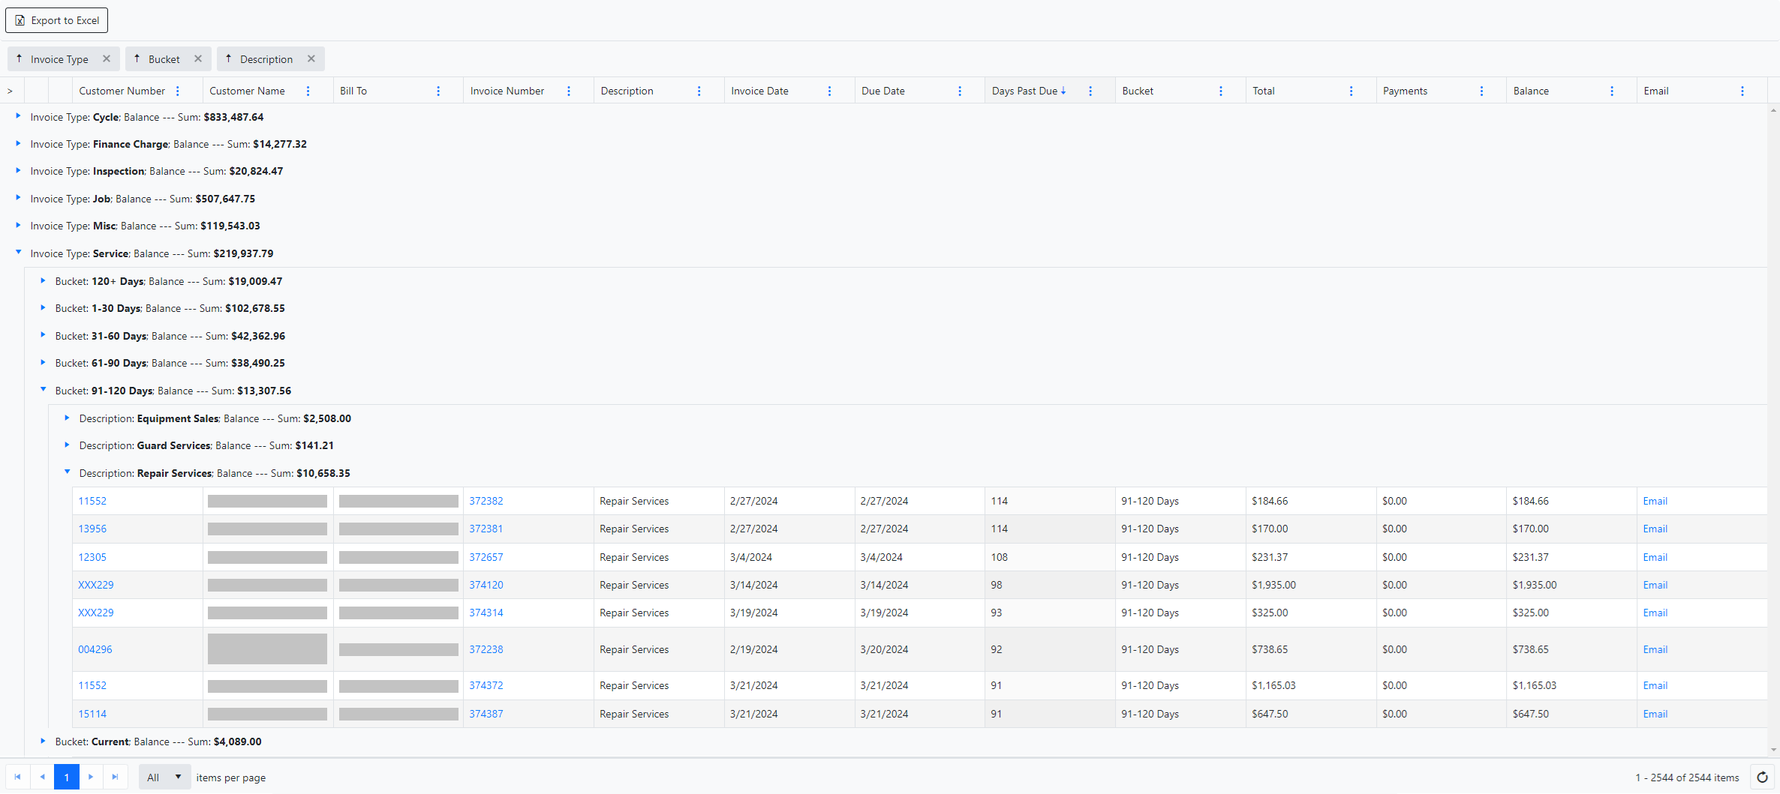
Drill Down Dashboard Grid

Slide 27
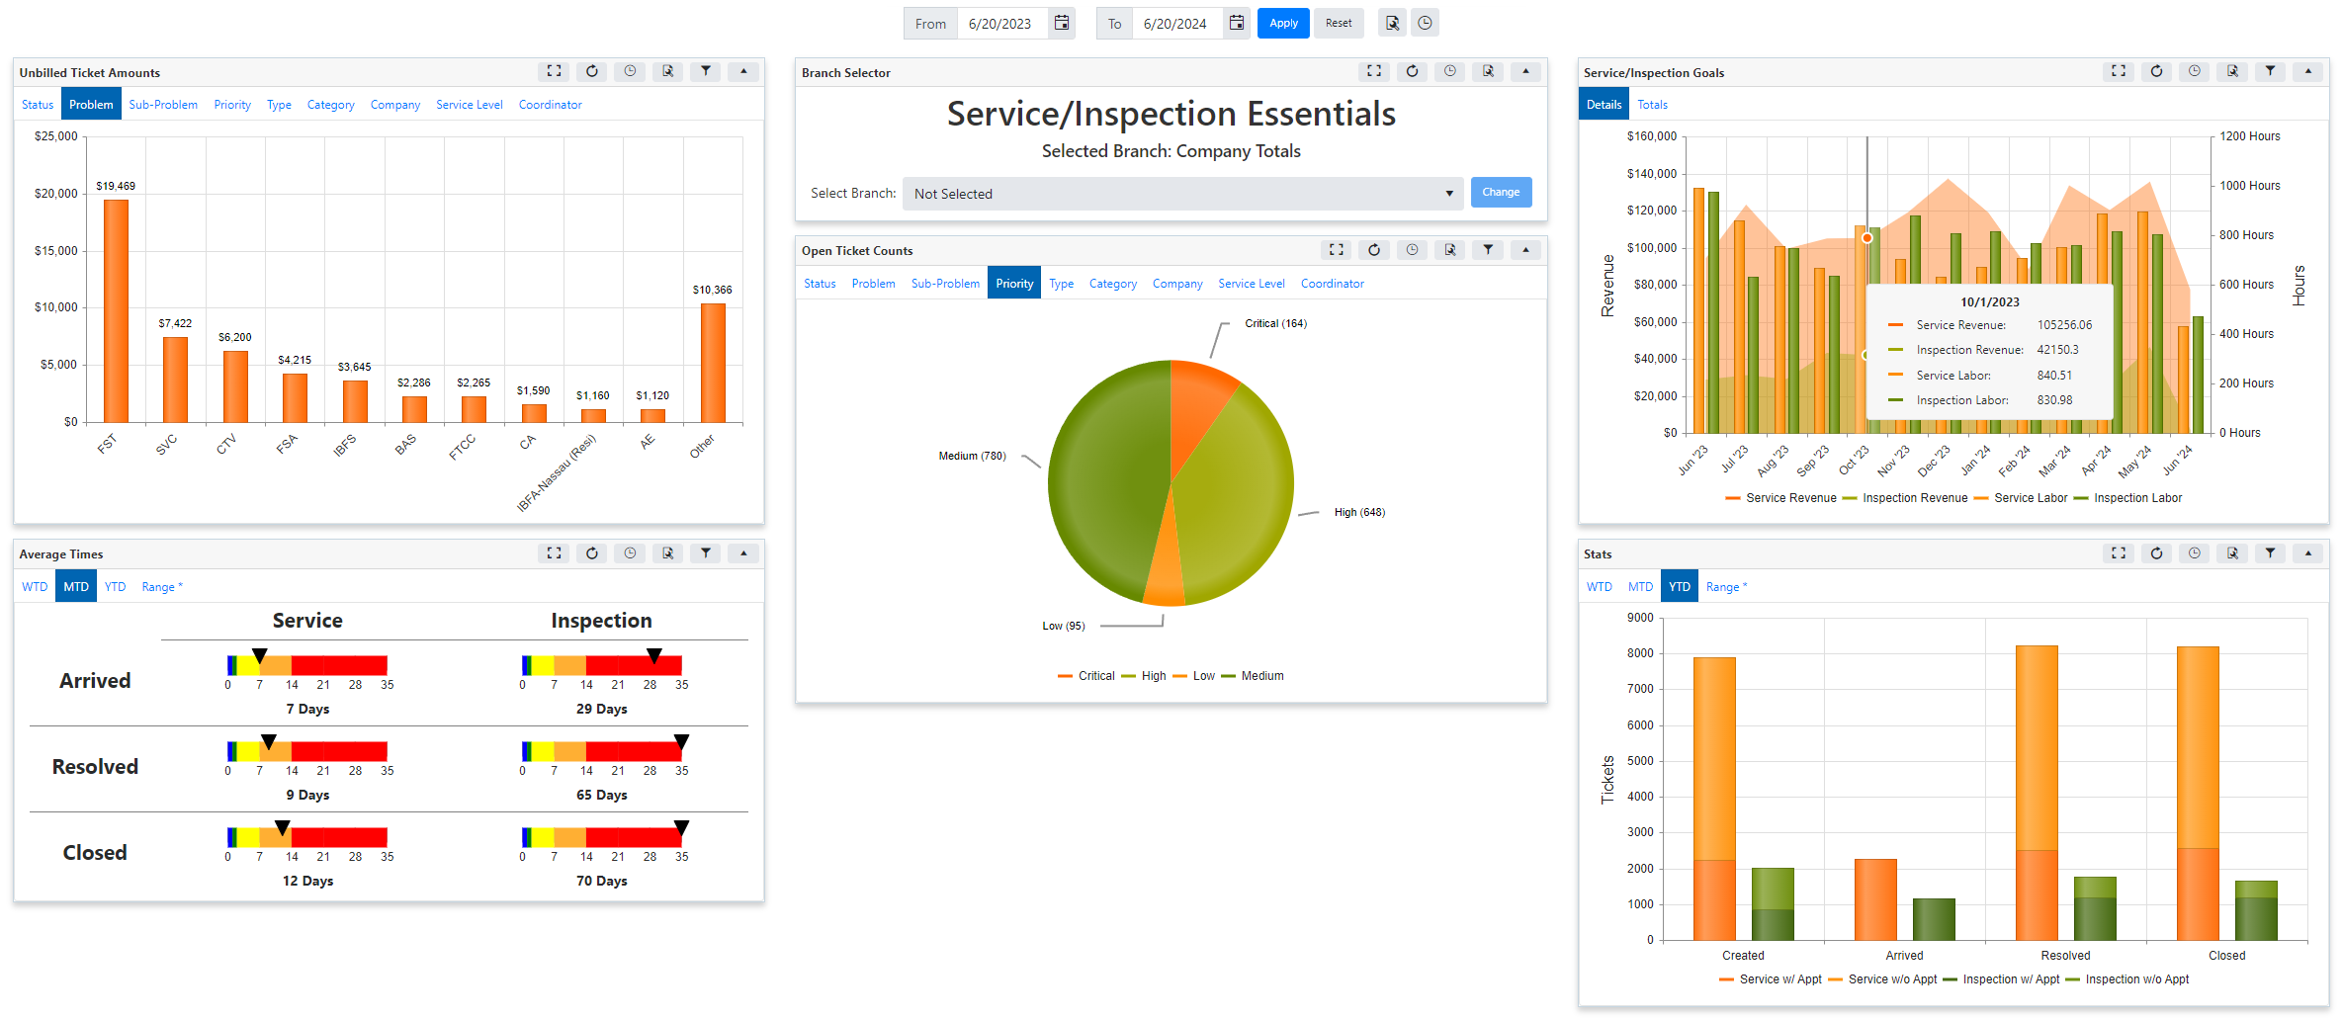
Service & Inspections

Slide 28
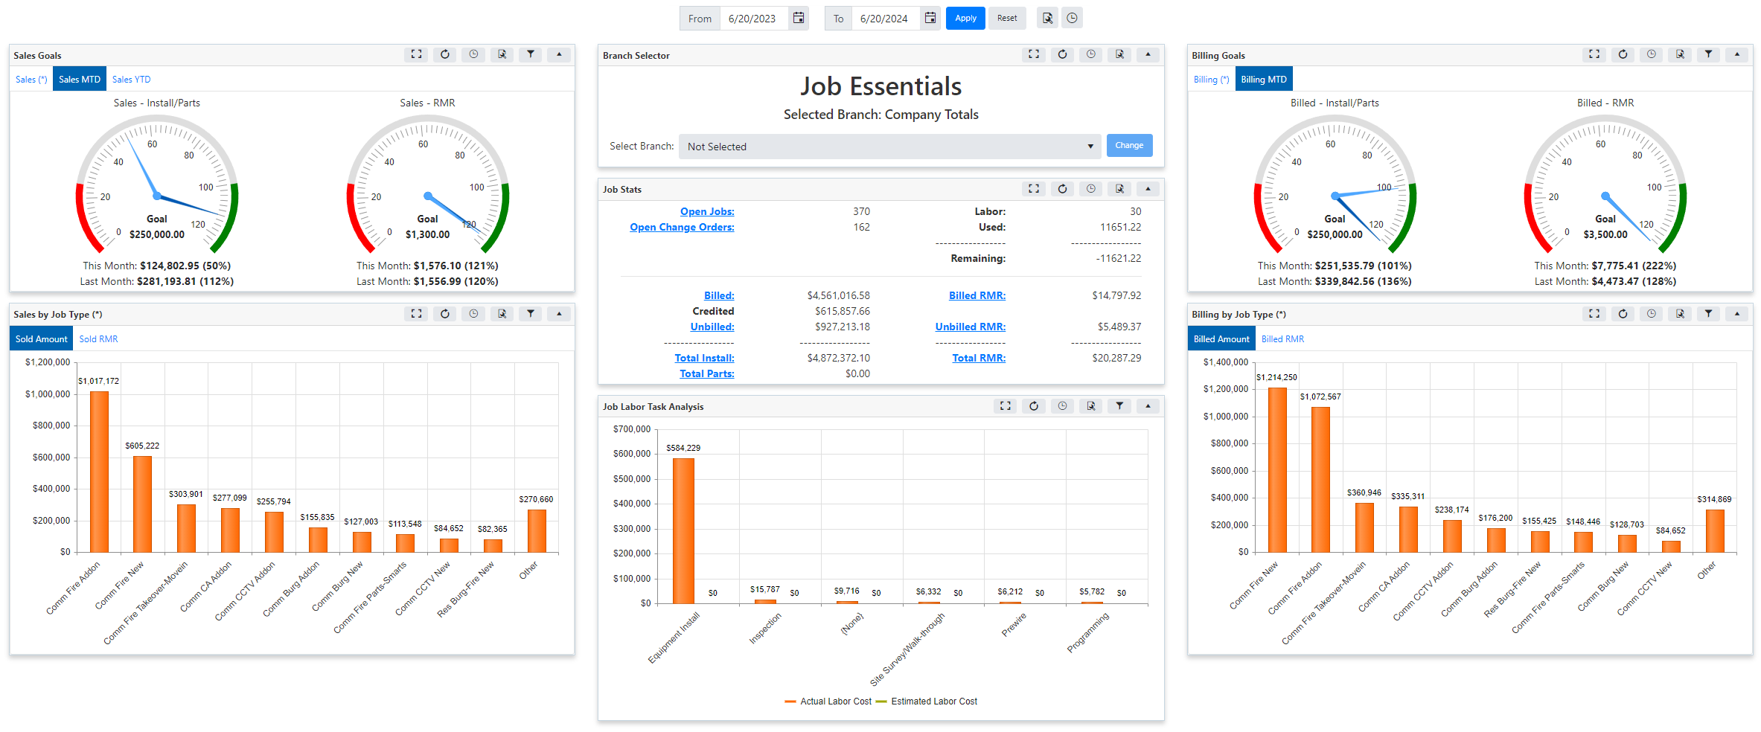
Jobs

Slide 29
CX
NPS
Surveys

Slide 30
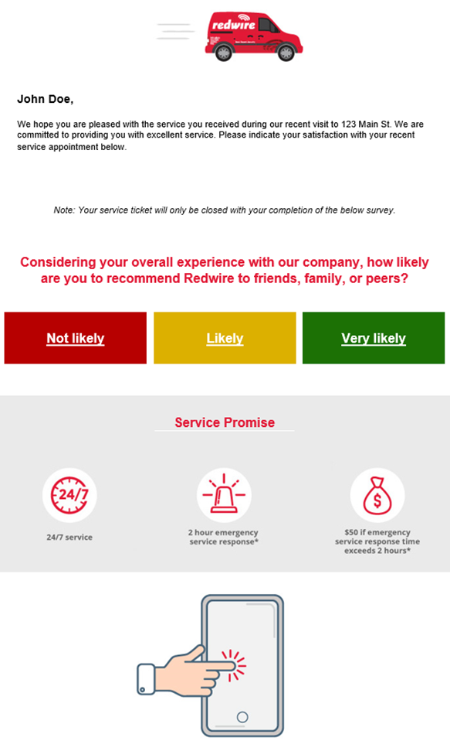
Survey Requests
Send requests to complete surveys based on recent interactions with the customer such as a service visit or recent installation.

Slide 31
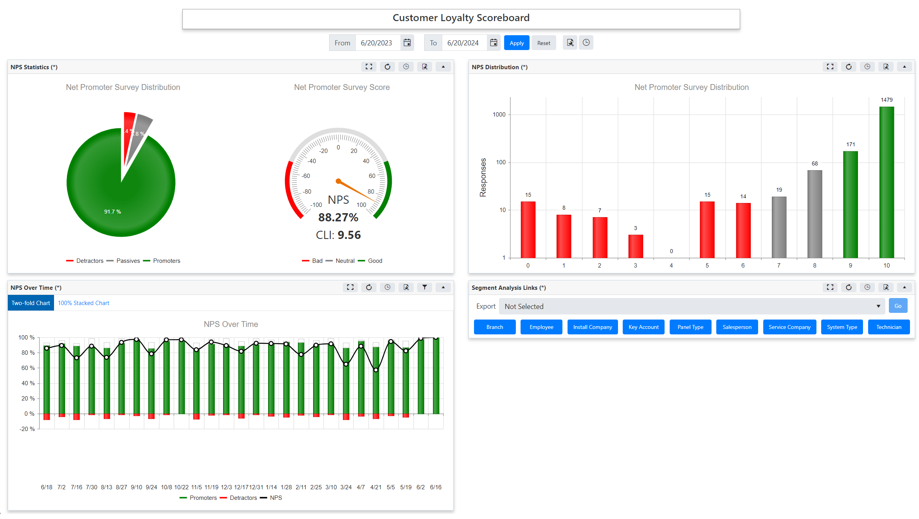
Survey Dashboard

Slide 32
CRM
Customer Management

Slide 33
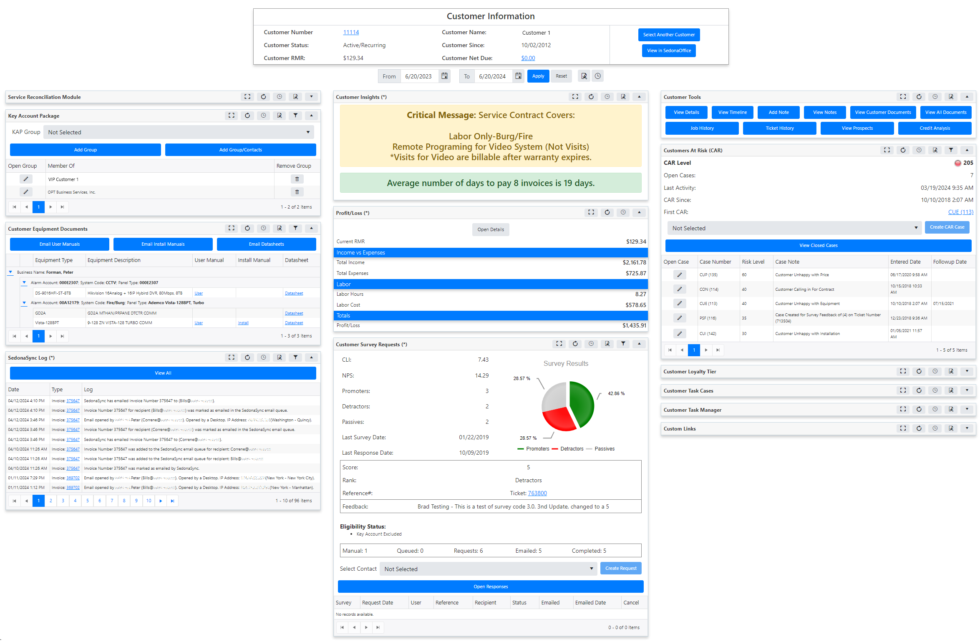
Customer Relationship Management

Slide 34
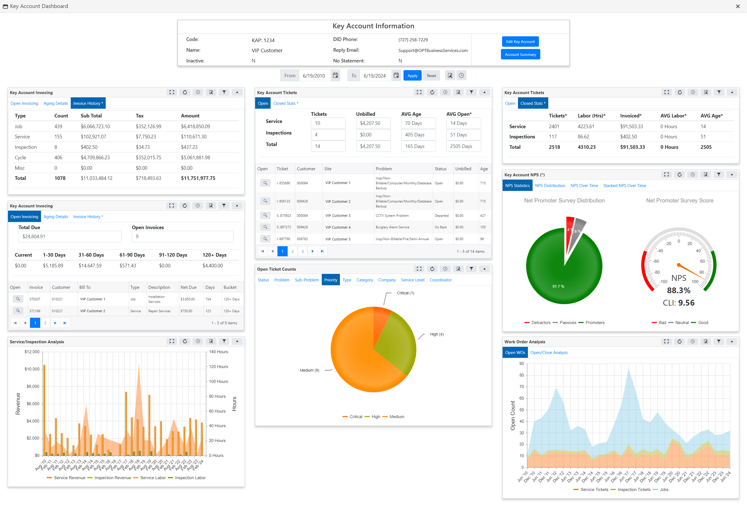
Key Account Management
Key Account Management

Slide 35
OPT Web Services Packages
OPT Essentials
High Level KPIs
AP, AR, Service, Inspection, Jobs
OPT Web Services
Drill Down
Dashboards
Landing Pages
Export

Slide 36
THANK YOU
Questions?
Sales@OPTBusinessServices.com
(727) 258-7229
OPT Business Services, Inc.

