Slide 1
Salesforce CPQ (Configure Price Quote): User Training/Testing

Slide 2
Agenda
Product Policy Primer
What is CPQ?
Why is are we implementing CPQ?
What will change with CPQ?
When is CPQ going into effect?
How do I use CPQ?
  Creating a quote
  Adding products to a quote
  Pricing/discounting a quote
  Submitting a quote
  Closing a quote
Notes:
***Re-frame entire meeting as intro to wholistic QTC framework

Slide 3
Product Policy Primer

Slide 4
Product Policy Primer
Some operational changes that you will observe post CPQ go-live are driven and designed by the Bold Group Product Policy and implemented through CPQ
These operational changes are intended to…
  Standardize operations across all products
  Allow contracts to flow into current terms and conditions
  Save time adhering to new product policies

Slide 5
Product Policy Primer
These operational changes include…
Standardization of billing periods (monthly, quarterly semiannually, annually)
Standardization of Net Payment terms (net 15 standard)
Standardization of payment terms for one-time fees (standard 100% upfront; option for 50/50)
Implementation of discount approval thresholds
Elimination of discounts for maintenance/support fees
Changes to standard product pricing

Slide 6
CPQ Training & Demo

Slide 7
What is CPQ?
CPQ (Configure, Price, Quote) is a Salesforce module that enables greater sophistication and automation in sales and quoting processes.
CPQ ensures that you have accurate pricing available at any point in the sales process and visibility into options available as part of a deal.

Slide 8


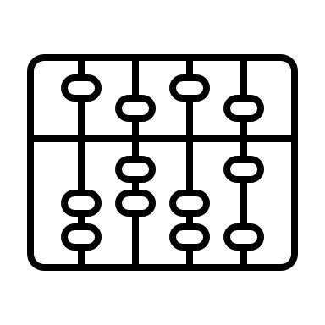

Why are we implementing CPQ?
CPQ delivers for us:
Automation around discounting and quoting
Granular data for billing (with high-level data for customers)
Accurate, on-line pricing
SOX-compliant data models and controls

Slide 9
When is CPQ Going Into Effect?
CPQ Available in Production 5/13
As of 5/13, any new quote must be generated using CPQ
In-flight quotes should be handled using the following logic…

Slide 10
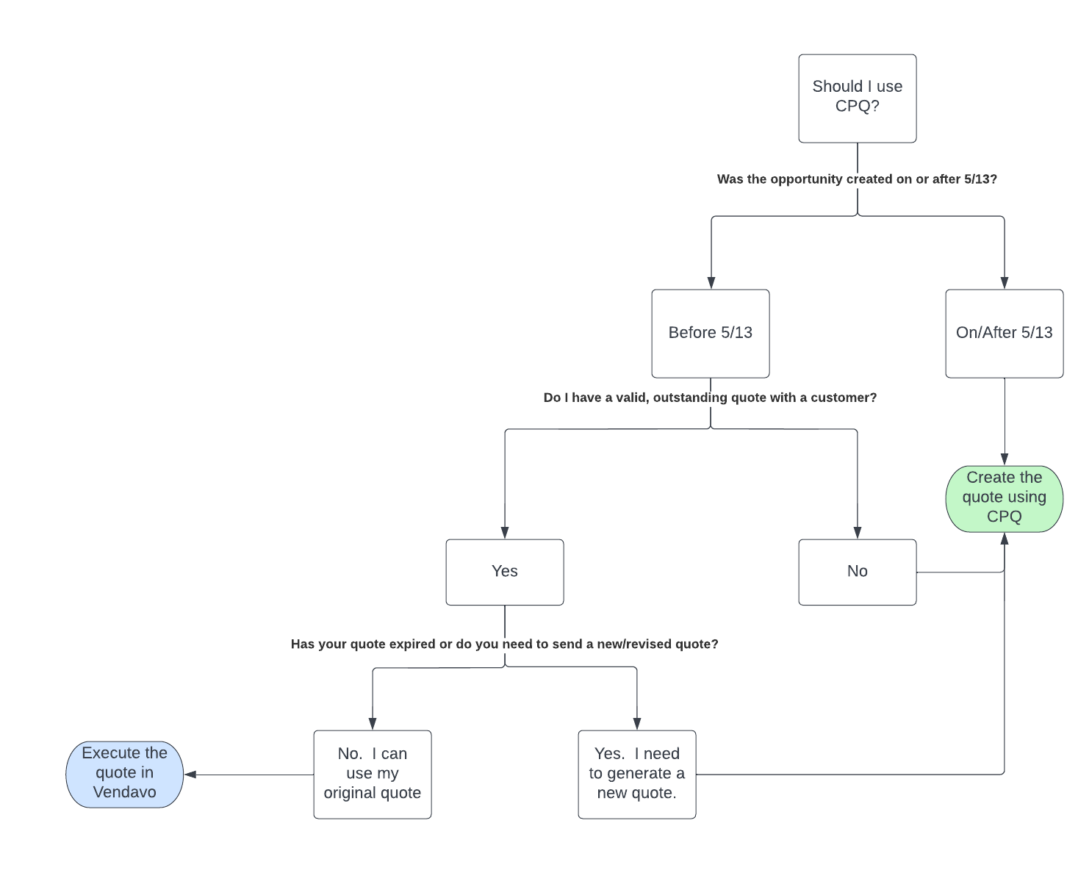
What Should I Do with In-Flight Quotes?

Slide 11
Expectations for Go-Live
How do I request support for issues or incomplete functionality?
Please reach out to Tammy Narowski or Sales Operations. If Sales Ops cannot resolve your issue, they will submit a ticket to the CPQ team.
How do I request additional training or learn more about CPQ?
The CPQ team will hold daily office hours from 5/16-5/20. You may drop into these sessions at any point.

Slide 12
CPQ Training Reference Slides

Slide 13
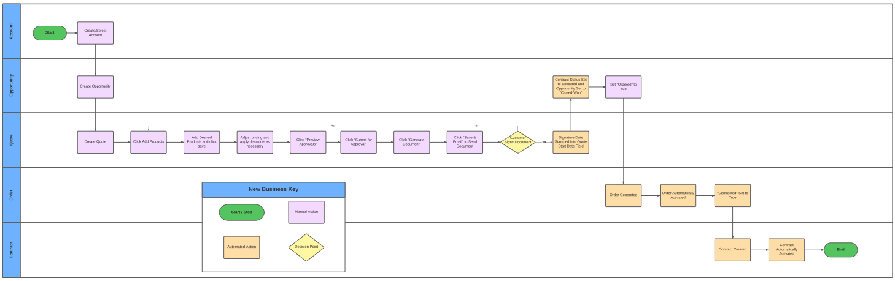
High-Level CPQ Workflow

Slide 14
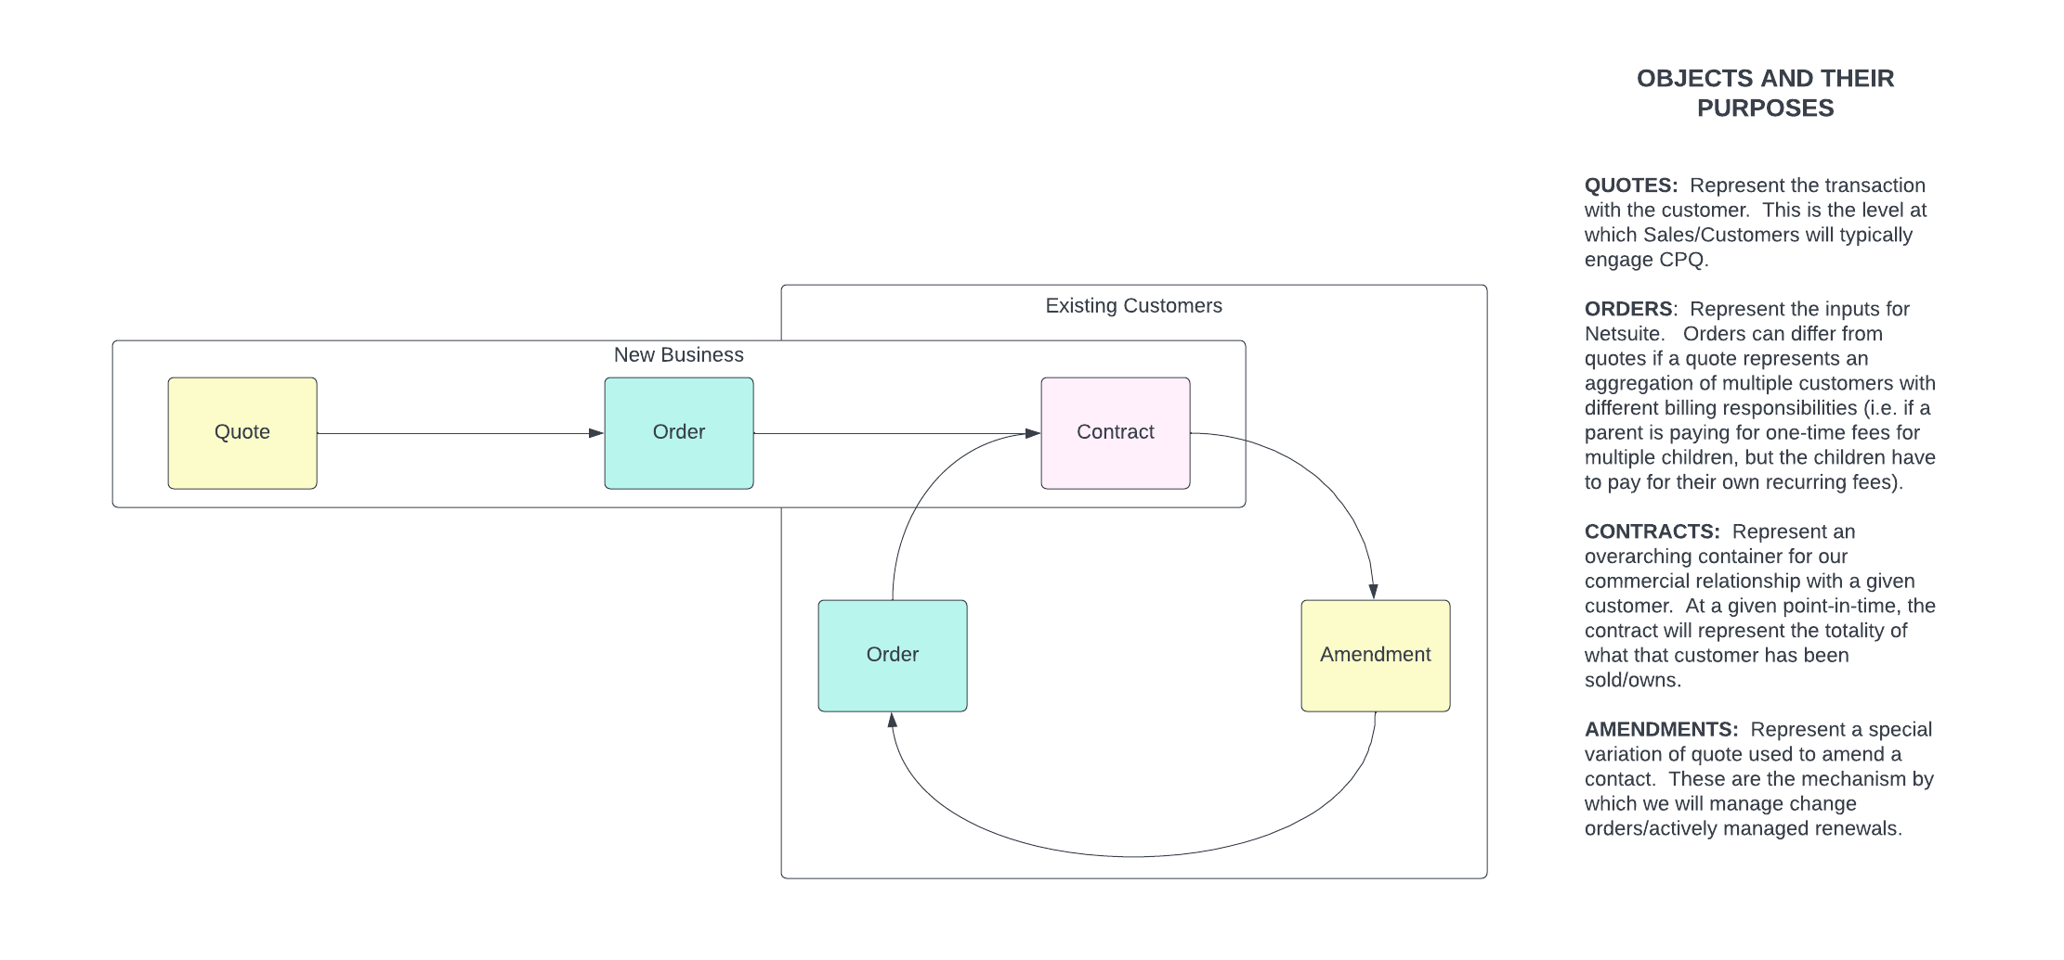
Customer Lifecycle from CPQ's POV

Slide 15
CPQ How-To
Create a quote
Add products to a quote
Configure products
Discount products
Submit for approval
Generate proposal
Close an opportunity
Create an amendment
Cost plus markup
Adding a partner for integrator reseller
Approval workflow

Slide 16
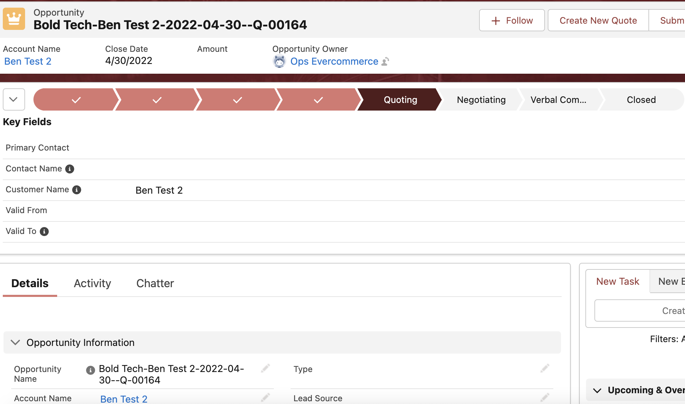
Creating a Quote
From the opportunity:

Slide 17
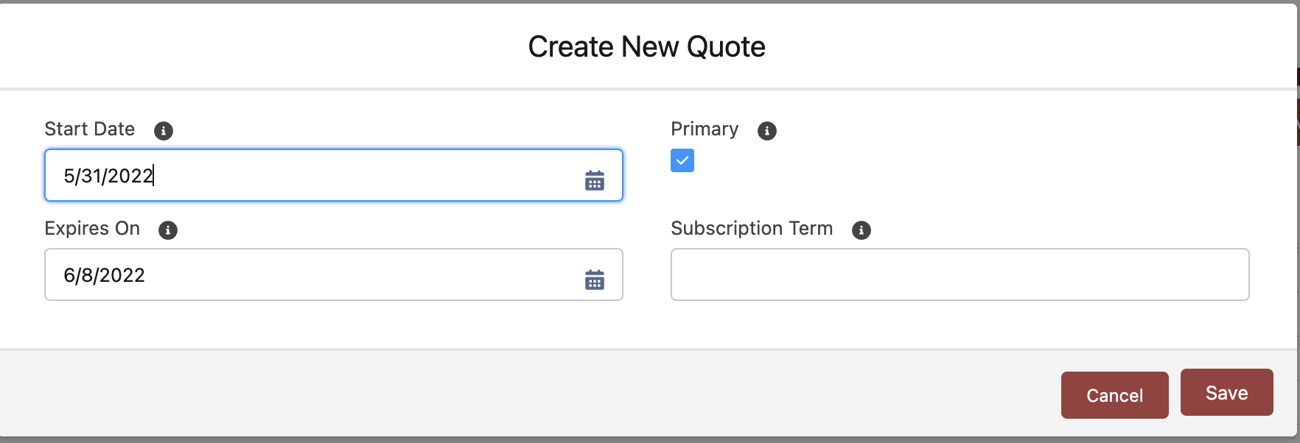
Creating a Quote
When creating a new quote be sure to check the “Primary” box and add a Start Date:

Slide 18
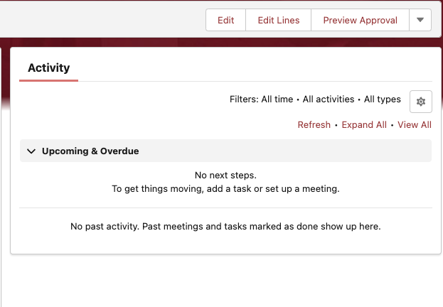
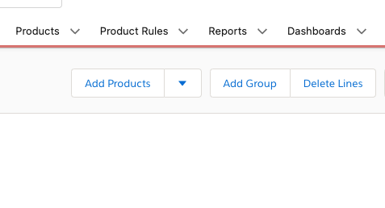
Adding Products to a Quote
From the quote:
After clicking "Edit Lines":

Slide 19
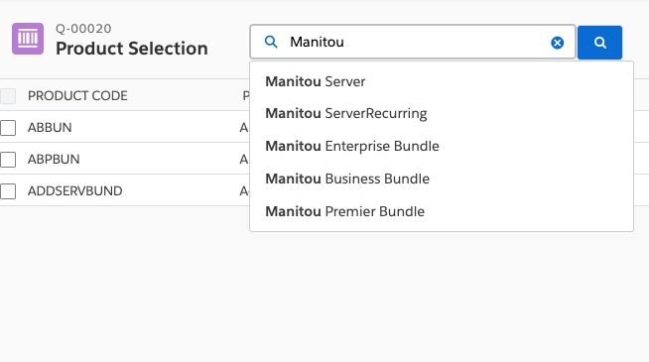
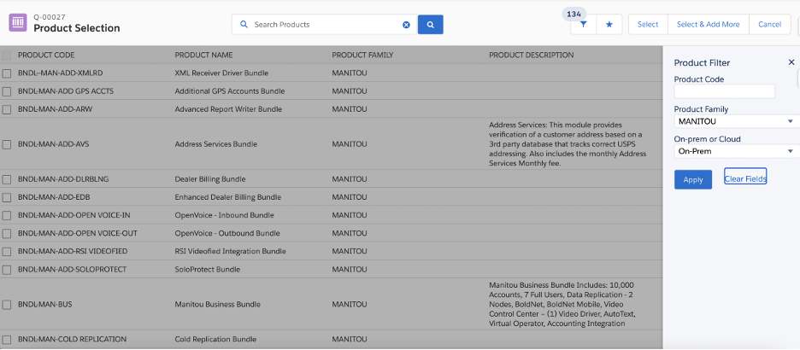
Adding Products to a Quote
Using the search feature:
Using Search Filters:

Slide 20
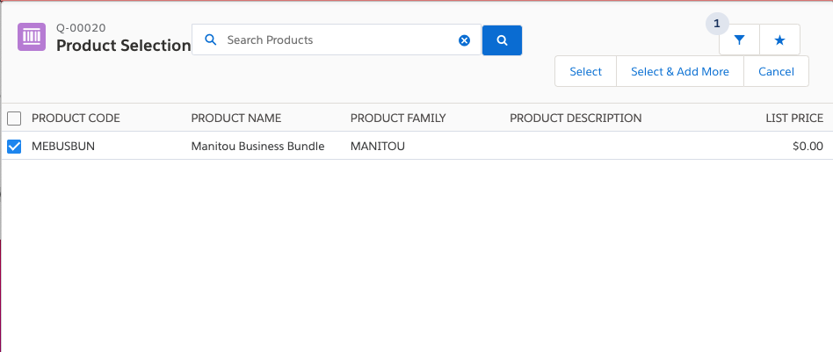
Adding Products to a Quote
Selecting your Product:

Slide 21
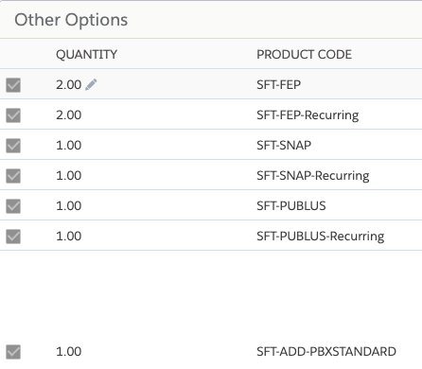
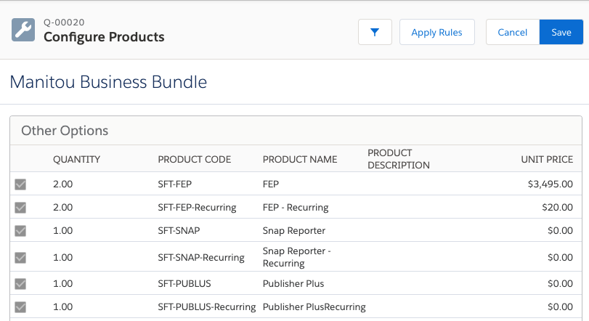
Configuring Products
Editing quantities of line items:
Saving the bundle:

Slide 22
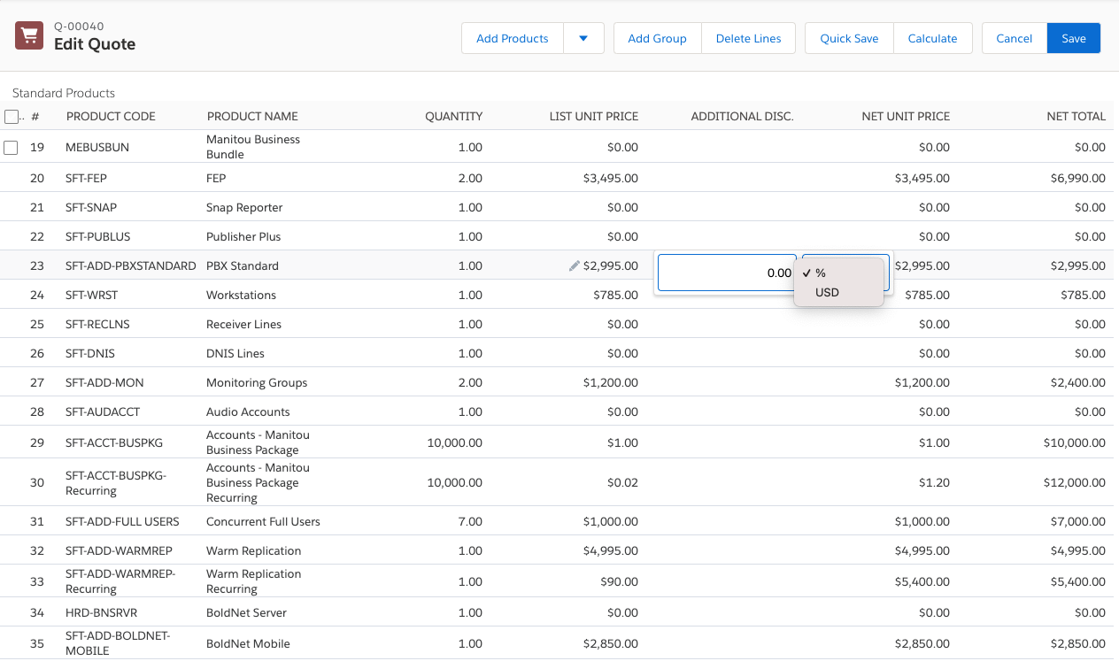
Discount Products
After clicking save:

Slide 23
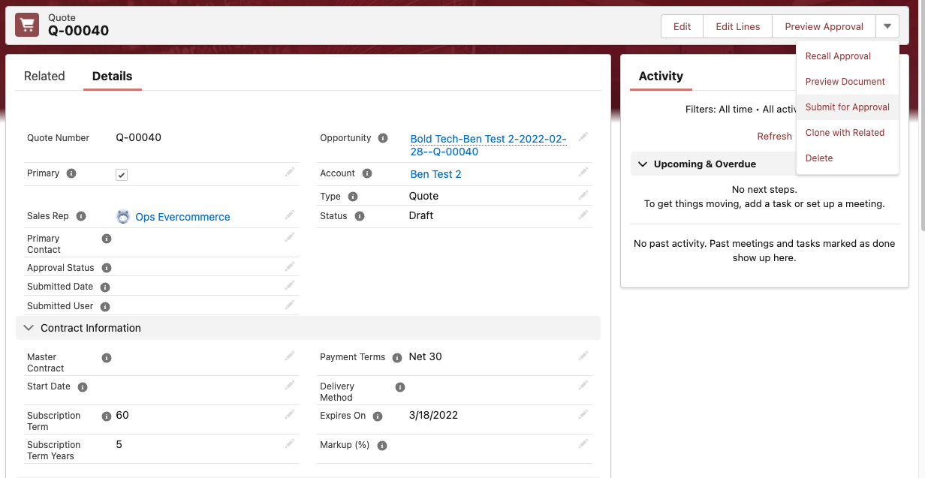
Preview and Submit for Approval
From the quote:

Slide 24
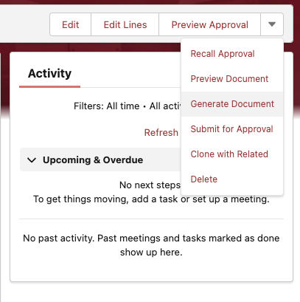
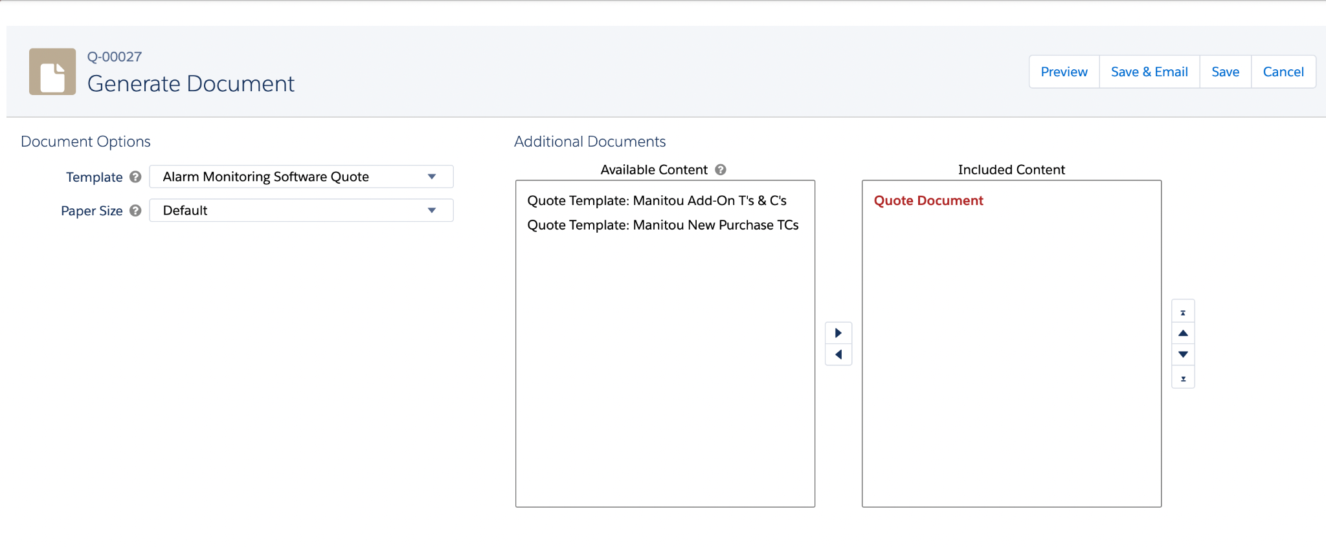
Generate and Send the Document
Once the quote is approved:
Select Template, T’s & C’s, and Generate:

Slide 25
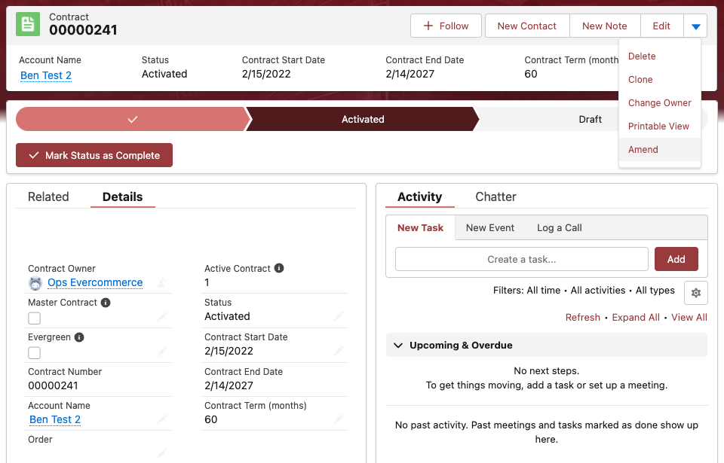
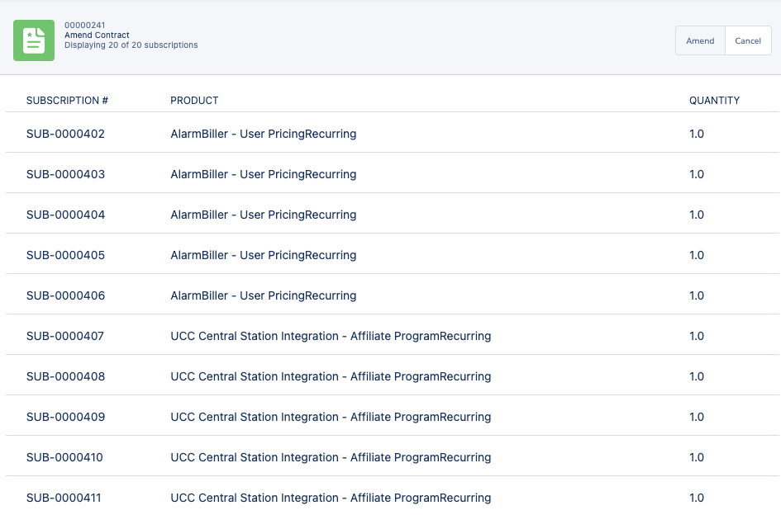
Create an Amendment
From the contract:
Generating the amendment:

Slide 26
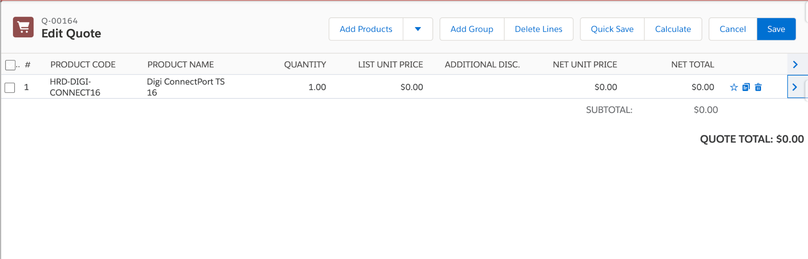
Cost Plus Markup
After selecting your Cost Plus Sku:

Slide 27
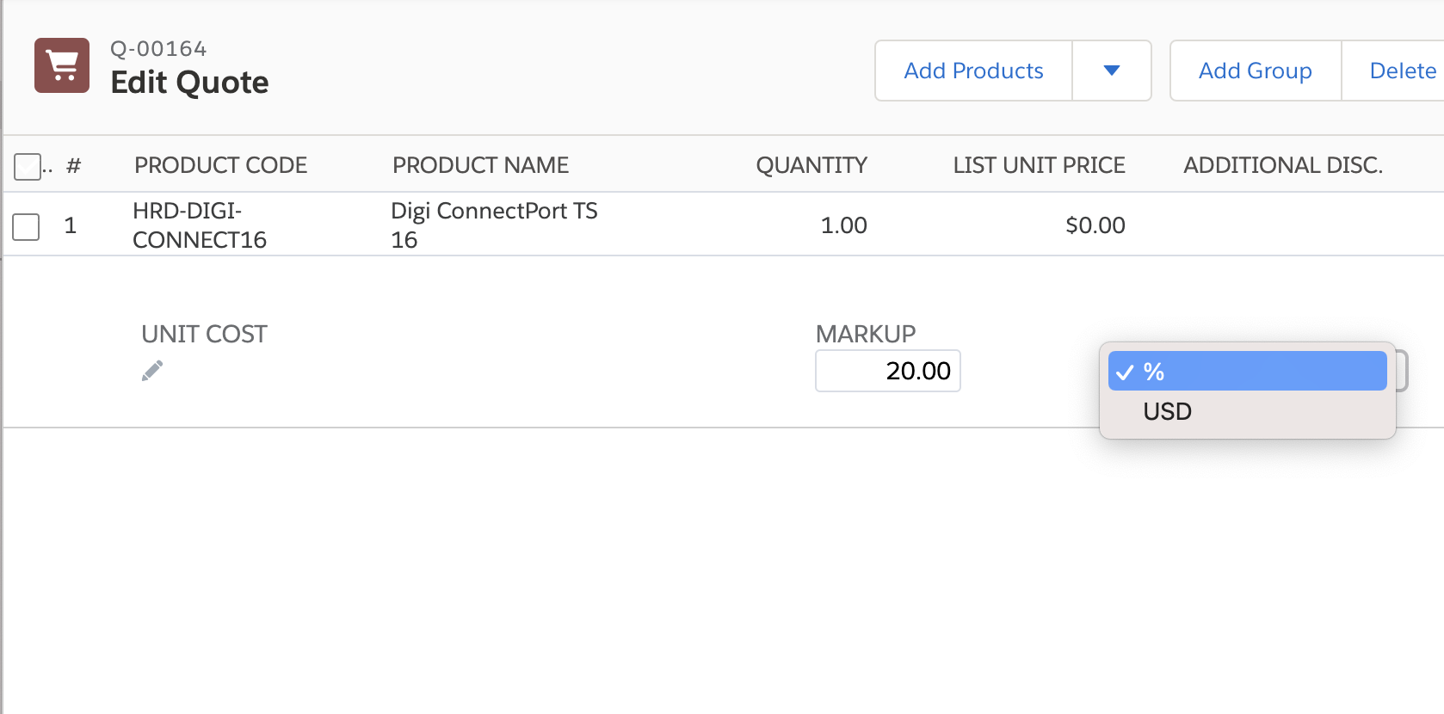
Cost Plus Markup
Enter your Unit Cost and Markup Percent/Amount:

Slide 28
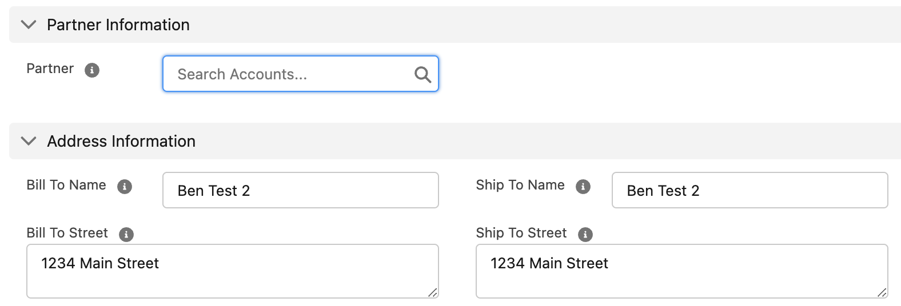
Add a partner for integrator reseller
Enter the Partner Account:

Slide 29
Approval workflow
Discount Percentages and Associated Approvers:
Discount Percent | Approver
>5% | Sales Manager
>10% | Sales/Sales Ops Director
>20% | President
Note that discount percent flags for approval whether it’s applied to an individual line item or the value of the entire quote.

