Slide 1

About us – corporate overview

Slide 2


Who IS BOLD GROUP?
For over 40 years, Bold Group has served the security and alarm industry with the most comprehensive array of alarm monitoring and integrated financial and business management solutions tailored to achieve optimal business performance for central monitoring stations, dealers and integrators.
Bold Group was established in March, 2019 with the operational merger of Perennial Software, Bold Technologies, SIMS and Secure Global Solutions (SGS).
Notes:
Bold Group is the security industry’s trusted provider of mission-critical alarm monitoring and financial management technology. We’ve brought together the most comprehensive portfolio of offerings available and supported by a network of strategic partnerships; we believe in the power of flexible, automated solutions to help our customers achieve their business goals while they ensure the safety and security of life and property for their customers. Through 24/7 technical support, robust ongoing training programs and a consultative partner approach, Bold Group is dedicated to building on our 40 years of experience with forward-thinking innovation to drive the future success of the industry.
The Bold Group product portfolio features the renowned alarm monitoring systems Manitou, stages™, and SIMS. These leading alarm monitoring systems are complemented by the industry’s top accounting and business management systems including SedonaOffice and AlarmBiller. This comprehensive portfolio of solutions is supported by a network of strategic partnerships, 24/7 technical support, and robust ongoing training programs.

Slide 3



COMPANY PROFILE
Parent Company: | EverCommerce
Product/Solution: | Bold Group offers the most comprehensive array of alarm monitoring and integrated financial solutions for the electronic security industry.
Established: | Bold Group established in March, 2019 with the operational merger of Perennial Software, Bold Technologies, SIMS and Secure Global Solutions.
Acquisition: | EverCommerce purchased Perennial Software in February 2018, Bold Technologies in May 2018, Security Information & Managements Systems (SIMS) December 2018, and Secure Global Solutions (SGS) in January 2019.
Associates: | 115
Customers: | Small to medium businesses to large enterprises, based globally. Companies monitoring anywhere from 10 accounts to upwards of 1M+.
Global Headquarters: | EverCommerce - Denver Colorado; Bold Group - Colorado Springs, CO
Regional Headquarters: | Chagrin Falls, Ohio; Canton, Michigan; Plano, Texas; Irvine, California; Mequon, Wisconsin
Bold Group President: | Alison Forsythe
3

Slide 4






FOUNDATION JOURNEY
FOUNDED
ACQUISITIONS
ESTABLISHED
1983
2006
February 2018
December 2018
March 2019
1981
1999
May 2018
January 2019
4
Notes:
40+ Years of Experience
Bold Group was formalized in February 2019 following the acquisitions and mergers of Bold Technologies, Perennial Software, Secure Global Solutions and SIMS.
By combining these top companies and industry-renowned technologies, Bold Group offers the most comprehensive array of alarm monitoring and integrated financial solutions for the electronic security industry.
Bold Group delivers the flexibility and resources to grow and realize future plans for integrated solutions within our dynamic industry.

Slide 5



ONE
COMPANY
5

Slide 6



ALARM MONITORING & FINANCIAL MANAGEMENT
Alarm Monitoring Software
Business Management Solutions
On-Prem
6
Comprehensive array of solutions for the Security Industry

Slide 7


INDUSTRY LEADERSHIP
trusted
Over 40 years of experience.
60 of the top 100 SDM Security companies are Bold Group customers.
Are in use at over 800+ monitoring centers worldwide.
Reputation for developing long-term, 10+-year relationships built on long-lasting customer-success.
Supporting monitoring centers serving millions of accounts and billions of dollars in assets.
Enjoy peace of mind when working with a partner who has earned the industry’s trust for decades.
7

Slide 8


The Bold
difference
Proven Industry Leadership & Vision
Comprehensive Suite Of Industry Specific Software
Integrated Alarm Monitoring And Business Management Solutions
Depth Of Experience And Expertise
Trusted In the Industry With Long-term, 10+-year Relationships, Built On Long-lasting Customer-success
Allows Customers Full Ownership Of Their Data
Corporate Strength And Stability (Evercommerce^{sm} Parent), Committed To Growth And Longevity
8

Slide 9















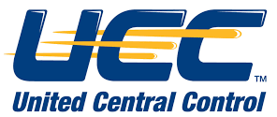






















Serving the largest organizations in the world
Alarm monitoring
CENTRAL STATIONS | DEALERS | COMMERCIAL / SLED / FED

Slide 10




















Serving the largest organizations in the world
Business management

Slide 11

Serving the largest organizations in the world
Alarm monitoring
CENTRAL STATIONS | DEALERS | COMMERCIAL / SLED / FED

Slide 12
Serving the largest organizations in the world
Business management

Slide 13

mission
To be the market leader in providing automated technology solutions to the security industry, enabling our customers to enhance and grow their business.

Slide 14

vision
We understand that each customer has their own goals they need to achieve, whether it be organizational growth, faster response times, workflow standardization or others. Bold Group will help find the right solution to meet each customers specific goals.

Slide 15

values
We take pride in our core values:
Reputation – built on integrity and honesty
Team Players – we hire the best people who take ownership for their work
Invested – our employees are invested in the success of their peers and our company
Innovation – we encourage forward-thinking and creative solutions to problems
Family – we maintain a culture of respect, encourage a fun environment and give back to our communities
Notes:
Our reputation is built on integrity
and honesty with a foundation of
superior products and service.
We hire the best: team players,
self-starters, and peer leaders
with a positive attitude who take
ownership in their work.
We encourage innovation and
welcome forward-thinking, creative
solutions to problems.
Our employees are invested in
the success of their peers and our
company. They provide our clients
with a best experience possible.
We are a family and maintain a
culture of respect, a fun environ-
ment, and a willing heart to give
back to our community.

Slide 16
Alarm monitoring

Slide 17

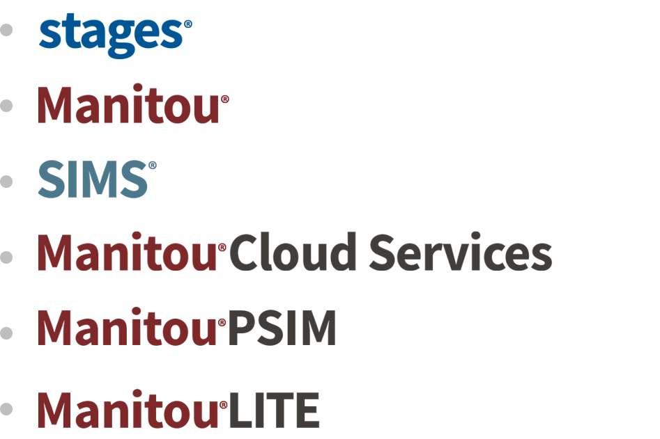
Our products
Alarm monitoring software that supports critical services that ensure the safely and security of life and property
17

Slide 18
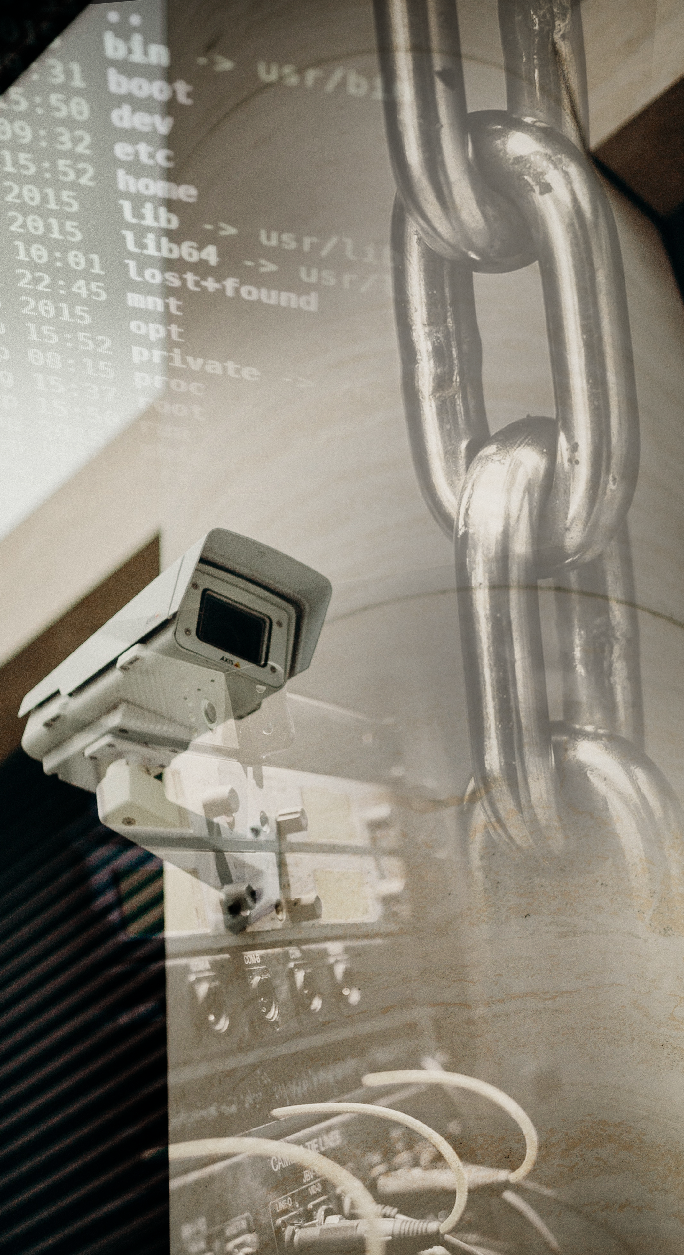
what we solve
Serving your customers at a high standard by providing security specific software solutions and 24/7 support.
Reducing costs by minimizing equipment and helping you stay current with the latest technology through Cloud based offerings.
Improving and enabling repeatable processes.
Access and better visibility of aggregated data.
Allowing for
More control to better drive operator efficiency.
Measurable metrics and outcomes aimed at driving business growth.
Increased efficiencies and increased operators-to-customer ratio.
Reduction of double data entry
18

Slide 19
Business management

Slide 20

Our products
Financial management and business operations software designed specifically for security companies.

Slide 21

what we solve
Automate accounting capabilities to drive accurate and consistent cash flow.
360-degree view of your business with one software application built for the industry.
Allow for deeper visibility into customer attrition.
Automate RMR, eliminating manual billing processes.
Allowing for
Reduce costs by minimizing labor and costly 3rd party software
Enable customers to focus on growing their business
Better business intelligence with reliable metrics

Slide 22
The bold experience

Slide 23


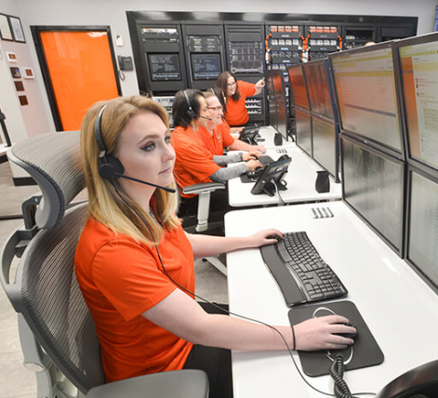

who we serve
CENTRAL STATIONS
SECURITY DEALERS/INTEGRATORS
PROPRIETARY/COMMERCIAL
FULL-SERVICE INSTALLATION & MONITORING
FULL-SERVICE INSTALLATION & MONITORING
INSTALL ONLY
RETAIL – GOVERNMENT - EDUCATION
3RD PARTY MONITORING
23

Slide 24
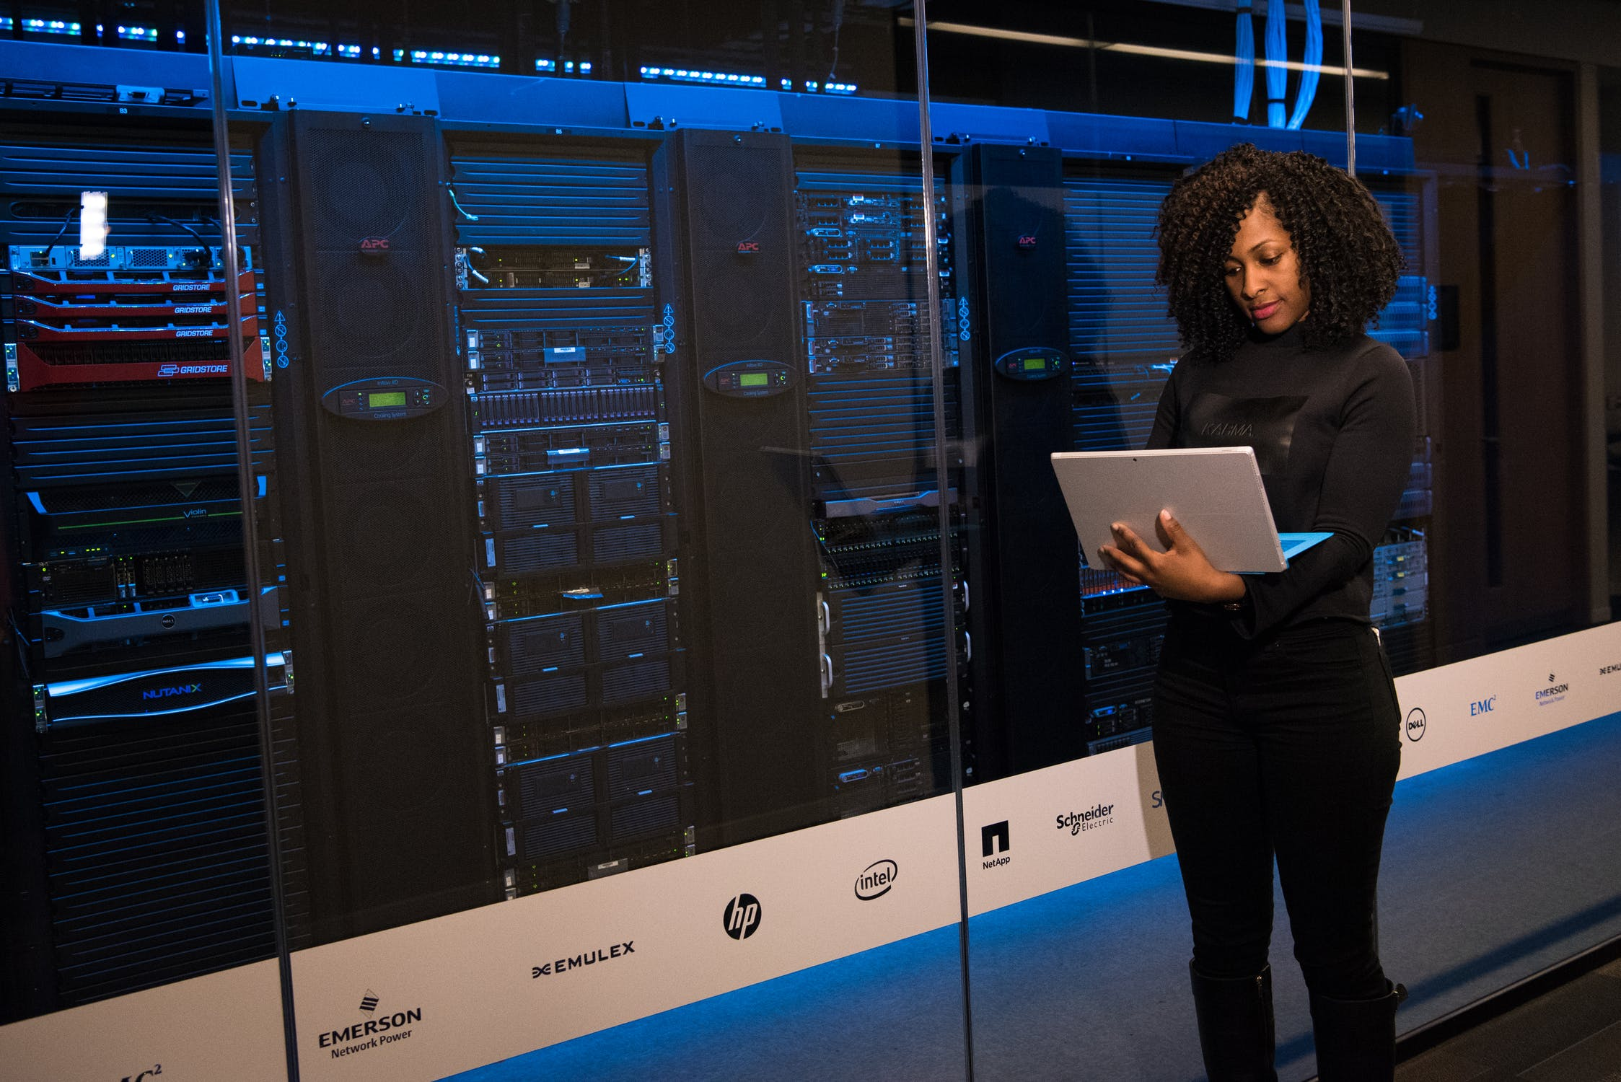







Services & support
Professional Services
With extensive knowledge of the industry, our data conversion and development teams help onboard your team for success and help you manage change.
Training
Our commitment to industry excellence and ongoing training with BoldU fosters a thriving learning community.
Strategic Consulting
We can work with you to customize a specific solution to our software based on your specific needs.
Support
Bold Customer support provides support Monday
through Friday, 8am – 8pm MST.
Emergency support through our Network Operations Center.
Our online support portal provides quick and easy access to submit requests and ask questions whenever needed.
24
Notes:
Professional Services
With extensive knowledge of the industry, our data conversion and development teams provide expertise to help you grow your business and manage change.
Data Conversion Services
Data Analysis
Development Services
Bold Consulting Services
Strategic Consulting
We can work with you to customize a specific solution to our software based on your specific needs. Work with one of our industry specialists to help optimize the capabilities to help grow your business.
Training
Our commitment to industry excellence and ongoing training with Bold U fosters a thriving learning community. Through free webinars, virtual/classroom-based training, and our Bold U we provide hands-on learning opportunities for our software users.
Support
Bold Customer support provides support Monday through Friday 7 - 5 MST. And 24/7 services for emergency situations. Our online support portal provides quick and easy access to submit requests and ask questions whenever needed.

Slide 25


The Onboarding
experience
Our implementation team works to answer your questions, clarify procedures, and provide change management support. We work hand-in-hand to assist you through the entire transition process by scheduling and tracking the tasks of the implementation including:
Hardware ordering and installation
Software installation
Signal verification (*alarm automation only)
Data collection
Data conversion
Data review
Training
Go-Live
25

Slide 26
HARNESS THE POWER TO GROW
THE POWER OF SOLUTIONS
To help you improve processes and drive efficiencies to focus on growing
your business
THE POWER OF DATA
See your business from a new perspective using your data to gain visibility and
identify areas of opportunity
THE POWER OF EXPERTISE
Experience, dedication and innovation fuel every solution we tailor to solve
your real-life challenges
THE POWER OF TRUST
Enjoy peace of mind when working with a partner who has earned our
industry’s trust for decades
26

Slide 27
THANK YOU

