Slide 1

AlarmBiller Sales & Marketing Tool Kits
For Central Stations

Slide 2

Background
Bold Group provides an opportunity to Central Stations to become an Affiliate to promote AlarmBiller to their dealer customer base.
For those Central Stations already using Stages as their alarm monitoring platform, the ability for a dealer to integrate its financial and operational management software with the Central Stations alarm monitoring drives significant differentiation and value for both organizations.
A Central Station now has a unique differentiator to elevate from their competition and a dealer can now streamline their operations.

Slide 3
Partnership
Strategy
Dealer
Central Station
Bold Group
BoldGroup: | Central Station: | Dealer:
Provide world-class products Provide sales kit to enable the Central Station Provide marketing kit to enable Central Station Provide customer support and service | Leverage existing dealer customer base to promote Alarm Biller Support the integration of AlarmBiller and stages for new customers | Get maximum impact and value of using AlarmBiller software

Slide 4

Roles
What is Bold's role in this partnership?
Continue to develop options and provide support towards removing barriers so you can realize your company’s greatest potential.
This effort includes providing the AlarmBiller/Stages integration and incentivizing you to market the benefits of this integration to your customers.
What is your role in this partnership?
Pursue dealer engagement and offer AlarmBiller by leveraging the Stages integration. To make it easier, we’ve provided a Central Station Sales Kit and Marketing kit to help you spread awareness of AlarmBiller and the integration’s benefits.

Slide 5

Value
Realize a return on both AlarmBiller and Stages investments by leveraging the power of integration and affiliation
Find remarkable increases in efficiency and productivity
throughout your business
Appreciate the edge you gain in our increasingly competitive market.
Realize greater returns and brand recognition as your customers see the advantages of working with you and using AlarmBiller to manage their own business
rive customer retention and loyalty.

Slide 6

Benefits
Revolutionary Integration:
Linking AlarmBiller to Stages creates a single point of data entry, reducing data entry while
improving accuracy.
Optimal Visibility:
The customer’s information populates on both AlarmBiller and Stages platforms.
Handle customer service from a single pane of glass –no more putting customers on hold while searching for information across several platforms!
Economical Attractiveness:
Changing accounting platforms can be burdensome, but customers will gladly do it if the benefits are significant enough.
AlarmBiller makes accounting straightforward.
Dealers already using AlarmBiller will be more likely to join your central station customer base.
Customer Loyalty:
Your AlarmBiller customers are far less likely to go elsewhere realizing more customer retention and stable RMR.
New Dealer Acquisition:
Leverage this integration providing a new product offering and providing differentiation from the competition.

Slide 7

PROGRAM DETAILS

Slide 8

Program Overview
  What: Activate net new sales and improve customer retention for
  central stations and Bold Group
  How: Providing a sales and marketing tooklit, and support to help promote Athrough leveraging the integration with Stages
  Who: Existing customers of central station who may or may not have AlarmBiller & Net new dealer opportunities for central stations
  Where: North America
Why: By leveraging the integration between Bold Group’s alarm monitoring and financial management solutions provides a unique differentiation; drives additional value and revenue opportunities for central stations; and growth opportunity for Bold Group

Slide 9


Process for how will we support you
Central Station (CS) starts to tell Dealers about AlarmBiller
If a dealer is interested, the CS submits through the Landing page
From the Landing page, Bold Group gets the lead, and a Bold Group representative sets up the meeting with the Dealer to go through ‘First call pitch’ and product overview
After first call, if Dealers are still interested, Bold Group helps set up a demo
Bold Group will then set up a scoping/licensing call
Bold Group will help prepare a proposal for the Dealer
Dealer purchases AlarmBiller and notifies CS
Dealer is contacted by Bold Group Implementation PM to start post sales implementation process
Implementation and integration is completed
Go-Live

Slide 10

Partner Agreement
Please see details of individual CS referral agreement
Host webinars permitting Company to co-host
Include marketing materials in Partner newsletters or other mass communications, by electronic or physical delivery to Partner Customers
Invite Company to attend Partner hosted events

Slide 11

SALES PLAYBOOK

Slide 12

Questions to ask your dealers to qualify an AlarmBiller opportunity
What are you using for your back office automation, billing, and accounting today? Are you happy with it? Is it tailored for you as a security dealer or more of a generic solution like quickbooks?
Are you still using a lot of paper invoicing, paper contracts, paper proposals?
Would a solution that combines back office automation, billing as well as accounting AND integrates with our alarm automation here at the central station be of interest?
Are you aware of how AlarmBiller integrates with Stages (our alarm automation solution here at the central station)?

Slide 13

AlarmBiller FAQ’s
WHAT IS ALARMBILLER?
AlarmBiller is a web application to run and operate your business. AlarmBiller provides you with all the functionality to manage your customer base, including billing, recurring billing, work order management, inventory, payment processing, credit card and eCheck processing.
IS ALARMBILLER JUST A BILLING APPLICATION?
No, AlarmBiller is an all-in-on business management application specifically designed for the physical security space. It includes functionality such as accounting, inventory management, work order management, accounts payable, customer web portal and much more!
WHAT IS MEANT BY "USER"?
A User is any person who uses your AlarmBiller software. Each of our Packages are 'right-sized' to include a specific set # of Users however you can optionally add Users beyond the number included. We have optional add-on modules that can be added to the core AlarmBiller software.
DO I NEED TO BUY THE BOLD SUCCESS LAUNCHPROGRAM?
Yes. All new AlarmBiller customers purchase BOLD SUCCESS LAUNCH PACK to ensure they get started on the right track. AlarmBiller is much more than just an out of the box software package; it’s about transforming your security business to be more efficient, customer-centric, and profitable.

Slide 14
AlarmBiller FAQ’s
ARE THERE ANY SEPARATE ADD-ON FEES?
Yes. AlarmBiller customers can optionally add additional features like; Mobile APP, Time & Attendance, SalesAutomation CRM and eForms. See ‘Additional Features’ for monthly costs per application or consider discussing your specific needs with one of our AlarmBiller reps.
DO I NEED TO PAY FOR A YEAR UPFRONT?
No. You are welcome to pay month-to-month, however, you'll receive a 10% discount off the monthly package rates when you pay annually.
HOW DOES A FREE TRIAL WORK?
Your Free trial provides you with a full version of AlarmBiller and the only limitation will be an inability to process credit card payments. This requires applying for Merchant Services through AlarmBiller.
WHAT DO I NEED TO GET STARTED?
Simply submit your information on our website or call (440) 247-1640. All new customers can use AlarmBiller for up to 14 days for no charge.

Slide 15
AlarmBiller FAQ’s
ARE THERE ANY SYSTEM REQUIREMENTS?
AlarmBiller is an Web based application, so if you can get on the web, you can use AlarmBiller.
WHAT FORMS OF PAYMENT ARE ACCEPTED?
ACH, MasterCard, Visa, American Express and Discover payments are all accepted.
WHAT ARE THE ASSOCIATED FEES FOR ONLINE PAYMENT?
Online payment fees are assessed by Forte with a low negotiated rate. Online payment is built into the application. Contact Sales for more information.
AM I ABLE TO IMPORT MY EXISTING CUSTOMERS?
Yes, we have an import utility. You can use our Excel template; simply load your existing data into our Excel template and with a press of a button all your account data will be imported.
DOES ALARMBILLER INTEGRATE WITH QUICKBOOKS?
Yes. We have an import/export utility to import intoQuickBooks versions 2008 and later.

Slide 16

Pricing
SalesAutomation
CRM & Proposal Writer
Lead generation and management, advanced estimating, proposal generating. Creates & updates customers, work orders, and invoices within the AlarmBiller application automatically.
Fee: $25/user/month
eForms
Create custom forms, import existing PDF documents, collects signatures electronically. Includes unlimited reusable templates, unlimited delivery & signatures, custom branding, reminders, in-person signatures, AlarmBiller integration.
Fee: $25/user/month
Time & Attendance
Keep track of hours logged by employees using Time & Attendance. Time & Attendance is an employee time tracking application designed to help companies take control of their work force.
Fee: $25/Month | Includes 5 users
Additional Users: $5/user/month
Central Station Integration
Fully integrate AlarmBiller with Stages alarm automation software to help reduce data entry, synchronize databases and alleviate error. Included in the monthly fee if your central station if part of our Affiliate Program.
Contact sales for more information
Professional services are separate, please contact sales for more information
Description of Services
AlarmBiller Application Suite
AlarmBiller is the leading business management and billing software in the industry. It is an end-to-end software solution fully inclusive of: Client Management, Accounts Receivable, Accounts Payable, General Ledger, Inventory, Estimates, Warehouses, Dispatch Board, Document Management, Customer Web Portal, RMR Tracking, Task Management, Billing Automation.
Fee: $125/month | Includes 1 user
Additional Users: $40/user/month
Sedona-X Mobile App
Field Service Application
Field service application designed for techs to complete work order using an app/web application. Mobile apps empower field workers to successfully complete complex work orders, present service reports for customer signature, provide dynamic pricing of labor, parts and products in the field and much more. This cross-platform app works on iOS and Android devices.
Fee: $40/user/month

Slide 17
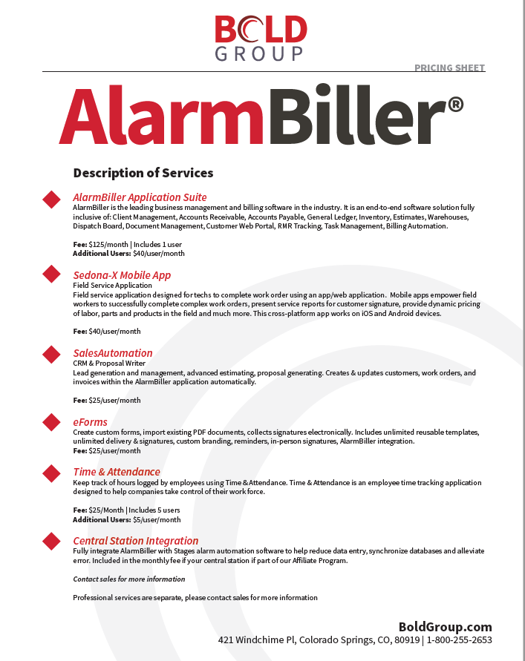
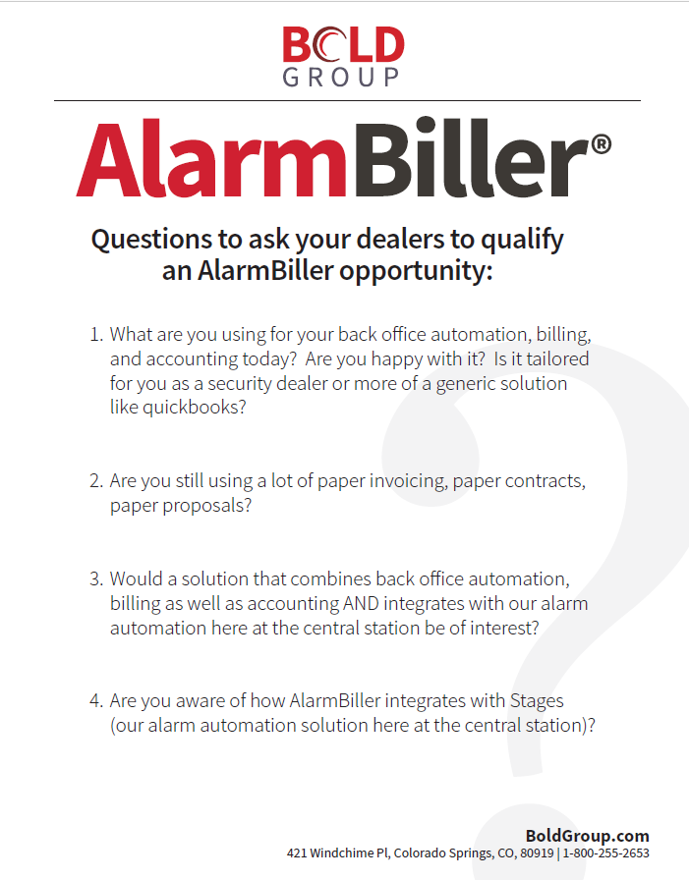

Pricing Sheet and Qualifying Questions

Slide 18

MARKETING TOOLKIT

Slide 19

Overview
Provided a series of marketing materials that you can use to help promote:
  Awareness of the AlarmBiller Software
  Education around the availability and integration of AlarmBiller/Stages
Ability to customize for co-branding
All files will be available via DropBox link to download

Slide 20

Campaign Goals & Objectives
What are we trying to achieve through our marketing campaign
Drive awareness about AlarmBiller and how it can help reduce manual redundant tasks and streamline a dealer’s financial operations​
Educate and Inform our audience how the AlarmBiller and Stages integration brings value through increased efficiency and productivity.​
Convince dealers to choose your central station because you offer the AlarmBiller/Stages integration
​
Convince dealers to choose or change to AlarmBiller to leverage the unique value of the central station integration with Stages​

Slide 21




Campaign Strategies
How will we achieve our goals and objectives
Awareness​
  Develop solution focused marketing tools that drive the impact and value of a dealer using AlarmBiller​
Educate and Inform​
  Provide clarity and understanding of how AlarmBiller and Stages integrate, and ​the operational challenges and pain points it will help alleviate to drive overall ​business efficiency.​
Convince​
  Create an urgency and evoke the importance of how the AlarmBiller and Stages integration will help differentiate and grow their business. ​

Slide 22

Communication
Objective
What is the single most important thing we want our audience to do?​ (Get someone to do something because they believe…)
Get a dealer to sign-on with a central station because they believe that through the AlarmBiller/Stages integration they will be able to reduce manual redundant tasks and see significant cost reduction and increased revenue.

Slide 23

Audience
Dealers / Owner
Dealers / Finance Team
Key Attributes | Typically wears many hats in their company, can run all depts and job sites
Reputation | Professional, jack of all trades, very knowledgeable about the industry,
Job Focus | Overseeing all aspects of the company and it’s growth.
Pain Points | Staffing, technicians being able to create work orders and invoice in the field, being efficient, small admin staff. Competitive market.
Fears | Losing business, technicians not being able to complete a job start to finish. Unhappy customers.
Pet Peeves | Slow system response time, unreliable equipment, being unorganized
Internal Influences | Owner
Motivators | Creating a successful business
Information Sources | Rely on those in the industry, industry publications, conferences, tradeshows, industry certifications, CE’s
Key Attributes | Accounting background and has been in accounting for many years
Reputation | Professional
Job Focus | Overseeing the company finances and look to increase efficiencies and reporting.
Pain Points | Integration issues, tracking invoices and payments,
Fears | Inconsistent reports, data loss,
Pet Peeves | Slow system response time, out-dated hardware and software
Internal Influences | Company President, CEO, Board of Directors, CFO,
Motivators | Reliable metrics, job performance,
Information Sources | Rely on those in the industry, industry publications, conferences, tradeshows, industry certifications, CE’s

Slide 24

MARKETING TACTICS

Slide 25

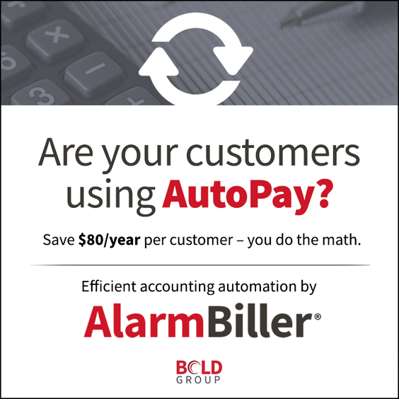
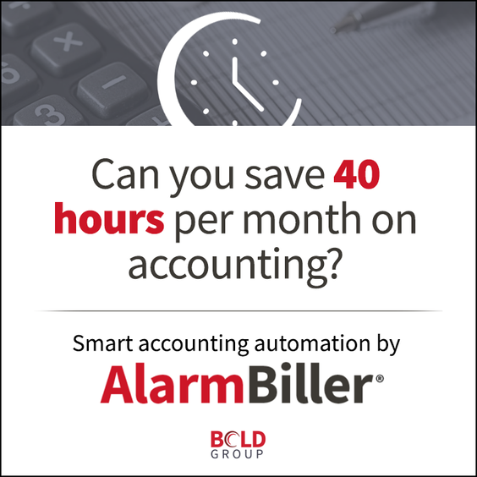
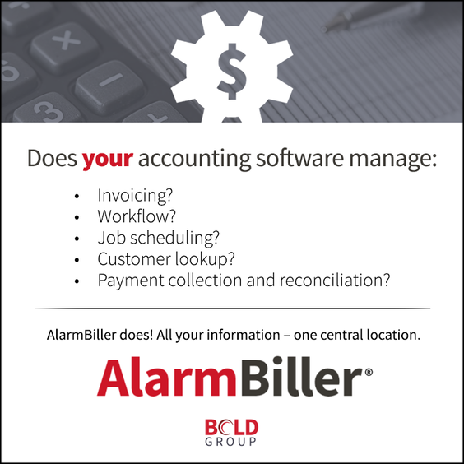


Awareness: AlarmBiller Display/Social Ads
Ad 1
What does boosting profit margin by 5% do for you?
You do the math – we’ll help your bottom line.
Efficient accounting automation by AlarmBiller.
[CTA]
Ad 2
Can you save 40 hours per month on accounting?
Smart accounting automation by AlarmBiller.
[CTA]
Ad 3
Are your customers using AutoPay?
Save $80/year per customer – you do the math.
Efficient accounting automation by AlarmBiller
[CTA]
Ad 4
Does your accounting software manage:
Invoicing?
Workflow?
Job scheduling?
Customer lookup?
Payment collection and reconciliation?
AlarmBiller does! All your information – one central location.
[CTA]
Ad 5
Does your billing software offer:
ACH payment processing?
Credit card decline handling?
No monthly statement fee?
Automated payment reconciliation?
24/7 payment options?
AlarmBiller does! All your information – one central location.
[CTA]

Slide 26
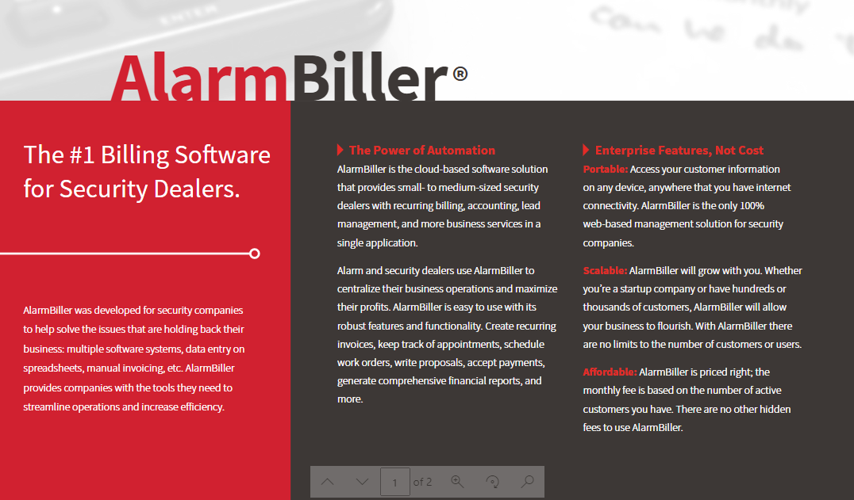
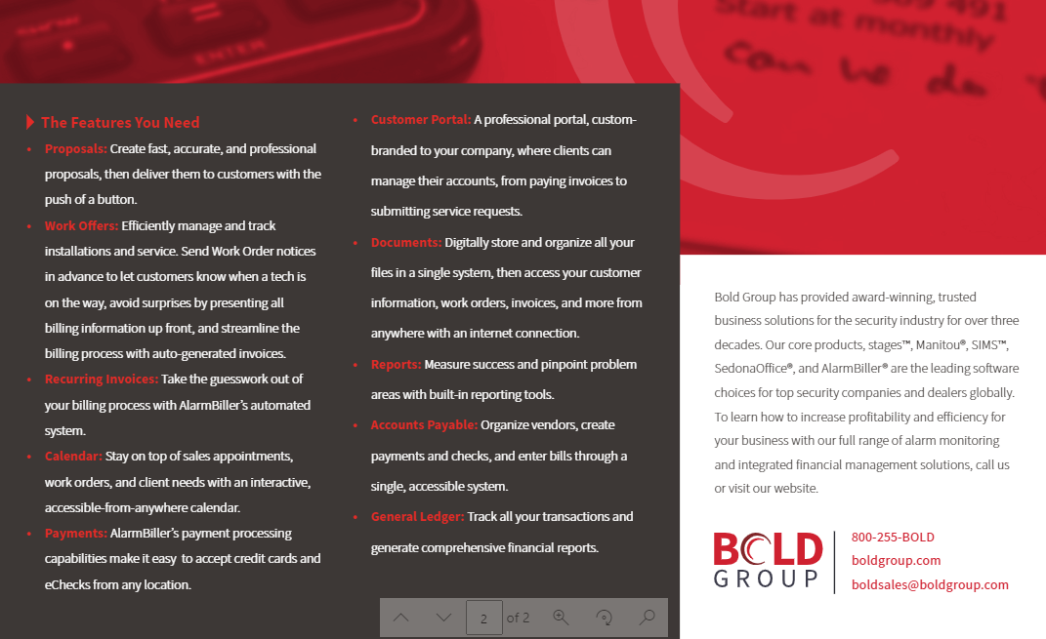
Awareness: AlarmBiller Data Sheet

Slide 27
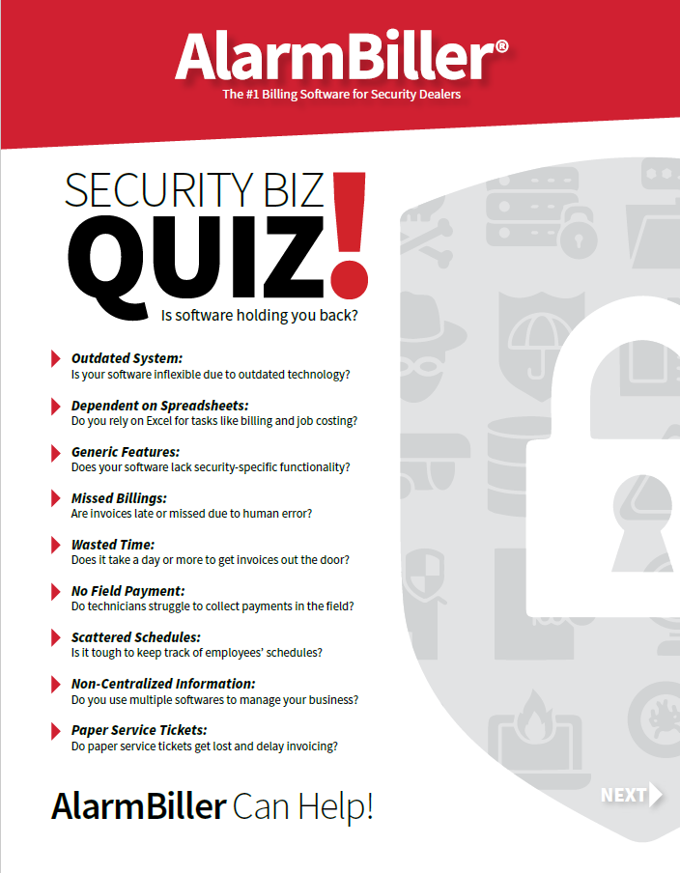
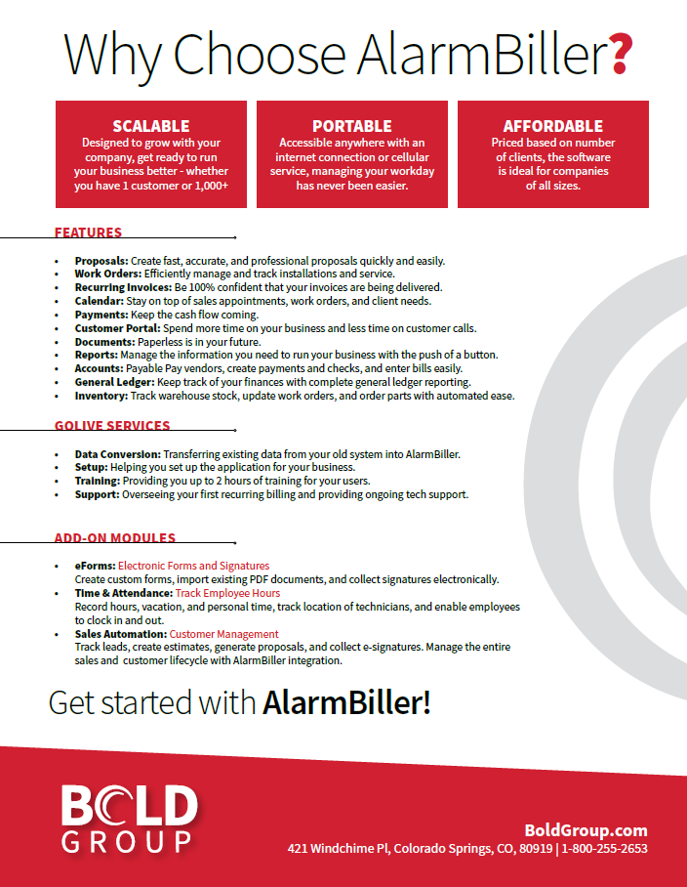
Awareness: AlarmBiller Brochure

Slide 28
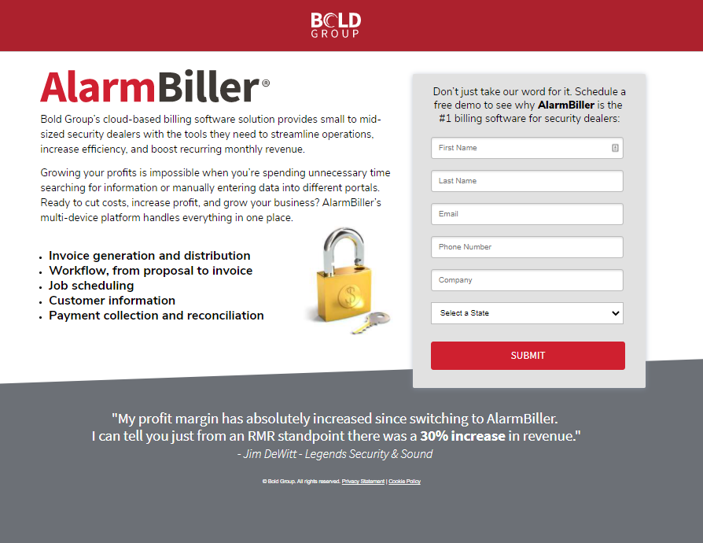


Awareness: AB Lead Landing Page

Slide 29



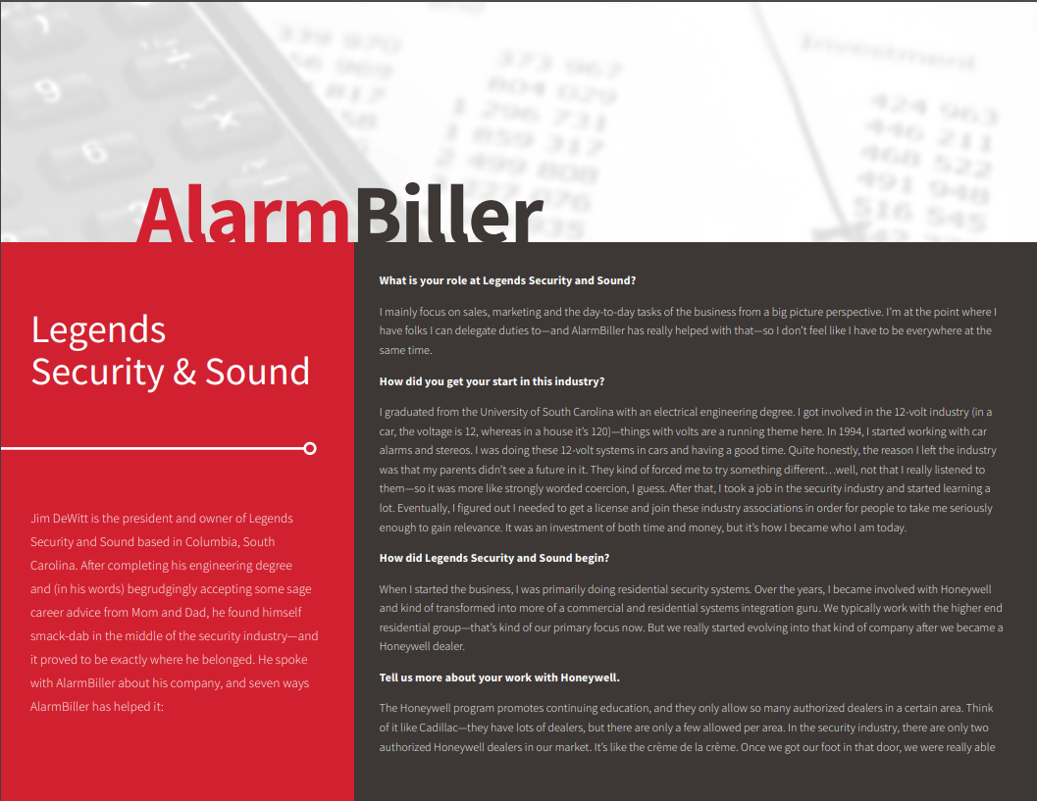
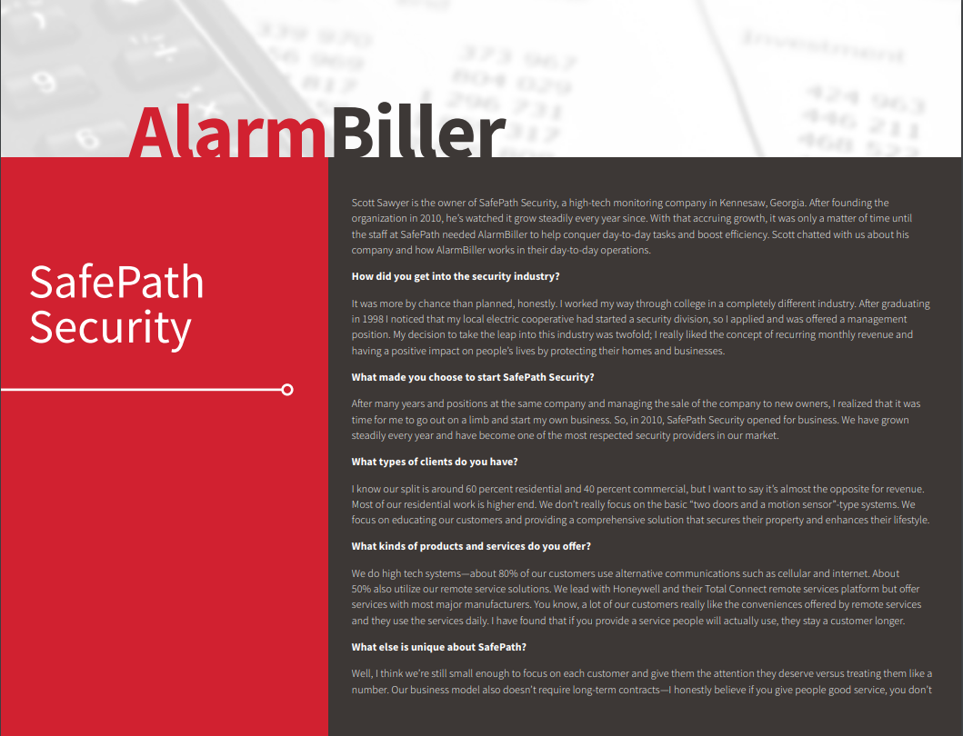

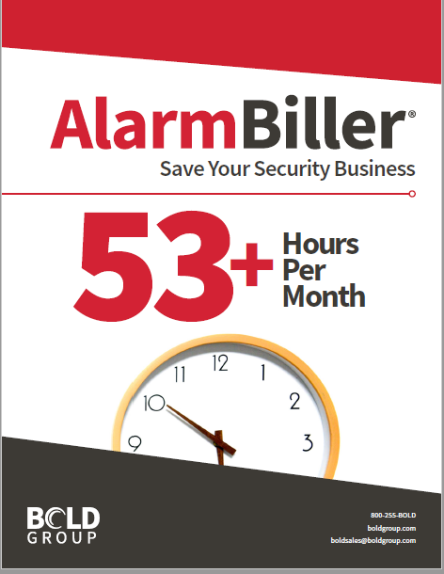
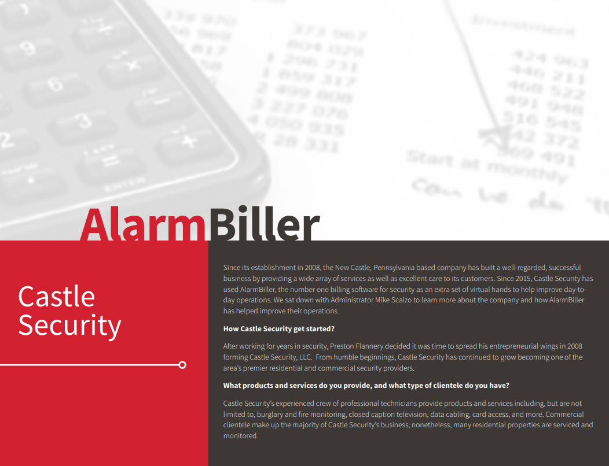

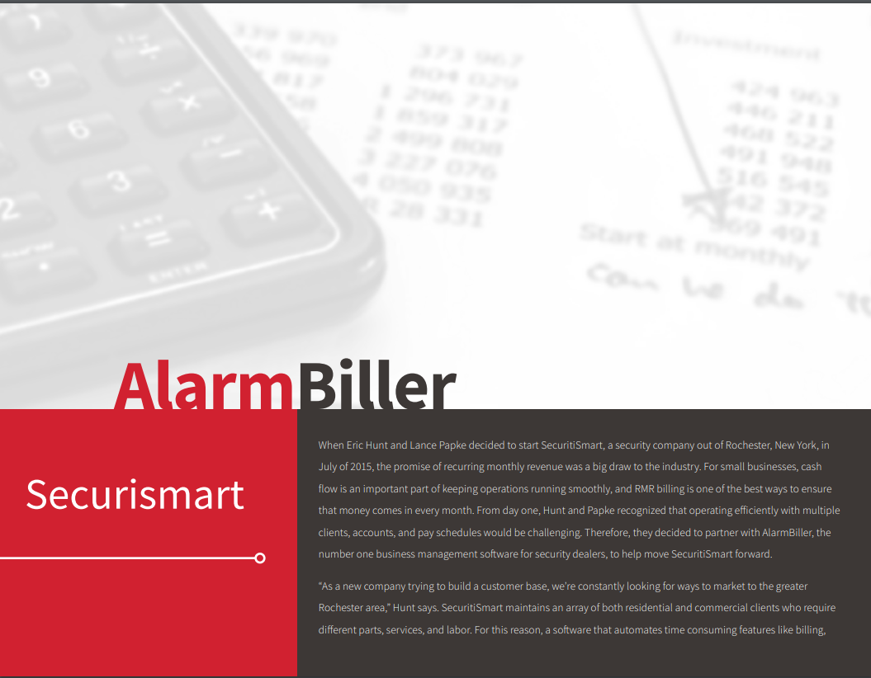
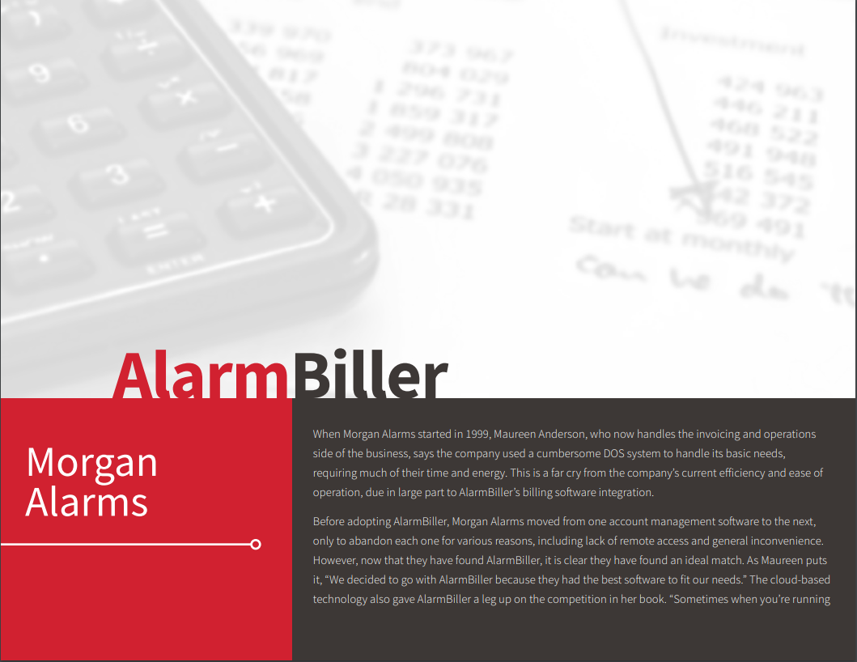
Awareness: AB Content
ebooks
Articles
Case Studies

Slide 30

Awareness: Emails
Email #1:
Subject Line: Is software holding you back?
Pre-header text: Take back your time
Does your current financial and business management software solution force you to:
Spend days manually generating invoices?
Rely on spreadsheets?
Host a scavenger hunt to find customer information?
Schedule technicians through a third-party calendar?
Take back your time and break free from billing bloopers and blunders.
AlarmBiller’s cloud-based billing software solution provides you with the tools you need to streamline operations, increase efficiency, and boost recurring monthly revenue.
If you’re ready to maximize efficiencies and grow your business, please contact us today [LINK]
Email #2:
Subject line: Streamlining every function in a single platform
Pre-header text: One multi-device platform handles everything
Reduce manual redundant tasks and streamline your financial operations today. The AlarmBiller Software solution provides one platform that can handle it all:
Workflow
Job scheduling
Customer information
Invoice generation and distribution
Payment collection and reconciliation
Accessible anywhere, managing your workday has never been more scalable, portable, or affordable.
Please contact us for a demo [LINK] to see why AlarmBiller is the #1 billing software for security dealers.

Slide 31

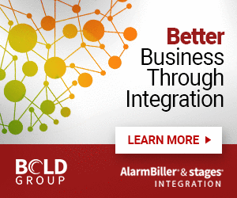
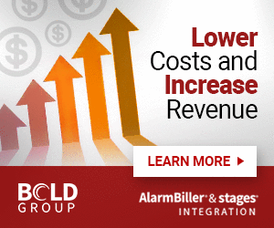
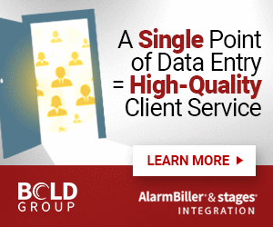

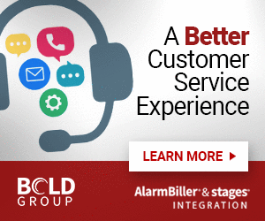
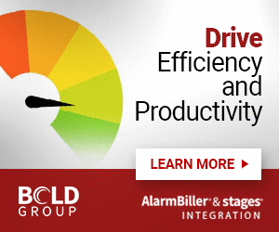
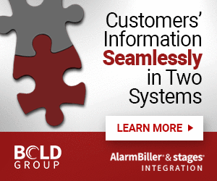
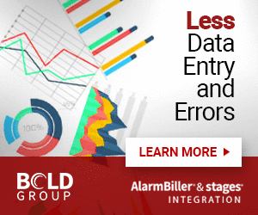
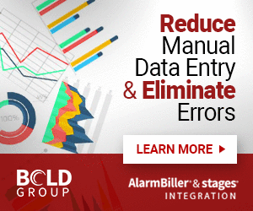
Education: Integration Display Ads

Slide 32
Education: Integration Social Ads
Ad 1
Integrated = Simplified
Reduce manual data entry and eliminate errors with the AlarmBiller® | stages® integration. [CTA]
Ad 2
Integrated = Profitable
Boost your bottom line by leveraging the AlarmBiller® | stages® integration for less data entry and errors. [CTA]
Ad 3
Integrated = Efficient
Your customers’ information is here… and now it’s there. A perfect match in two systems with no extra data entry via the AlarmBiller® | stages® integration. [CTA]
Ad 4
Leverage the power of integration!
Drive efficiency and productivity, lower costs, and increase revenue with the AlarmBiller® | stages® integration. [CTA]
Ad 5
Better customer service through integration.
Your customer data effortlessly entered in your central station’s software with no manual process or errors. It’s possible with stages® and AlarmBiller®. [CTA]
Ad 6
Better business through integration
AlarmBiller’s integration with stages creates a single point of data entry, guarantees high-quality customer care, and increases revenue. [CTA]

Slide 33
Education: Emails
Email #1 - Problem-Based:
Subject Line: Are you integrated?
Pre-header text: Eliminate manual data entry with your critical security software platforms
Are you running on multiple financial management or business operations software systems? Maybe you are using spreadsheets to manage your financials? Or spending days on manual invoicing. Are you tired of having to manually hand-off customer data to your [Central Station]?
If issues like these are holding back your security business, it’s time to break free with Bold Group’s AlarmBiller.
[Central Station Name] is excited to announce we now offer an integration between Bold Group’s AlarmBiller and stages software systems.
By integrating these two systems you no longer will need to:
Triple check data to ensure it’s correct in multiple places
Put customers on hold while you frantically search for their information
Manually enter the same information into different platforms
AlarmBiller’s integration with stages ensures everything is in one central location - providing you with the tools to streamline operations, increase efficiency, and create a seamless customer experience.
To learn more about the AlarmBiller integration with stages. please contact us for a demo [LINK]
Email #2 - Solution and Feature-Based:
Subject line: Leverage the power of integration
Pre-header text: Increased efficiency, lowered costs
What if you could increase productivity and efficiency while also guaranteeing high-quality service to your customers? With AlarmBiller’s integration with stages, you can do just that. A single point of data entry will now populate on both AlarmBiller AND stages. No more hand-off of customer data between you and [Central Station Name].
Businesses that have access to this 360-degree view of their customers are unstoppable. AlarmBiller’s integration with stages provides
Reduced manual, redundant data entry
Improved accuracy
Time savings
Increased efficiency
Create a better customer experience by leveraging AlarmBiller’s integration with stages. To learn more about AlarmBiller and the stages integration contact us for a demo [LINK].

Slide 34
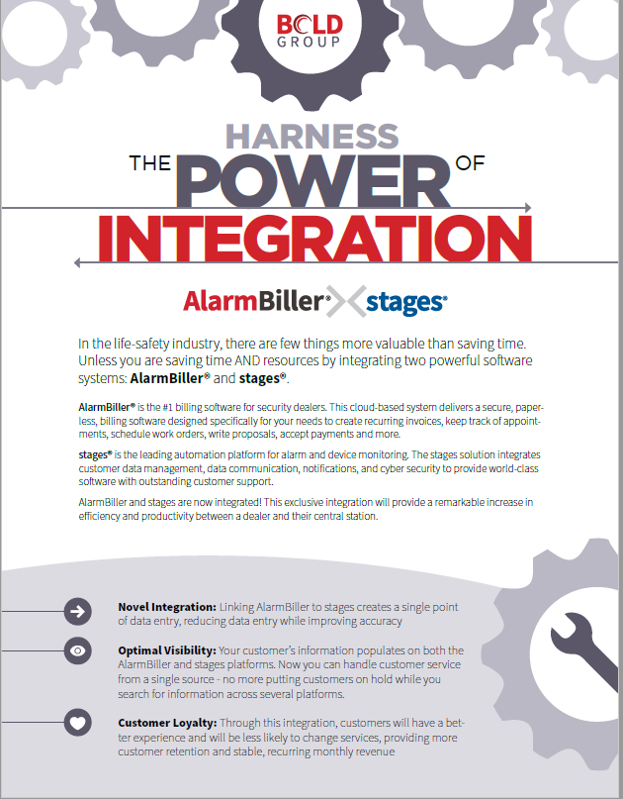
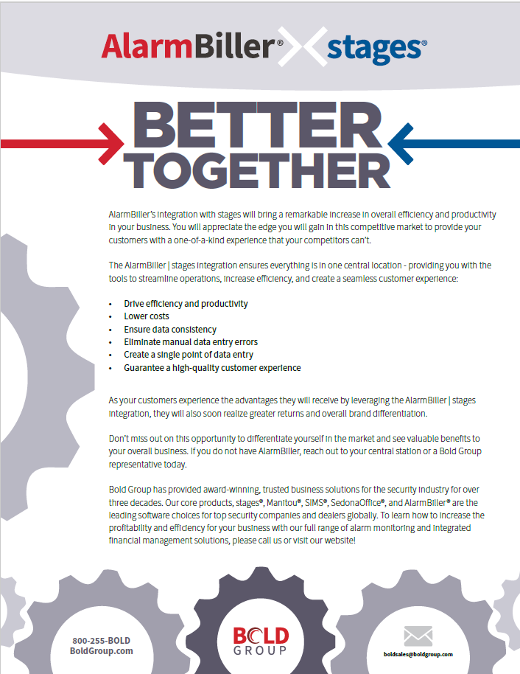
Education: Integration Brochure

Slide 35

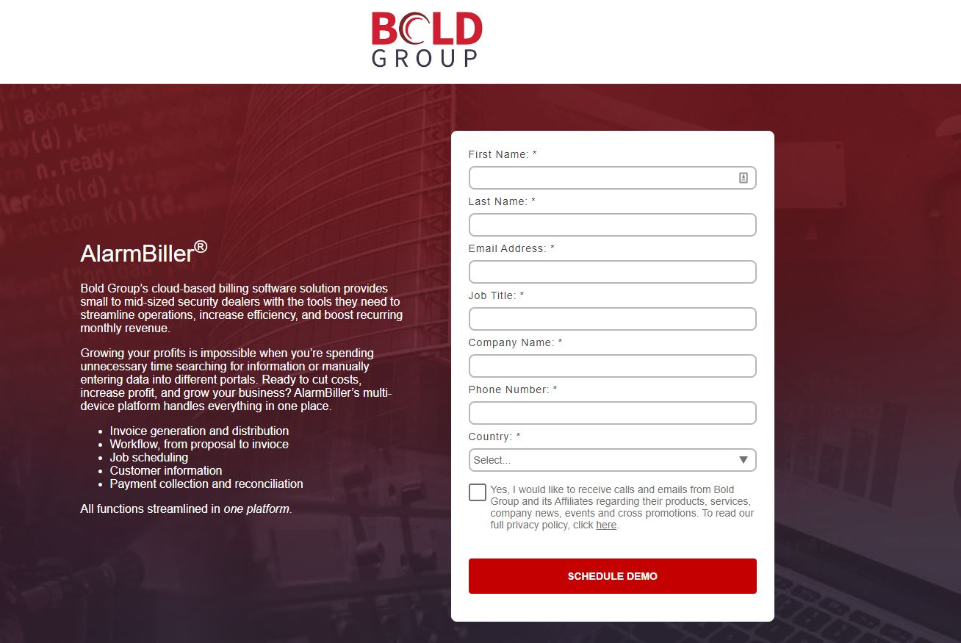
CC Lead Submission Landing Page

Slide 36
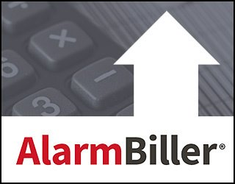
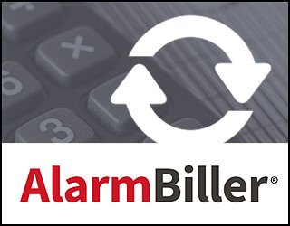
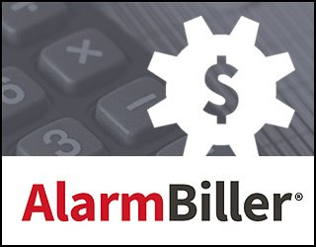


Graphic image support

Slide 37

Questions?

