Slide 1

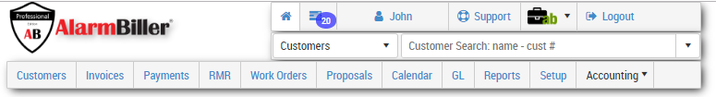
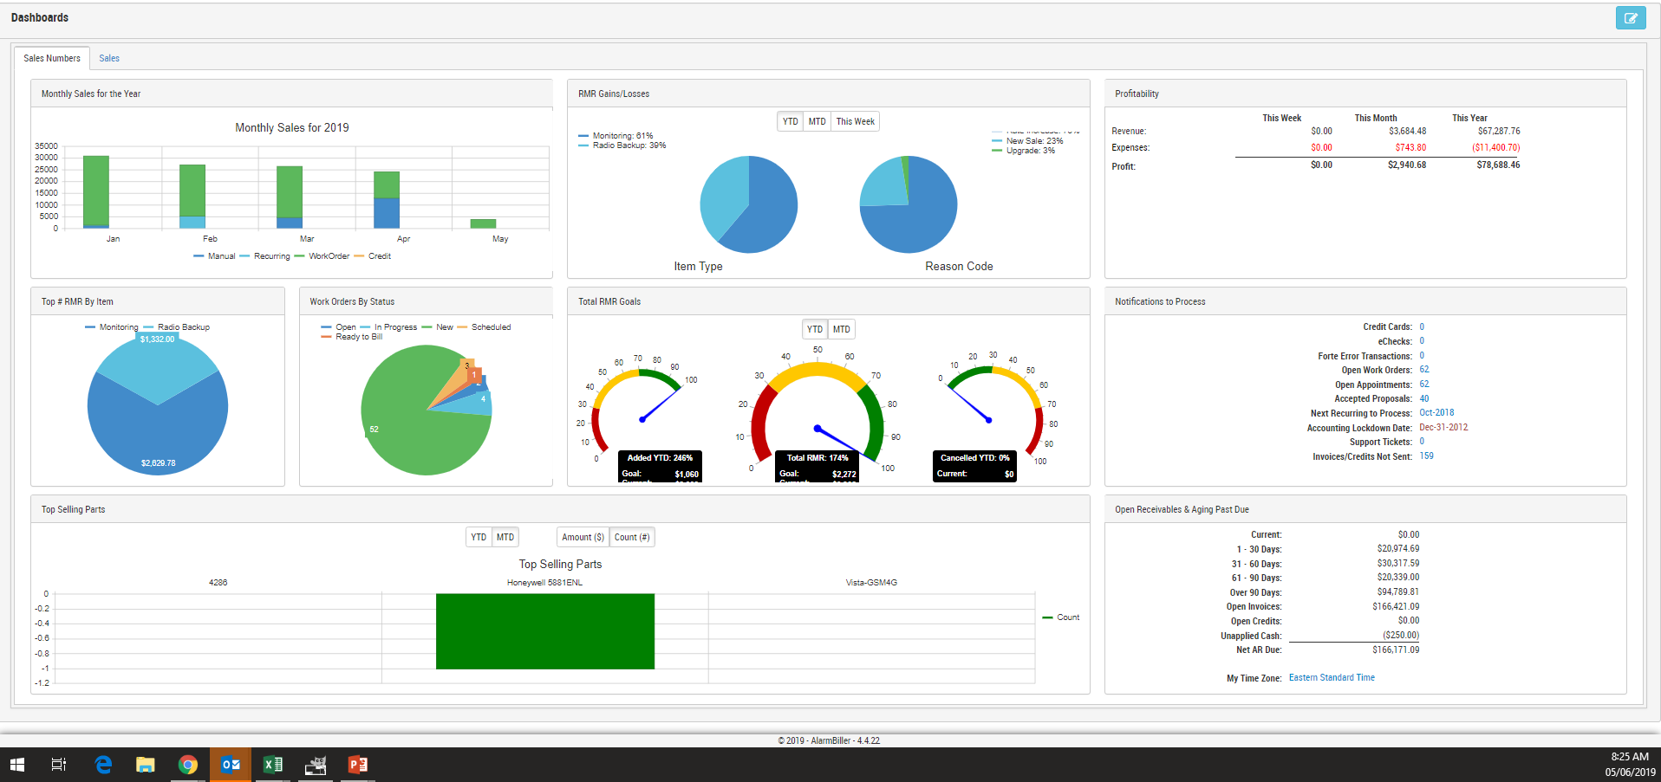
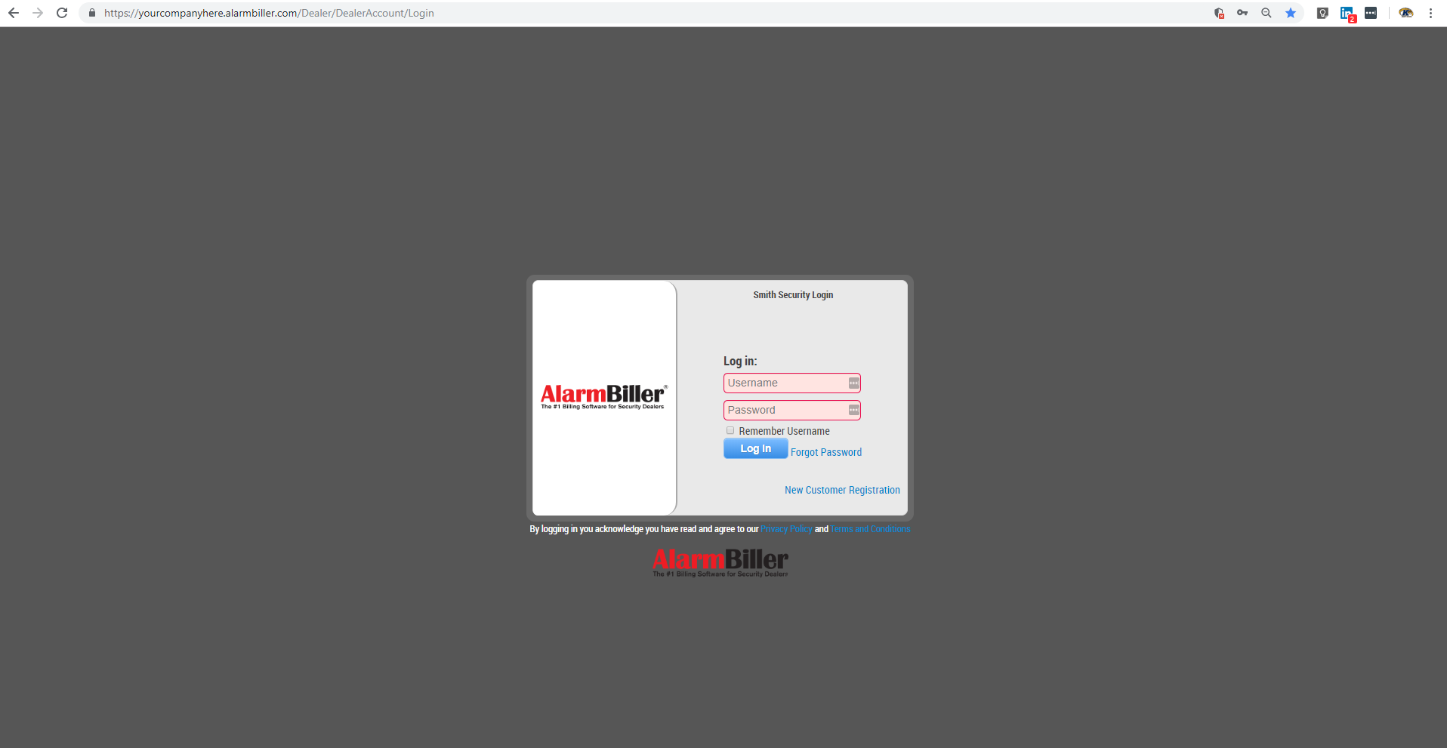
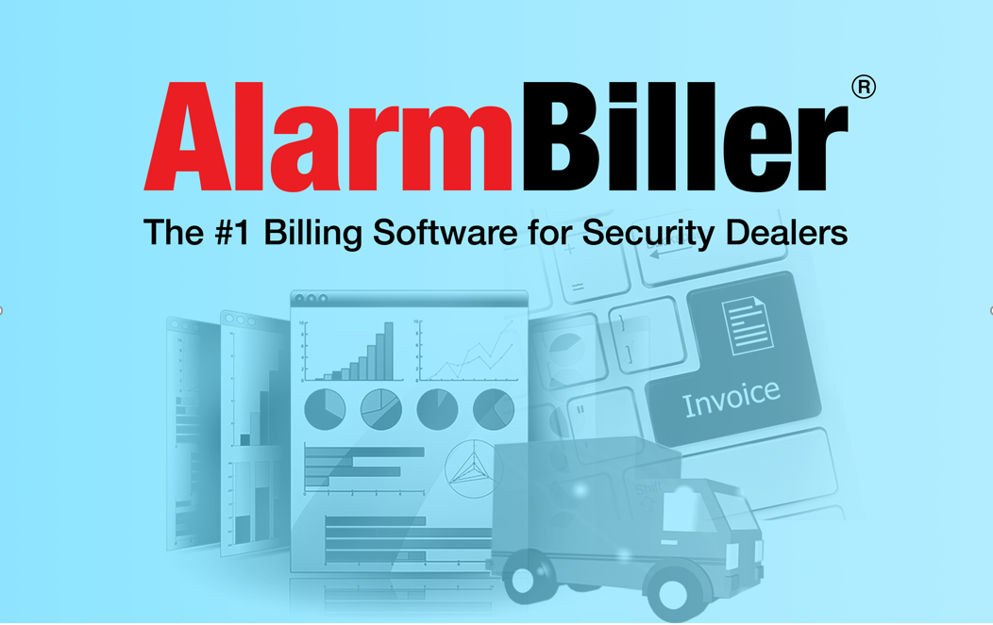
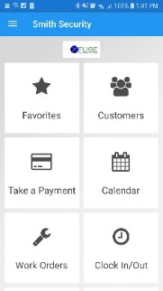

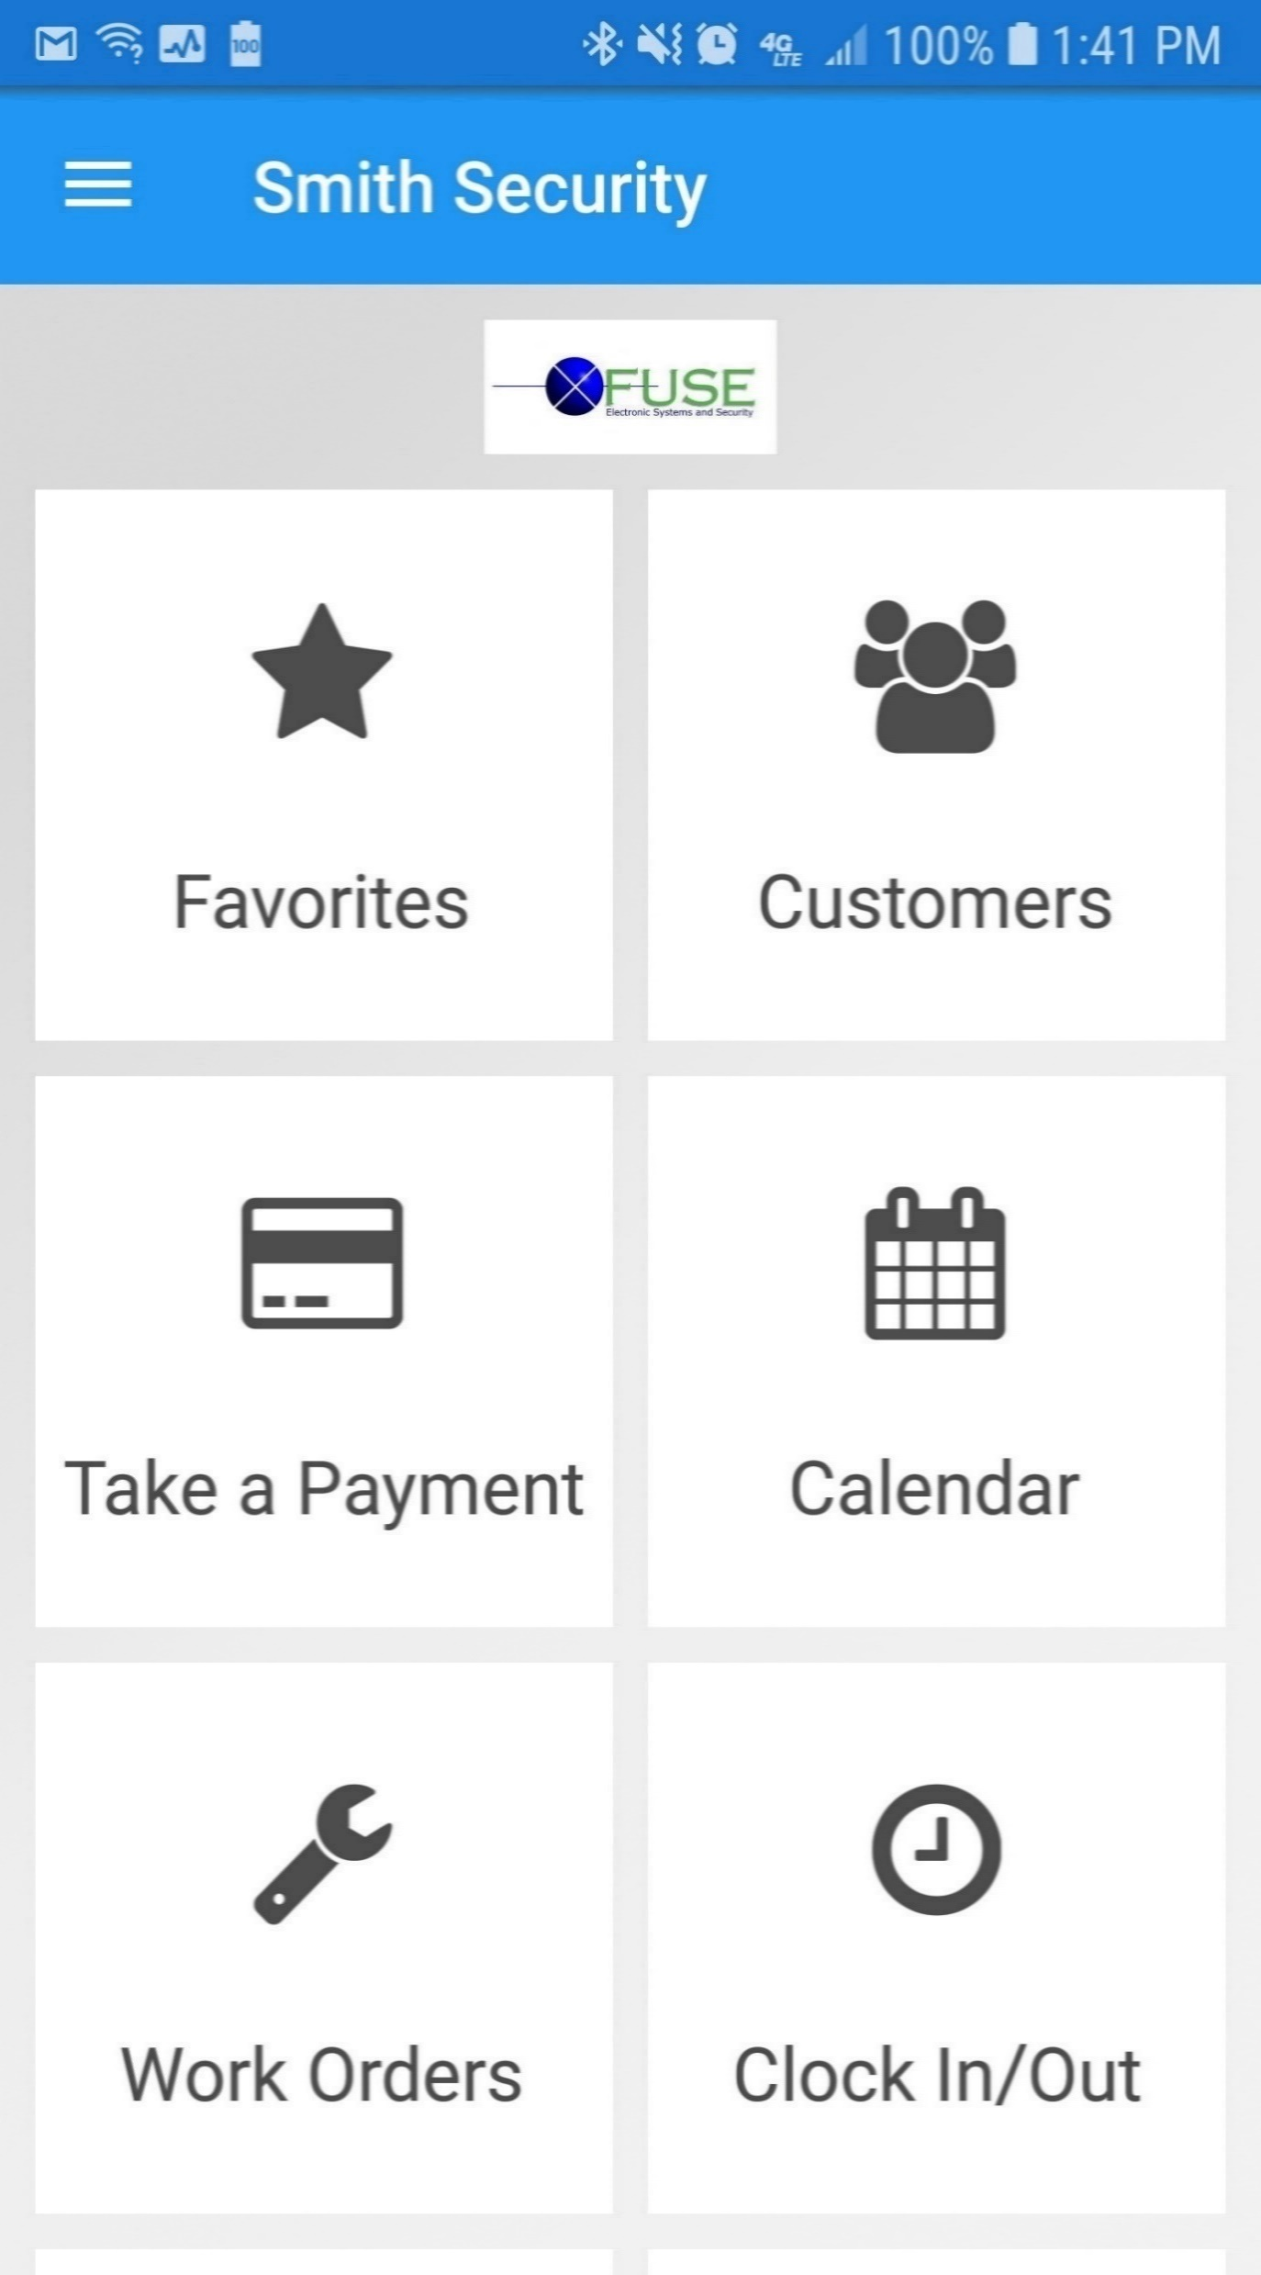
Notes:
Welcome everybody! Introduce yourself. Take a minute to have everyone introduce themselves and their role with the company.
Was everyone able to login to the goto meeting ok?
Thank everyone for joining the call and as we get started I would like to set todays agenda for the call:
☐ Quick slide deck explaining AlarmBiller
☐ Live Interactive Demo
☐ and we will Q and A , but by the end of this meeting I would to know if our solution would be a good fit for your company and discuss how to implement our solution for your organization.
Before I get started, we are going to take a quick poll Are you using, or are you familiar, with AlarmBiller?

Slide 2






The Bold Group has been providing total business solutions for the security industry for over four decades. Our core products, Stages, ManitouNEO, Sims, SedonaOffice, and AlarmBiller are the leading software choices for over 1000+ top security companies and dealers globally.
Notes:
The Bold Group is a pioneer and a leader in the alarm industry, providing solutions for over four decades.
We understand the unique needs and challenges security companies face. Our industry changes constantly, and we strive to provide innovative products to keep your business at the forefront of those advances.

Slide 3





powers Security dealers through our cloud-based, paperless, secure alarm billing software to keep track of appointments, invoices, work orders, proposals and payments.
November 2018
1996 - Founded
July 2018 -Merged
2014
2000
February 2018 - Acquired by
February 2019
Notes:
a brief history of our heritage and where were headed.
Perennial Software was founded in 1996 and who is the makers of Sedona Office and AlarmBiller
Sedona Office has actually been on the market for over 20 years and holds over 60% of the top 100 companies in the industry.
AlarmBiller has been around since 2014 and is a100% web based application
meaning as long as you have internet access anyone is able to use it from any device.
Back in February of 2018 we were acquired by Evercommerce who is the leading service commerce platform with over 29 companies under their umbrella.
They also acquire Bold Technologies and began to merge Perennial and Bold Together in July of 2018.
We began to rebrand and now we are the Bold Group.

Slide 4


“Of the industry is investing in digital transformation that will be able to maximize outcomes”
https://www.mbtmag.com/article/2018/06/how-digital-transformation-impacts-manufacturing-industry
30%
Notes:
There has actually been A study by Industry Today; a highly recognized publication for business technologies which mentions that only 30% of dealers are investing in digital processes that will be able to maximize outcomes.
With that being said a lot of my customers choose AlarmBiller because they were losing paper service tickets by their technicians out in the field. I actually was working with a dealer about 3 months ago that lost on average 1 service ticket a week which added up to roughly $36,000 a year in lost revenue.

Slide 5









Dependent on Spreadsheets
Is Excel your go-to for complex tasks like billing?
Generic Features
Does your software lack security-specific functionality?
Scattered Schedules
Is it tough to keep track of technicians’ schedules?
Non-Centralized Information
Does it take multiple software's to manage your business?
Missed Billings
Are invoices late or missed due to human error?
Paper Service Tickets
Are you still using paper service tickets which get lost and delay invoicing?
No Field Payment
Do technicians struggle to collect payments in the field?
Wasted Time
Does it take a day or more to get invoices out the door?
Outdated System
Is your software inflexible due to outdated technology?
Notes:
Other examples of reasons why businesses switch to AlarmBiller, range from paper service tickets to scattered schedules, whatever it may be it is because their current processes are not streamlined to meet their needs.
Quick Poll: What of these are a motivator for you to move to AlarmBiller?

Slide 6
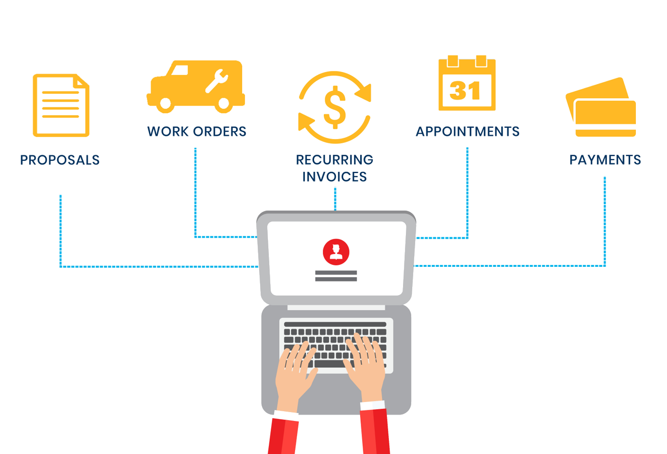

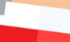
Notes:
In AlarmBiller we provide you with an all-in one application to manage your customer base, from tracking leads, to sending out proposals, creating work orders, scheduling and specific to our industry, the recurring payments.
A lot of the functionality is tied around recurring, which is all automated.
We also provide a full customer web portal for your customers to login online and pay their bills and lastly an integrated payment processing solution built right in to generate, create, and deliver invoices automatically, along with applying payments and run credit cards and ACH.

Slide 7









Add-Ons
Proposals
eForms
Work Order
Time & Attendance
Recurring Invoices
Sales Automation
Calendar
Sedona-X Mobile App
Payments
Customer Portal
Documents
Reports
Accounts Payable
General Ledger
Inventory
Notes:
AlarmBiller is rich with features and functionality to efficiently operate your business and maximize your profits.
The biggest compliments we receive from our customers is how easy it to use an how it centralizes all business operations within on software solution.
With that being said we are really excited to announce that we have officially released our AB Pro Edition which consists of everything within AlarmBiller and Adds Inventory, Sales Automation, Time & Attendance, and eForms.
These 3 integrated modules work seamlessly within the application.

Slide 8
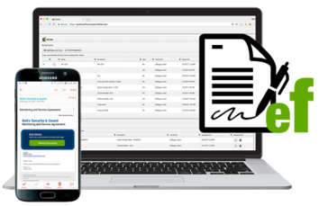
Create custom forms, import existing PDF documents, and collect signatures electronically.
Features
Centralized location for all forms and contracts
Automated work flow management to eliminate hassle
Documented stages of every contract – follow your form from “sent” to “signed”
Designed to integrate with AlarmBiller
Notes:
E-Forms allows business the opportunity to create custom forms, and or agreements to be e-signed and fulfilled by your customers.
This module is my favorite because its so versatile to our customers. I was working with a dealer the other day to help them streamline their customers zones and call lists to his central station.

Slide 9
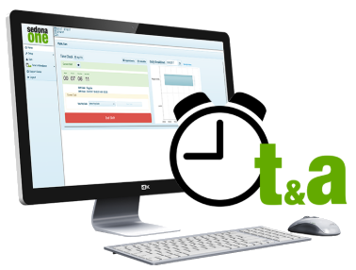
Record hours, vacation, and personal time, track location of technicians, and enable employees to clock in and out.
Features
Easily send company payroll through Excel export
Use the comment system to make notes on recordings
Employee approval for pay periods
Fully integrates with AlarmBiller
Notes:
Time and Attendance gives your business the opportunity to record hours, vacation, track location of your technicians, and enable employees to clock in and out.

Slide 10

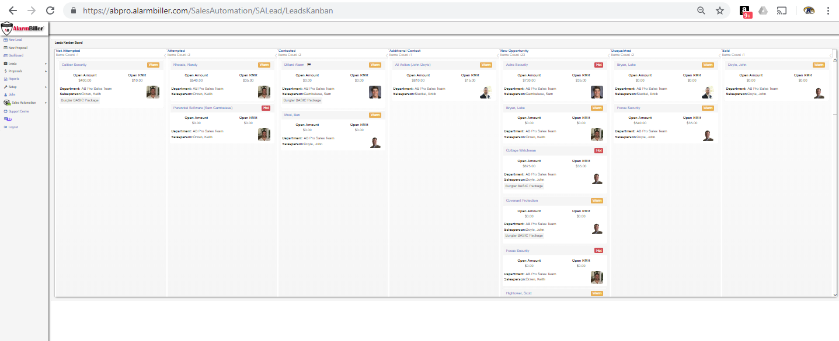
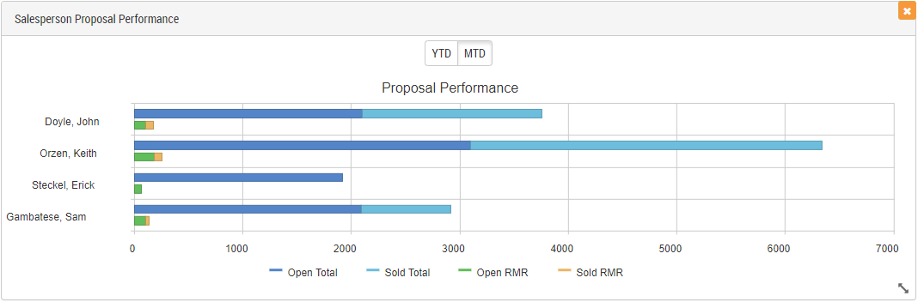

Track leads, create estimates, generate proposals, and collect e-signatures. Manage the entire sales and customer lifecycle with AlarmBiller integration.
Features
Monitor lead status through sales stages and workflow
Automate reminders for follow up actions
Manage sale life cycle
Customize your process
Notes:
The Sales Automation tool allows your team to track sales actions from managing and tracking leads, qualifying, creating estimates, generating proposals, and collecting e-signatures.

Slide 11


“We’ve easily added thousands in profits, and our gross monthly profit has doubled.”
~Oliver Keeling founder of Astra Security
Proposals
Invoices
Customer Portal
Payments
Accounts Payable
Documents
General Ledger
Reports
Work Orders
Calendar
Notes:
By implementing a system like AlarmBiller it will help streamline your operations and eliminate time chasing down documents.
Automate your Recurring Monthly Revenue and
Lower your operating capital and operating expenses making us the leading cloud based security solution in the industry.

